Slide 1
The United States Legal System
Copyright © 2017 Margaret Z. Johns and Rex R. Perschbacher. All rights reserved.

Slide 2
A Dual System
The Federal Government
Areas of federal law under U.S. Constitution; enumerated powers
Three branches of federal government
The State Governments
Areas of state law: broad general powers, except where excluded by federal law
Three branches of state government
Local governments: counties and municipalities
Federalism
The division of power between the state and federal government; the proper relationship between the two

Slide 3
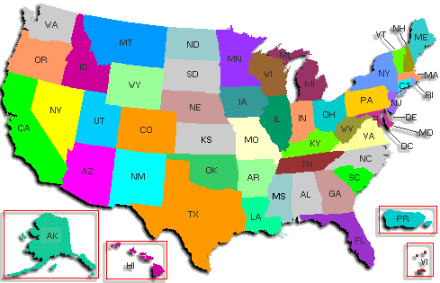
Fifty States; One United States

Slide 4
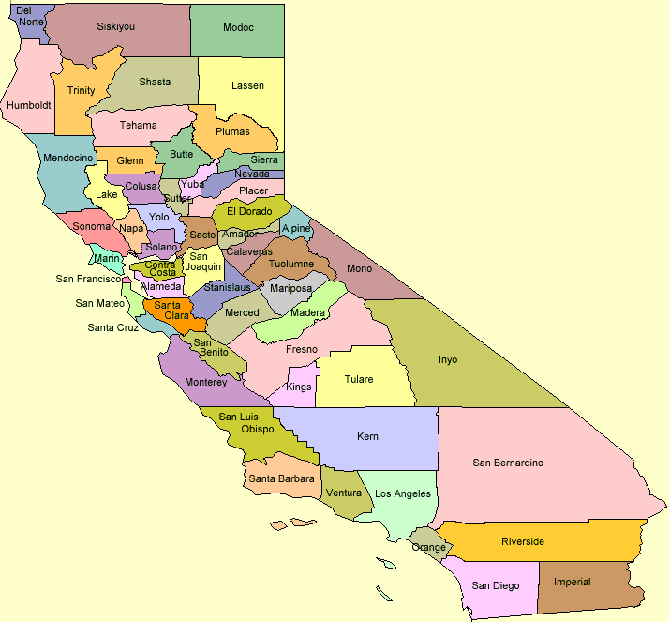

Slide 5
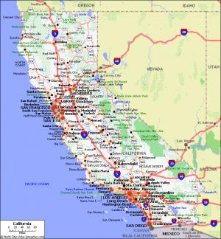

Slide 6
International relations
War and the military
Patent law
Admiralty law
Immigration law
Interstate commerce
Food and Drug Admin.
Environmental Protection Agency
Occupational Safety and Health Act
Federal Aviation Act
Civil Rights
Criminal law
Real estate law
Landlord-tenant law
Marriage and divorce
Adoption
Trust, wills, estates
Contract law
Tort law
Assault
Battery
Trespass
Malpractice; negligence
Products liability
Areas of Federal Law
Areas of State Law

Slide 7
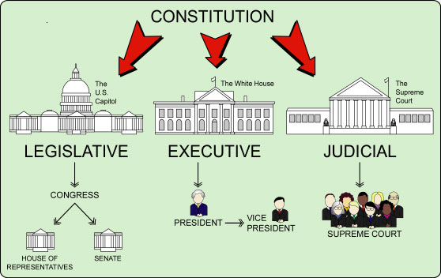
The Three Branches of Government (federal)

Slide 8
Where does the law come from?
Legislative branches
Enact statutes
Example: Patent Act
Executive branches
Administrative agencies adopt regulations
Example: EPA regulations re engineers on waste water treatment plants financed w/ federal money
Judicial branches
Interpret Constitutions, statutes, regulations
Develop common law:
Separation of Powers

Slide 9
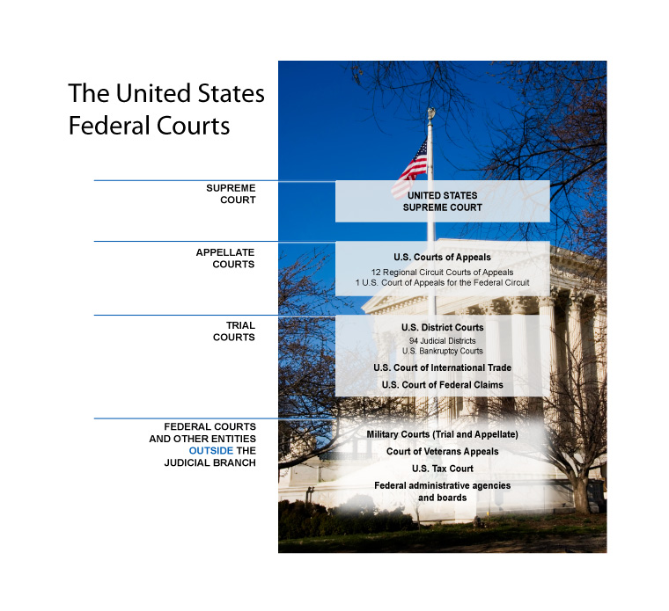
The Federal Courts

Slide 10
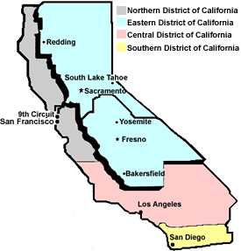
The Federal Courts California

Slide 11
The full set of 112 slides is available upon adoption of this book. If you have adopted the book for a class and would like to receive the full set, contact Beth at bhall@cap-press.com

