Slide 1
Carolina Academic Press – Sample PowerPoint Slides
Merges and Duffy, Patent Law and Policy, 7th ed. (2017)

Slide 2
Myriad: decided June 13, 2013
133 S.Ct. 2107 (2013)
The gene
The patent
The controversy

Slide 3
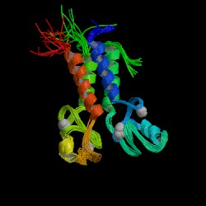
BRCA-1

Slide 4
cDNA

Slide 5
Parke-Davis v Mulford
189 F. 95 (CC SDNY 1911)
Opinion by Judge Learned Hand

Slide 6
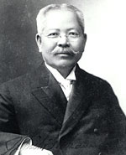
Jokichi Takamine

Slide 7
Hand’s decision
“While it is of course possible logically to call this a purification of the principle, it became for every practical purpose a new thing commercially and therapeutically.”
-- 189 F. 95, 103

Slide 8
The Incandescent Lamp Patent
Incandescing conductor
Bamboo discovered as an incandescing conductor.

Slide 9
First-to-File System: Prior Art
Question: What statutory language establishes the first-to-file rule?
Answer: Section 102(a)(2).
Note that (a)(2) provides the fundamental rule that, between first filer A and second filer B, B cannot get a patent because A’s earlier effective filing date makes the application prior art to B.

Slide 10
Graham v. John Deere
Is it obvious to move the hinge plate from position A above the shank to position B below the shank?
B
A

