Slide 1
READ THIS SLIDE
You must “play” this presentation for it to make sense.
To “play” the presentation, press the F5 key.
Press the spacebar to advance the slides.
Copyright © 2017 Ned Snow. All rights reserved.

Slide 2
a few slides from
Chapter 3
Trademark
Trade Dress
Notes:
https://commons.wikimedia.org/wiki/File:Coca-Cola_1915_Contour_bottle.jpg
https://commons.wikimedia.org/wiki/File:Porsche-964.jpg
http://ortegasmexicanrestaurant.com/gallery/#prettyPhoto

Slide 3
The trade dress of a good or service may receive protection
under trademark law.
What is trade dress?
“[T]he total image of a product, including features such as size,
shape, color or color combinations, texture, graphics, or even
particular sales techniques.”
Syndicate Sales, Inc. v. Hampshire Paper Corp., 192 F.3d 633, 636 (7th Cir. 1999).

Slide 4
The trade dress of a good or service may receive protection
under trademark law.
What is trade dress?
total image of a product or service
includes packaging of a product; design of the product itself;
and experience or atmosphere of a service
must indicate source

Slide 5
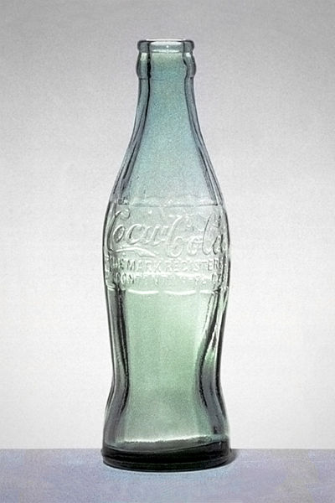
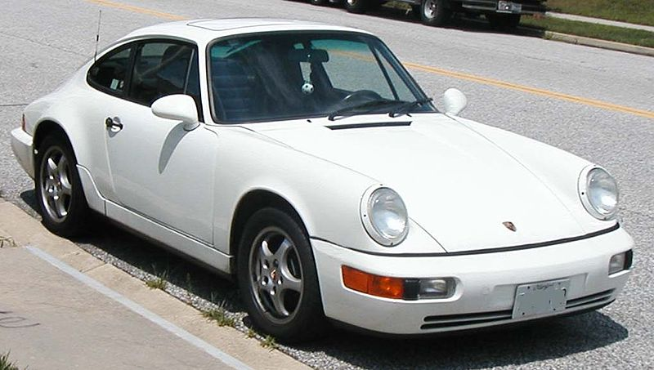
Consider three examples:

Slide 6
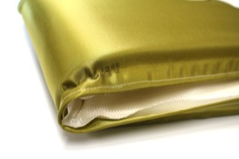
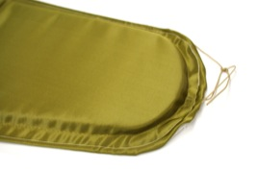
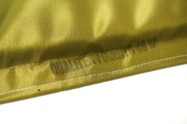
Qualitex Co. v. Jacobson Products Co.
514 U.S. 159 (1995)
Facts:
Since the 1950s, Qualitex has employed a green color on the
pads that it sells to dry-cleaning firms.
In 1989, Jacobson sold a similar green-color pads to
dry-cleaning firms.
In 1991, Qualitex registered its green color for the pads
with the PTO.
Qualitex sued Jacobson for infringement.
Procedure:
The District Court ruled for Qualitex.
The Ninth Circuit reversed, holding that “color alone”
cannot receive protection.
Photos courtesy of Professor Eric E. Johnson of the Univ. of North Dakota School of Law

Slide 7
Qualitex Co. v. Jacobson Products Co.
514 U.S. 159 (1995)
Issue:
Can color alone receive trade dress protection?
If so, is secondary meaning necessary to gain protection?
Holding:
Yes; color alone may receive trademark protection,
but only on showing secondary meaning.
Reasoning:
Color may further the purposes of trademark law
if consumers perceive color to be identifying source.
The statute’s inclusion of “symbols” as protectable subject
matter indicates “anything at all that is capable of carrying
meaning.”

Slide 8
Qualitex Co. v. Jacobson Products Co.
514 U.S. 159 (1995)
Issue:
Can color alone receive trade dress protection?
If so, is secondary meaning necessary to gain protection?
Holding:
Yes; color alone may receive trademark protection,
but only on showing secondary meaning.
Reasoning:
Color is unlike traditional marks that are inherently
distinctive (arbitrary, fanciful, or suggestive marks).
It takes time for consumers to understand that color signifies brand. Hence, secondary meaning must be shown.

Slide 9
Qualitex Co. v. Jacobson Products Co.
514 U.S. 159 (1995)
Arguments against color:
Color will produce uncertainty about which shades of a color
competitors may lawfully use.
Response: Courts deal with difficult questions in trademark law; color is no different.
(2) Colors are limited in supply.
Response: If color depletion arises, the functionality doctrine would prevent anti-competitive effects.
(3) There’s no need to include color as subject matter of trademark.
Response: Some products may not allow for more marks to be attached.

Slide 10
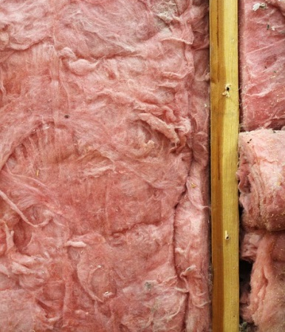
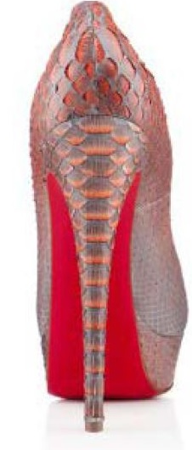
Can this color receive trademark protection?
Pink for insulation?
Yes. See In re Owens-Corning Fiberglas Corp., 774 F.2d 1116 (Fed. Cir. 1985).
Magenta for phone service?
Yes. See T-Mobile US, Inc. v. AIO Wireless LLC, 991 F.Supp.2d 888 (S.D. Tex. 2014).
Red for outsoles of non-red shoes?
Yes. See Christian Louboutin S.A. v. Yves Saint Lauren Am. Holding, Inc., 696 F.3d 206 (2d Cir. 2012).

Slide 11
a few slides from
Chapter 10
Copyright
Subject Matter

Slide 12
The Merger Doctrine
The Idea-Expression Dichotomy
“In no case does copyright protection for an original work
of authorship extend to any idea, procedure, process, system,
method of operation, concept, principle, or discovery, regardless
of the form in which it is described, explained, illustrated, or
embodied in such work.”
Copyright does not protect the idea that underlies expression.
Copyright does not protect expression where the idea can only be expressed one way.
17 U.S.C. § 102(b)

Slide 13
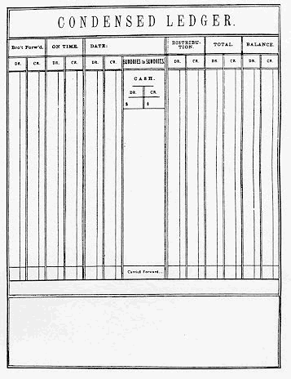
Baker v. Selden
(S. Ct. 1879)
Facts:
In 1859, Charles Selden procured a copyright for his book about a type of bookkeeping. The bookkeeping system allows entry of all relevant data onto a single page, whereas previous systems required double entry (onto pages not facing each other). In the book, Selden provided illustrations of his bookkeeping methodology (with its headings, columns, and ruled lines).
Mr. Baker published a similar layout, with some minor variations. The similarity is such that if Selden holds a copyright on the single-page booking-keeping entry, Baker would be infringing.

Slide 14
Baker v. Selden
(S. Ct. 1879)
Issue:
Does Selden hold a copyright in the illustrated method of bookkeeping displayed in his book?
Procedural History:
Selden’s representative sued Baker. The district court held that Selden held a copyright, so Baker was infringing. The appellate court affirmed.
Holding:
Reversed. Selden cannot copyright the art (or field), but rather only the expression of the art.

Slide 15
Baker v. Selden
(S. Ct. 1879)
Reasoning:
“[T]here is a clear distinction between the book, as [an explanation of a system], and the art which it is intended to illustrate.”
For example, you can copyright a book about a method of plowing, but that copyright does not allow you to keep others from practicing the method of plowing—only to keep others from copying the expression.
To give a right to the subject matter of the expression would be a fraud on the public. Patent law is the proper domain for determining whether a monopoly should exist in the subject matter.

Slide 16
Baker v. Selden
(S. Ct. 1879)
Reasoning:
If there be only one way to express the art (or field of study), those expressions are necessary incidents to the art—given to the public. Here, Selden’s bookkeeping system can only be expressed one way, so the idea of the system merges into the expression. He has therefore given the expression to the public.

Slide 17
a few slides from
Chapter 19
Patent
Infringement

Slide 18
When is a patent infringed?
A patent is infringed when, during the term of the patent, someone exercises one of the rights of the patentee without permission. The rights of a patentee are to exclude anyone from making, using, offering to sell, selling, and importing the patented invention within (or into) the United States.
These rights to exclude are with respect to each individual claim in a patent.
Section 271(a) of the Patent Act states:
“[W]hoever without authority makes, uses, offers to sell, or sells any patented invention, within the United States or imports into the United States any patented invention during the term of the patent therefor, infringes the patent.”

Slide 19
Types of Infringement
Direct Infringement
The defendant (or someone acting on the defendant’s behalf) commits the act of infringement.
Indirect Infringement
The defendant acts to induce or contribute toward someone else’s direct infringement.

Slide 20
Direct Infringement
Strict Liability
Even if a person is not aware of a patent or mistakenly believes that he has permission to exercise one of the rights, that person is still liable if he commits the act of infringement. Lack of knowledge is no defense to an allegation of direct infringement.
Literal Infringement
Literal infringement occurs when every limitation, exactly as described in a claim, is found in an accused device or activity.
Doctrine of Equivalents
Courts may find infringement if the accused device or activity is thought to be equivalent to the patented claim.

Slide 21
Larami Corp. v. Amron
(E.D. Pa. 1993)
Facts:
Larami manufactures toy water guns called “Super Soakers.” Amron owns patent ’129 that covers a water gun, similar to the Super Soakers, that operates by pressurizing water in a tank with an air pump. The pressure enables the water to travel out of the tank through a trigger-operated valve into an outlet tube and to squirt through a nozzle.
The ’129 contains electrical features to illuminate the water stream and create noises. The Super Soaker does not. Moreover, the water tank in the ’129 patent is not detachable—it is contained in the housing body of the water gun.

Slide 22
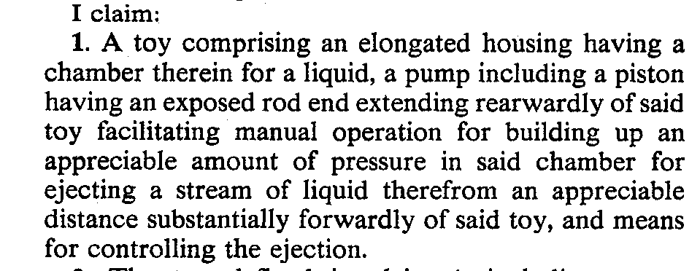
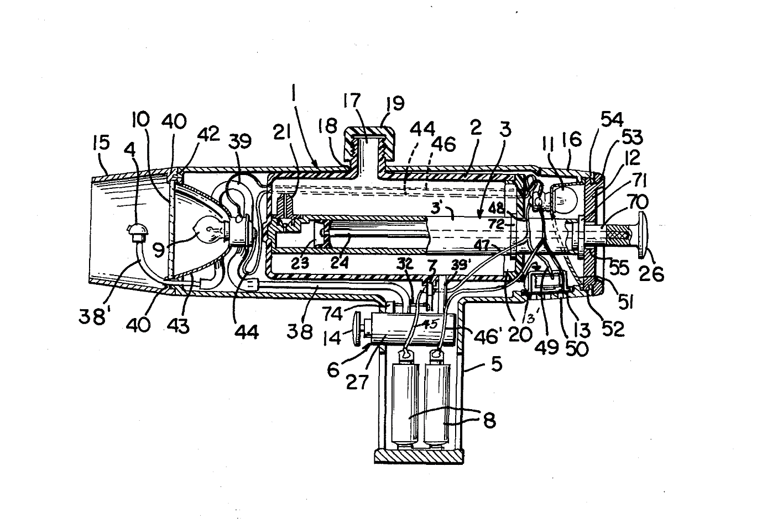
Larami Corp. v. Amron
(E.D. Pa. 1993)

Slide 23
Larami Corp. v. Amron
(E.D. Pa. 1993)
Issue:
Does the Super Soaker literally infringe the ’129 patent?
Holding:
The Super Soaker does not literally infringe the ’129 patent because Amron failed to show that all elements of claim 1 were present in the Super Soaker.
Reasoning:
To meet the burden of establishing literal infringement, a patent owner must show the presence of every element or its substantial equivalent in the accused device. Even if one element of a patent’s claim is missing from the accused product, then there is no infringement.

Slide 24
Larami Corp. v. Amron
(E.D. Pa. 1993)
Reasoning:
Amron claims that Super Soaker literally infringes claim 1 of the ‘129 patent. Claim 1 requires that the toy gun have “an elongated housing having a chamber therein for a liquid.” Amron argues that Super Soaker contains a “chamber therein for a liquid” as well as a detachable reservoir.
However, it is difficult to understand where this “chamber therein” is located. The only thing close to a chamber is the external water reservoir at the top of the housing. The water is located within the housing of the Super Soaker only when the trigger is pulled.

Slide 25
Doctrine of Equivalents
The accused device or activity is thought to be equivalent to the patented claim if every element of the claim is present either literally or equivalently in the accused device or activity.
Courts employ two tests in making this determination:
Function-Way-Result Test
The accused product or process must perform substantially the same function in substantially the same way to obtain substantially the same result.
Insubstantial Differences Test
Differences between the elements of the claim and the accused product or process must be insubstantial.

Slide 26
a few slides from
Chapter 21
Trade Secret
Subject Matter

Slide 27
What is the subject matter of a trade secret?
Information . . .
UTSA
“including a formula, pattern, compilation, program, device, method,
technique, or process . . . .” – UTSA § 1
DTSA
“all forms and types of financial, business, scientific, technical,
economic, or engineering information, including patterns, plans,
compilations, program devices, formulas, designs, prototypes,
methods, techniques, processes, procedures, programs, or codes,
whether tangible or intangible, and whether or how stored,
compiled, or memorialized physically, electronically, graphically,
photographically, or in writing ….” – 18 U.S.C. § 1839

Slide 28
What elements must be satisfied for the information to
receive trade-secret protection?
the information must have independent economic value, which as a result of not being generally known or readily ascertainable, gives its holder a competitive advantage; and
reasonable, affirmative efforts are made to preserve the secrecy of the information.

Slide 29
The full set of PowerPoint slides is available upon adoption. Contact Beth at bhall@cap-press.com for more information.

