Slide 1
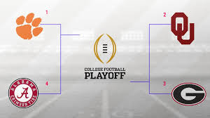
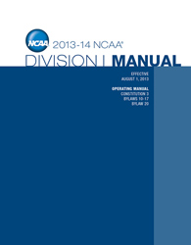
Sports Law Spring 2018
Chapter 1: Legal Relationships in Amateur Sports
Copyright © 2018 Carolina Academic Press, LLC. All rights reserved.

Slide 2
Welcome to Sports Law
Administrative Details
Class Format & Syllabus
Problem Method, Experiential
Team Hot Topics Reports
Industry Experts
Writing, Presenting
Get Involved! Sports Lawyer Ass’n, BHBA
Your Interests in Sports, Sports Law?
Part I – Amateur Sports & The Law
Chapter 1 – Legal Relationships in Amateur Sports

Slide 3
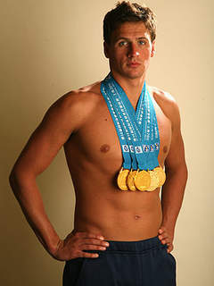
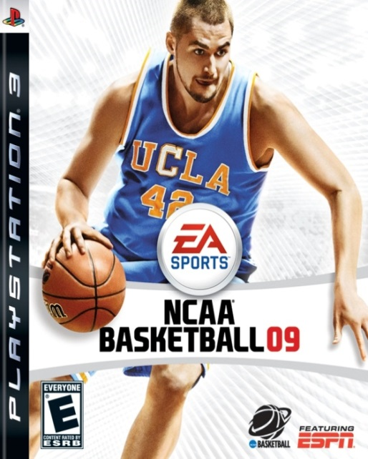
Why Sports Law? What is Sports Law?

Slide 4
Ch 1: Legal Relationships in Amateur Sports
What is Amateurism? Why?
Governing Bodies & Rules – NCAA, CFP, Conference Structure
Amateur Athletes’ Rights & Athletic Scholarship
Barney Moore v. SSU -- jilted recruit’s options?
Taylor v. Wake Forest -(reciprocal obligations)
Ross v. Creighton – K claim- identifiable promise that D failed to honor; judicial reluctance to inquire into quality of educational services (e.g., educational MP).
McAdoo v. UNC – injured pro prospects claim speculative
Advise Athletic Director/Coaches regarding recruitment activities
Advise the student-athlete -
National Letter of Intent
The Athlete as Employee -- Are scholarship athletes entitled to: 1. Worker’s Comp for sports-injuries?
2. Unionization?
3. Minimum Wages?

Slide 5
What is Sports Law?
Governance
Law & Sport & Lex Sportiva
Operational & Governance: How does competitive sport happen? Who organizes and runs sports?
Under what authority?
Selection & Eligibility
Discipline & Sanction
Law & Process: What are the respective rights and responsibilities of sport governing bodies and the athletes?
State statutory and common laws
Contract/Tort ; Criminal
Law of Private Association
Federal: Constitutional: due process, 1st Am
Statutory - Labor; Antitrust; IP;
Title IX; Civil Rights; ADA
Lex Sportiva: Distinctive body of law applicable to sport.
Sport-specific legislation;
Arbitration rulings/precedent?

Slide 6
Who Loves College Sports? Why?
Notes:
Only in the US do universities sponsor athletic programs whose revenues, media coverage, and enterprise resemble professional sports franchises.
* Passion- allegiance to school, tailgating, painted face, screaming fans
* Boosts school spirit; donations; student application; money; commercialized

Slide 7
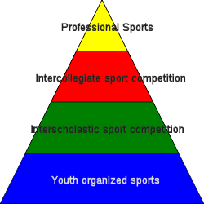
U.S. Sports Structure: Pro/Amateur
Education-Based Associations
By Sport - League
Olympic Sports
USOC
[NGB]
NCAA
State High School
Athletic Associations
www.nfhs.org
Little League Intl, etc.
Notes:
Key word “Association”. Organized by sport, region, education, conference…

Slide 8
European Sports Structure: Club System
European Sports Federation (UEFA)
National SF
National (Olympic, Euro, World)
Club/League (e.g. Premier)
Regional Sports Federations
Grassroots Federations/Clubs (youth & amateur)
EU Restraint of Trade Law
Pure Sporting Exception?
System of Promotion & Relegation
Notes:
European Model for Sport http://ec.europa.eu/sport/documents/library/doc248_en.pdf

Slide 9
Who Regulates College Sports? National Collegiate Athletic Association
Voluntary Association of over 1,200 member institutions; 460,000 s/a
Purposes:
* Responsible for governance; maintaining amateurism in college sports
Fundamental Policy
* ICA as vital part of education system
* Maintain ICA as integral to education by clear demarcation amateurism
* Regulates virtually every aspect of ICA
Institutional control
Rules of play for ICA
http://www.ncaa.org/about
Notes:
Limits years of eligibility student-athletes
Regulates the hours student-athletes may dedicate to sports
Defines what benefits may be provided to student-athletes

Slide 10
The Principle of Amateurism
“Student-athletes shall be amateurs in an intercollegiate sport, and their participation should be motivated primarily by education and by the physical, mental and social benefits to be derived. Student participation in ICA is an avocation, and student-athletes should be protected from exploitation by professional and commercial enterprises. “
NCAA, Div. I Manual 2.9 (2012-13)

Slide 11
The full set of 489 PowerPoint slides is available upon adoption of this book. If you are a professor using this book for a class, please email Beth at bhall@cap-press.com for more information.

