Slide 1
Learning Objectives
Learn about the Uniform Crime Reporting (UCR) Program
Recognize the importance of crime rates
Compare crime trends in Massachusetts to the national average
Compare crime trends across cities in Massachusetts

Slide 2
Uniform Crime Reporting Program (UCR)
Created in 1929 by International Association of Chiefs of Police
FBI began collecting and publishing crime statistics in 1930
18,000 police departments
Analyze crime trends over time and geographically

Slide 3
UCR
Part I Index Crimes:
Murder/Non-negligible manslaughter
Rape
Robbery
Aggravated Assault
Burglary
Larceny-theft
Motor Vehicle Theft
Arson

Slide 4
Limitations of UCR
Only crimes reported to police
Does not capture dark figure of crime
Hierarchy Rule
Only counts most serious crime at an event

Slide 5
Crime Rate
Ratio of crime in an area to the population of that area
Considers number of crimes out of standardized population
Gives more accurate representation of amount of crime

Slide 6
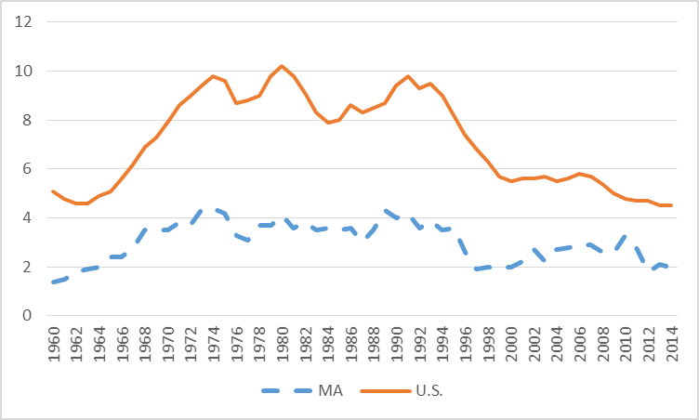
Murder Rates (per 100,000) in MA Compared to the National Average, 1960-2014

Slide 7
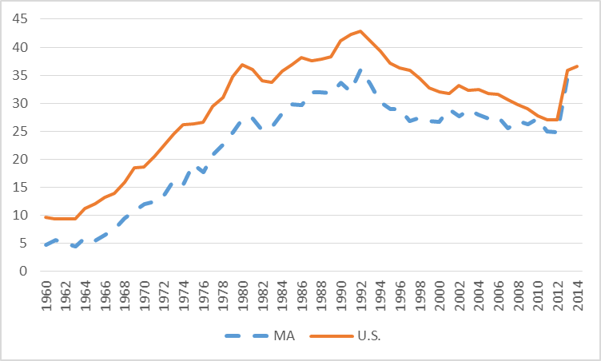
Rape Rates (per 100,000) in MA Compared to the National Average, 1960-2014

Slide 8
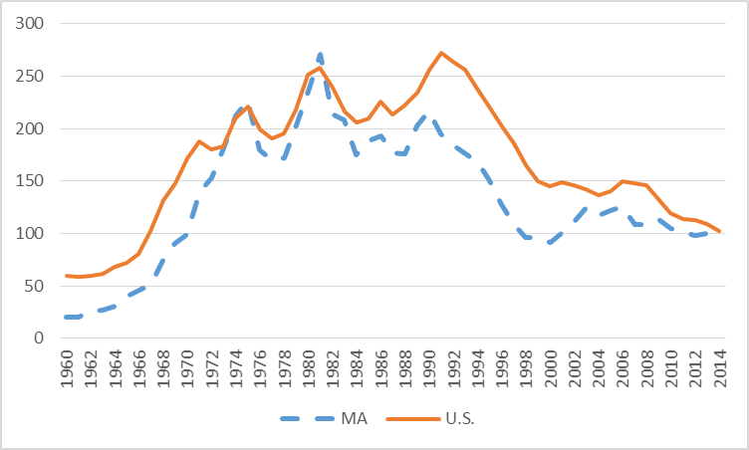
Robbery Rates (per 100,000) in MA Compared to the National Average, 1960-2014

Slide 9
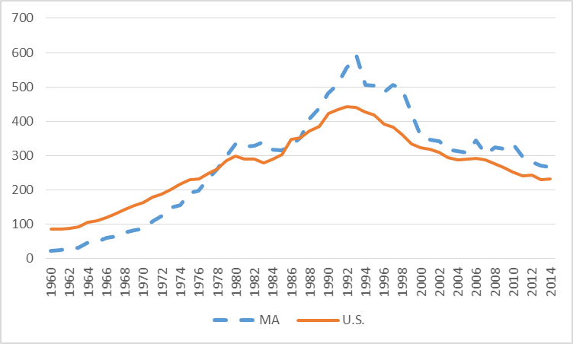
Aggravated Assault Rates (per 100,000) in MA Compared to the National Average, 1960-2014

Slide 10
The full set of 152 slides is available upon adoption of this book. If you are a professor using this book for a course, please contact Beth at bhall@cap-press.com to request your slides.

