Slide 1
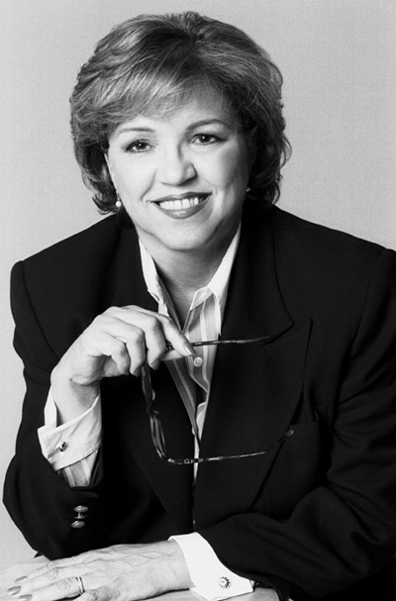
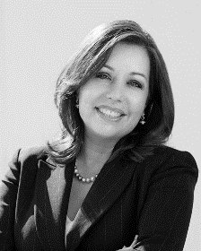
Immigration Law for Paralegals FIFTH EDITION By: Maria Isabel Casablanca & Gloria Roa Bodin
Power Point Presentation by: Gloria Roa Bodin, Esq.

Slide 2
Summary of the Immigration System
The United States Immigration classifications are divided into two major systems, i.e., temporary and permanent residence. The visas which start with one alphabetical letter, e.g., B-2, are temporary visas. The permanent residence visas are employment or relative-based.
This presentation is divided into two major visa systems:
1: Non-immigrant (NIV), which is temporary visa.
2: Immigrant Visa (IV), which grants a “Green Card” or Lawful Permanent Residence.

Slide 3
MEETING WITH THE CLIENT
Initial client contact; setting up appointment/new vs. status calls
Handling Interview
Interview/Intake Sheet/Consultation fee?
Review of entry documents, if any; EWI problems
“3/10 unlawful presence rule, bar to adjustment”
Criminal issues
Controlling talkative client: narrowing the issues
Exploring all options; visa unavailability problems
Setting the fee

Slide 4
OFFICE PROCEDURES
Retainer agreement/sequential receipts
Opening a file
Case management system: sequential file number
Color coded folders
Attaching interview sheet/ documents to file
Assigning file to paralegal/attorney
Tickler system

Slide 5
Summary of the Immigration System
USCIS Service Centers where applications are processed:
EAC - Eastern Adjudication Center (Vermont Service Center)
WAC - Western Adjudication Center (California Service Center)
LIN - Lincoln Service Center (Nebraska Service Center)
SRC - Southern Regional Center (Texas Service Center)
NBC - National Benefits Center
MSC - Missouri Service Center (National Benefits Center)
IOE - USCIS Electronic Immigration System (ELIS)
See http://uscis.gov/graphics/index.htm

Slide 6
Temporary Visas Visitors for Business (B-1) and Pleasure (B-2)
Individuals entering the United States as visitors for business (B-1) or pleasure (B-2) enter with a temporary nonimmigrant visa.
Visa Waiver Program (VWP) is another visitor classification. The VWP program allows nationals from certain participating countries to enter the United States without applying for a B2 visa at the consulate. This program automatically grants entry at the border or port of entry for ninety days.

Slide 7
Temporary Visas Visitors for Business (B-1) and Pleasure (B-2)
The application for a B-1 and/or B-2 visa is filed with the consulate or embassy in the home country or current place of residence abroad. The process involves an interview with the consular officer, who will analyze the application and interviews the individual. If the officer suspects preconceived intent, such as intent to work or marry rather than visit, the application will be denied. Applicant must have ties to home country and adequate funds to carry out purpose of visit.

Slide 8
Temporary Visas Visitors for Business (B-1) and Pleasure (B-2)
An Applicant must complete the nonimmigrant Visa Application, DS-160. The following documents are required:
(a) passport valid at least six months beyond intended stay(s) in the U.S.;
(b) One recent photo;
(c) Proof of ties to home country, e.g., savings account, employment, tax returns, and/or real estate owned;
(d) (i) If visit is for business, a letter from the employer outlining temporary nature of business trip,
(ii) If visit is for pleasure, a letter of invitation from friend or relative in the U.S. and notarized affidavit of support, together with a U.S. tax return;
(e) Copy of round trip airline ticket; and
(f) Proof of family relationship, e.g., marriage certificate and birth certificate(s).

Slide 9
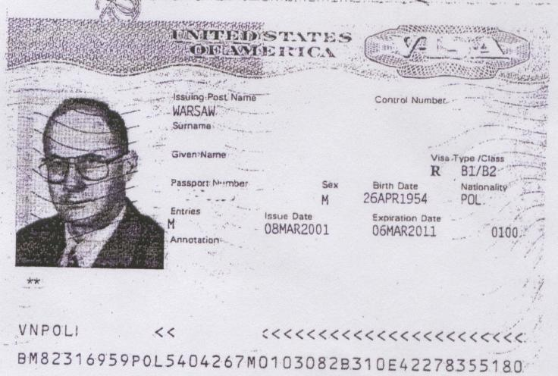
Temporary Visas Visitors for Business (B-1) and Pleasure (B-2)
Once the consular officer is satisfied with applicant’s true intent, a visa sticker will be affixed to the passport, stating, among other things, the issuance date and expiration date. Some visas are granted for as little as thirty days and others for up to ten years.
Sample of Visa Stamp

Slide 10
Temporary Visas Visitors for Business (B-1) and Pleasure (B-2)
Permissible Activities for of B-1 Visa Holders
(Visitors for Business):
Commercial transactions that do not involve gainful U.S. employment, e.g., taking orders for foreign goods;
Contract negotiation;
Installation, service, or repair of commercial/industrial equipment
Consultation with business associates;
Litigation;
Participation in scientific, educational, professional or business conventions, conferences, or seminars;
Professional entertainers involved in cultural events, paid for and sponsored by a sending country that will involve public appearance before a non-paying audience;

Slide 11
Temporary Visas Visitors for Business (B-1) and Pleasure (B-2)
Investors seeking investments that may eventually qualify them for immigrant or E-2 nonimmigrant status;
Independent research or professional artistic activity;
Construction and set-up support by foreign employer in connection with exhibits at international fairs and exhibitions;
Certain religious and charitable activities (e.g., missionaries and recognized international volunteer efforts);
Certain athletes who are professional but intend to receive no salary;
Individuals or members of a foreign-based team in an internationally recognized sporting activity;
Servants for foreign employer temporarily in the U.S.

Slide 12
Temporary Visas Visitors for Business (B-1) and Pleasure (B-2)
Permissible Activities for B-2 (Visitors for Pleasure):
Usual tourist activities, e.g., visit tourist attraction, friends, and/or relatives;
Medical treatment;
Participation in a conference, convention of social or fraternal organizations;
Short course of study incidental to tourist or social activities; and

Slide 13
Temporary Visas Visitors for Business (B-1) and Pleasure (B-2)
The Visa Waiver Pilot Program (VWP)
Under the VWP for tourists and business visitors, nationals from the following countries can visit the U.S. for ninety days:
Andorra
Austria
Australia
Belgium
Brunei
Denmark
Finland
France
Germany
Iceland
Ireland
Italy
Japan
Liechtenstein
Luxembourg
Monaco
The Netherlands
New Zealand
Norway
Portugal
San Marino
Singapore
Slovenia
Spain
Sweden
Switzerland
United Kingdom
Note: No change of status or extension may be obtained under this classification.
Under certain circumstances (immediate relatives of citizens), adjustment of status will be permitted.

Slide 14
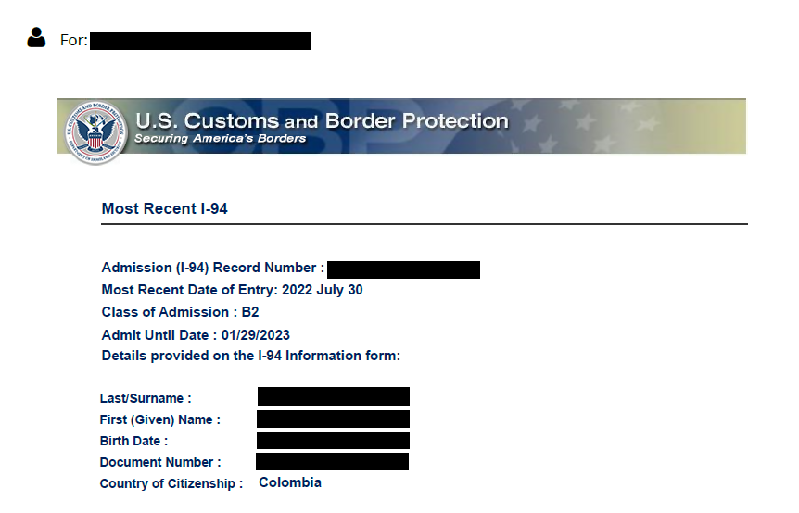
Temporary Visas Visitors for Business (B-1) and Pleasure (B-2)
The Arrival/Departure Document, Form I-94 Card, is issued at the port of entry. The card is white for the B-1/B-2 visitor and green for the ninety day VWP visa. At the port of entry, the Form I-94 is completed to request permission for admission to the U.S. The B-2 is initially granted for six months and can be extended for up to one year. The B-1 is granted for the time needed to complete business activities and may be extended for up to one year.
I-94 Sample

Slide 15
Temporary Visas Visitors for Business (B-1) and Pleasure (B-2)
An individual’s failure to maintain status or overstaying for the allotted time may trigger consequences under the Illegal Immigration Reform and Immigration Responsibility Act (IIRAIRA) (1996). Under this law, a person who is unlawfully present for more than 180 days but less than 1 year who voluntarily departs is barred from readmission for 3 years. A person unlawfully present for more than one year who departs is barred from re-entry for a period of 10 years. This is known as the “3/10” bar rule.

Slide 16
Temporary Visas Visitors for Business (B-1) and Pleasure (B-2)
If the alien is refused entry at the border or port of entry because of fraud, criminal activity, false documents, violation of prior authorized stay or pre-conceived intent, he or she will be removed immediately (expedited removal) and held to be inadmissible to the U.S. He/she will be barred from re-entry for a period of 5-10 years.
Extensions of stays are obtained by filing the Application to Extend Status/Change Non- Immigrant Status, Form I-539

Slide 17
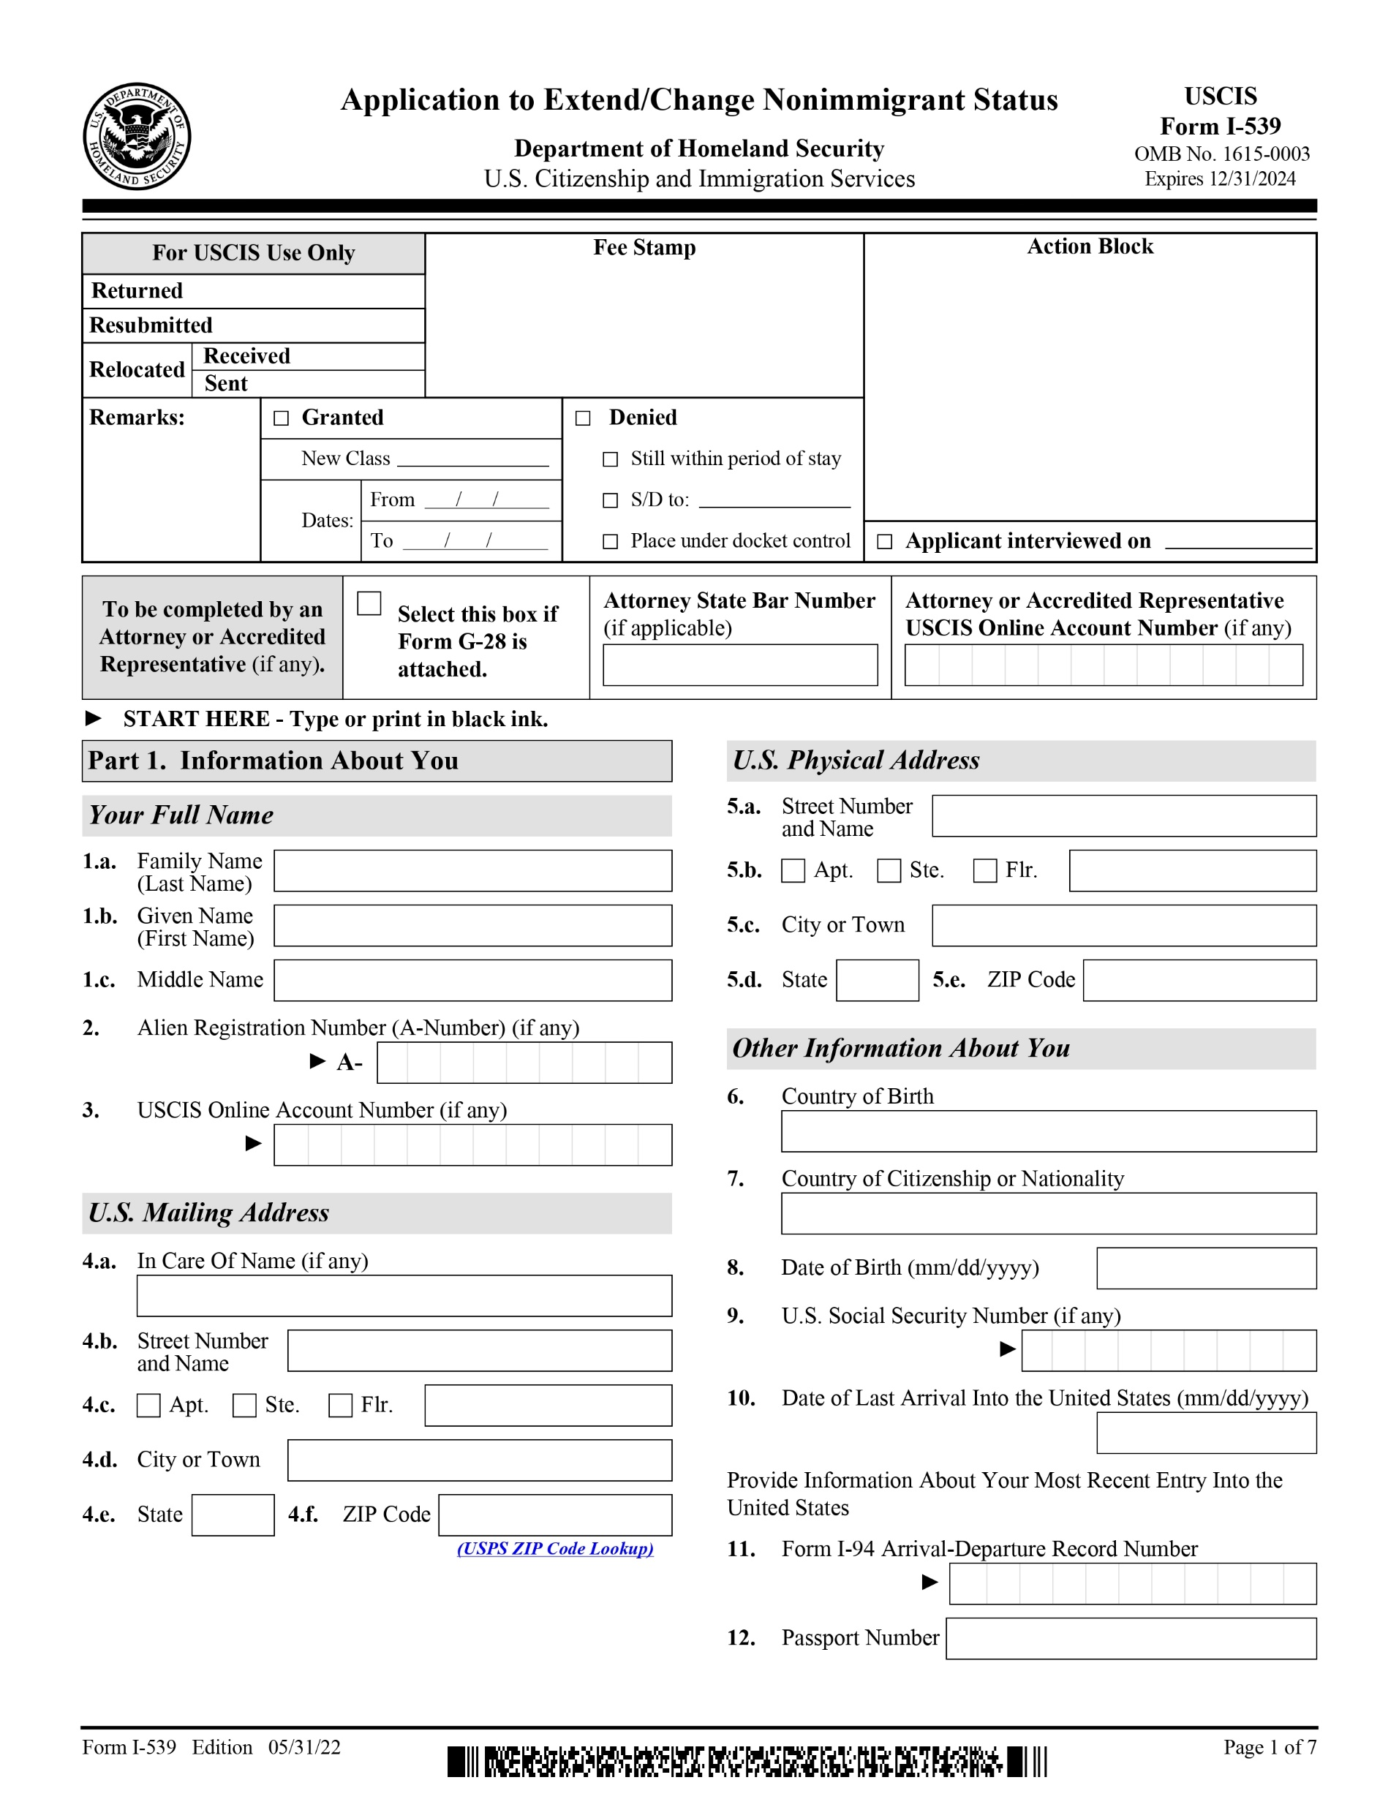
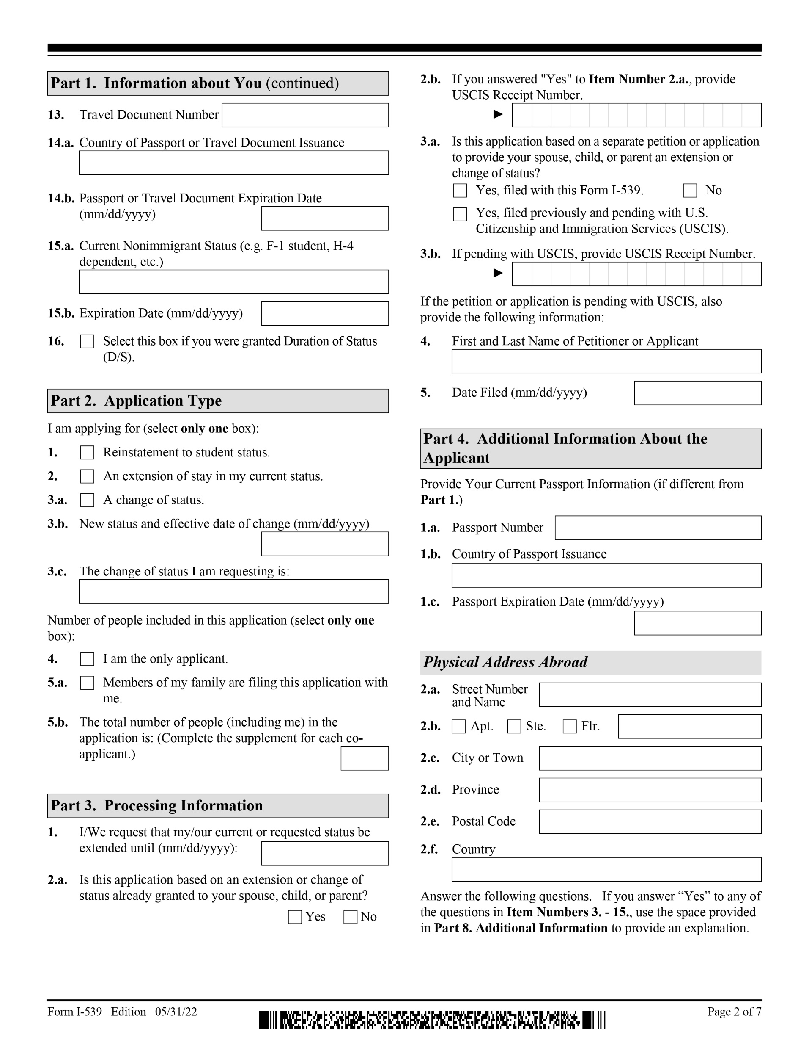
Temporary Visas Visitors for Business (B-1) and Pleasure (B-2)
Form I-539

Slide 18
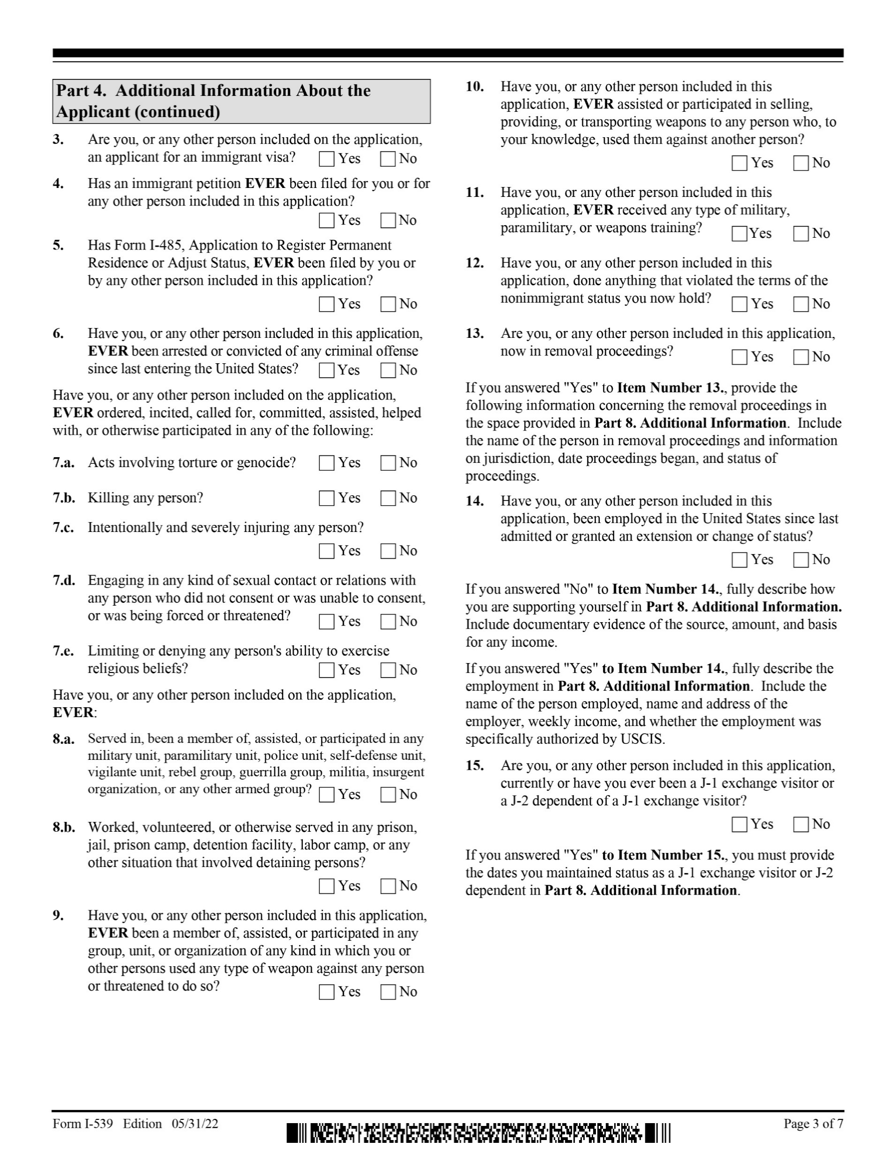
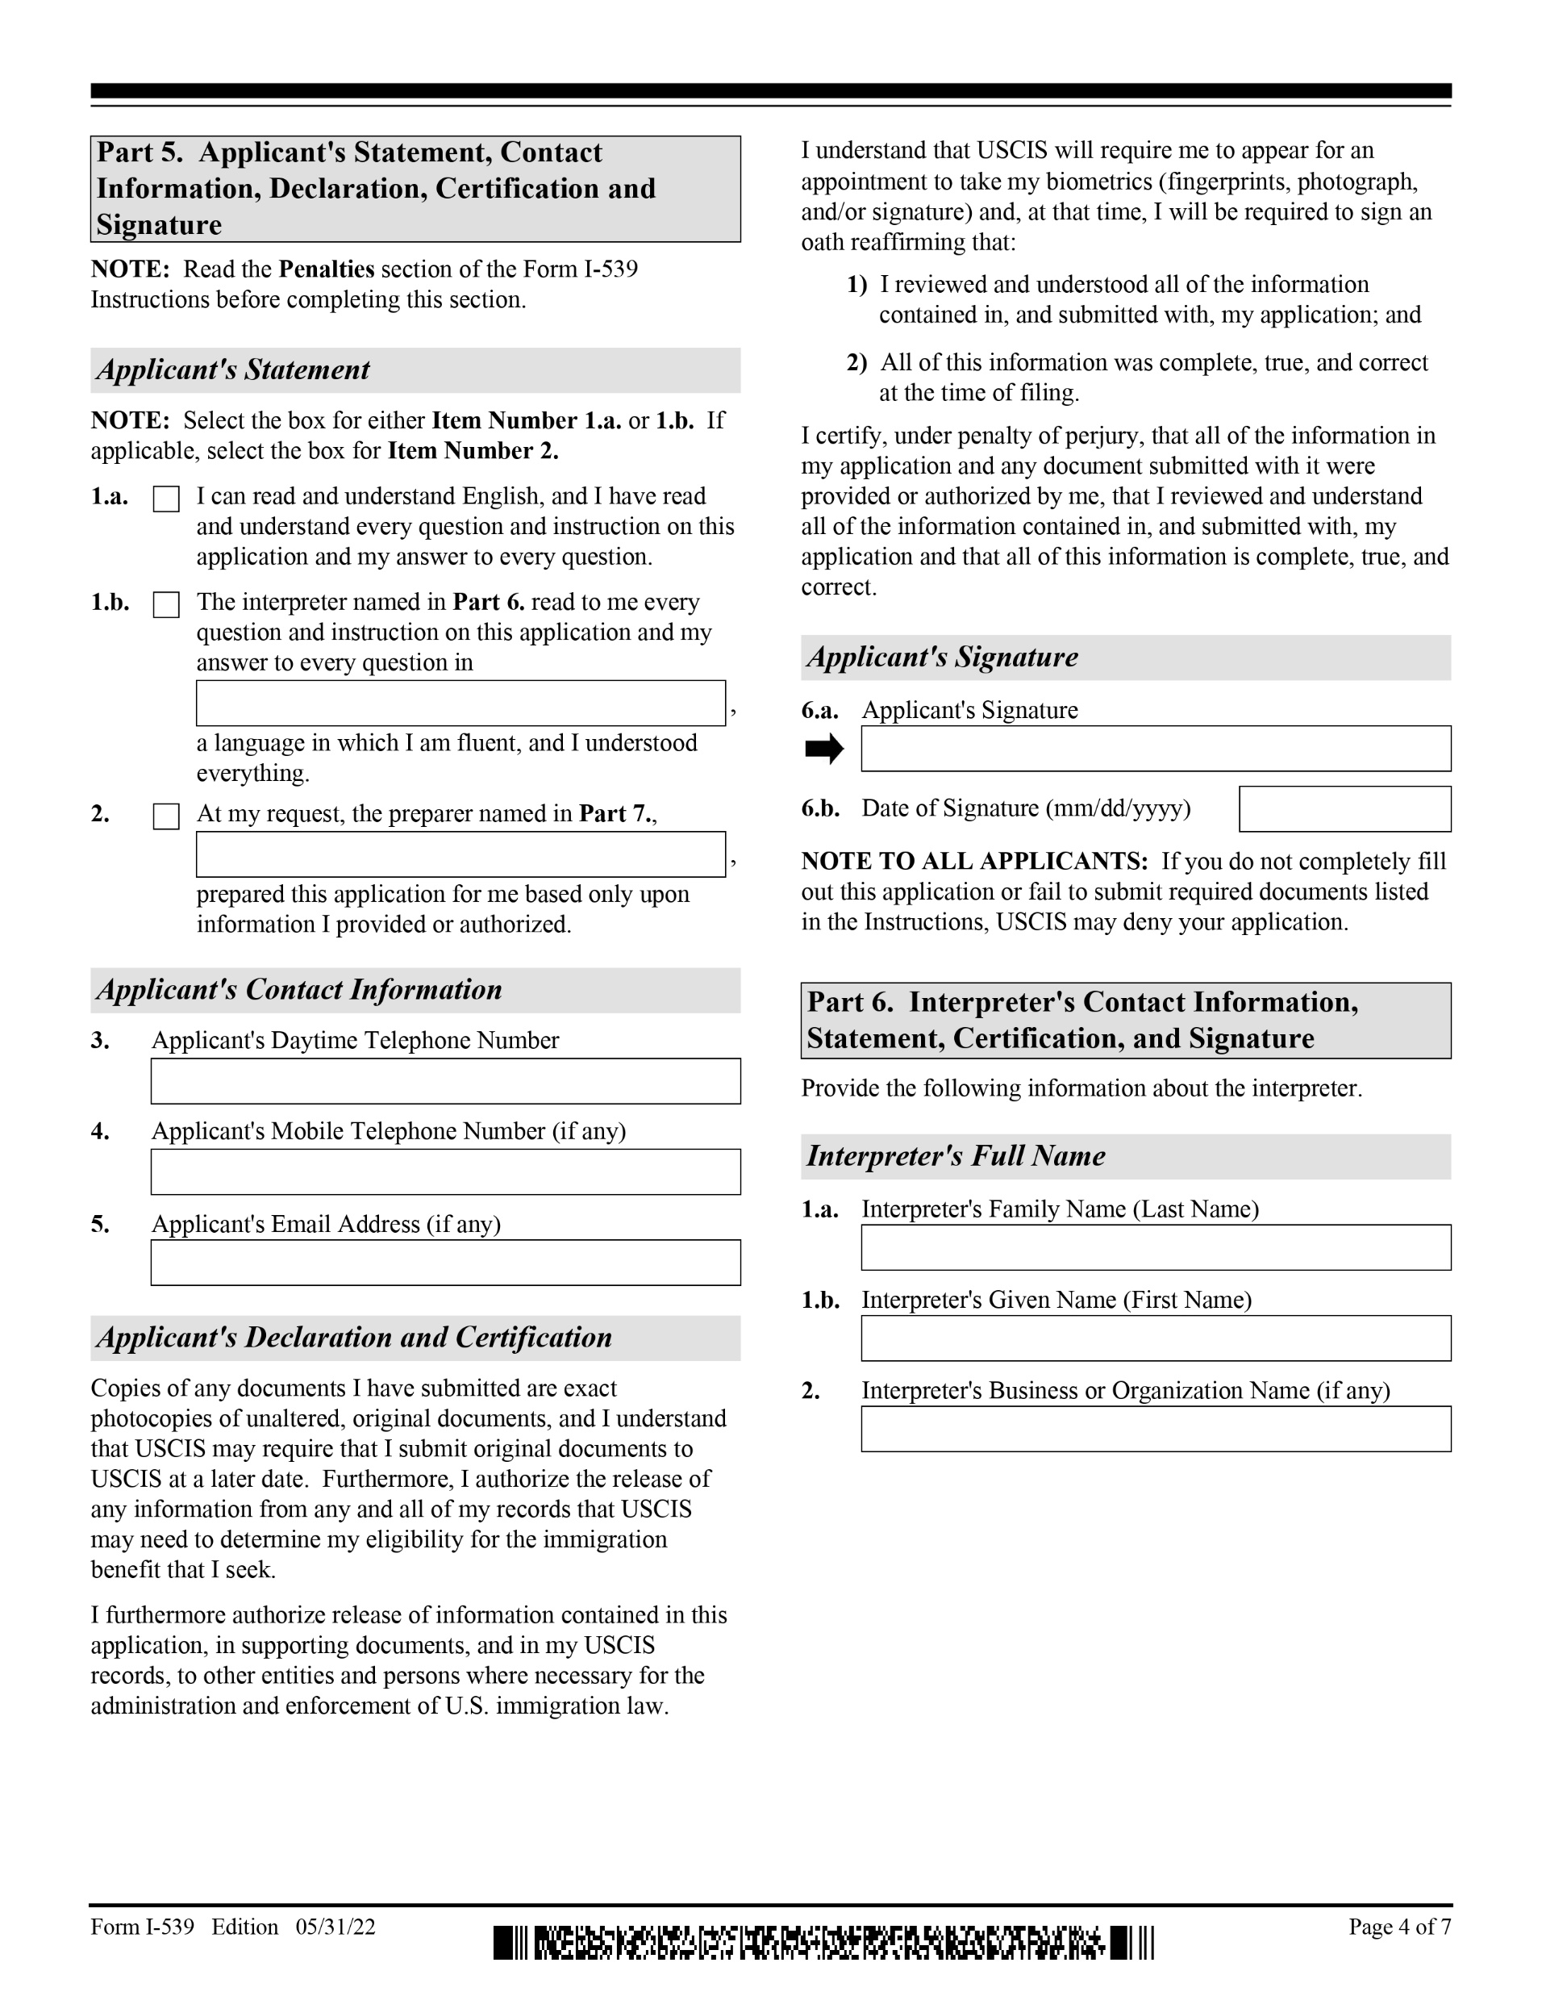
Temporary Visas Visitors for Business (B-1) and Pleasure (B-2)
Form I-539

Slide 19
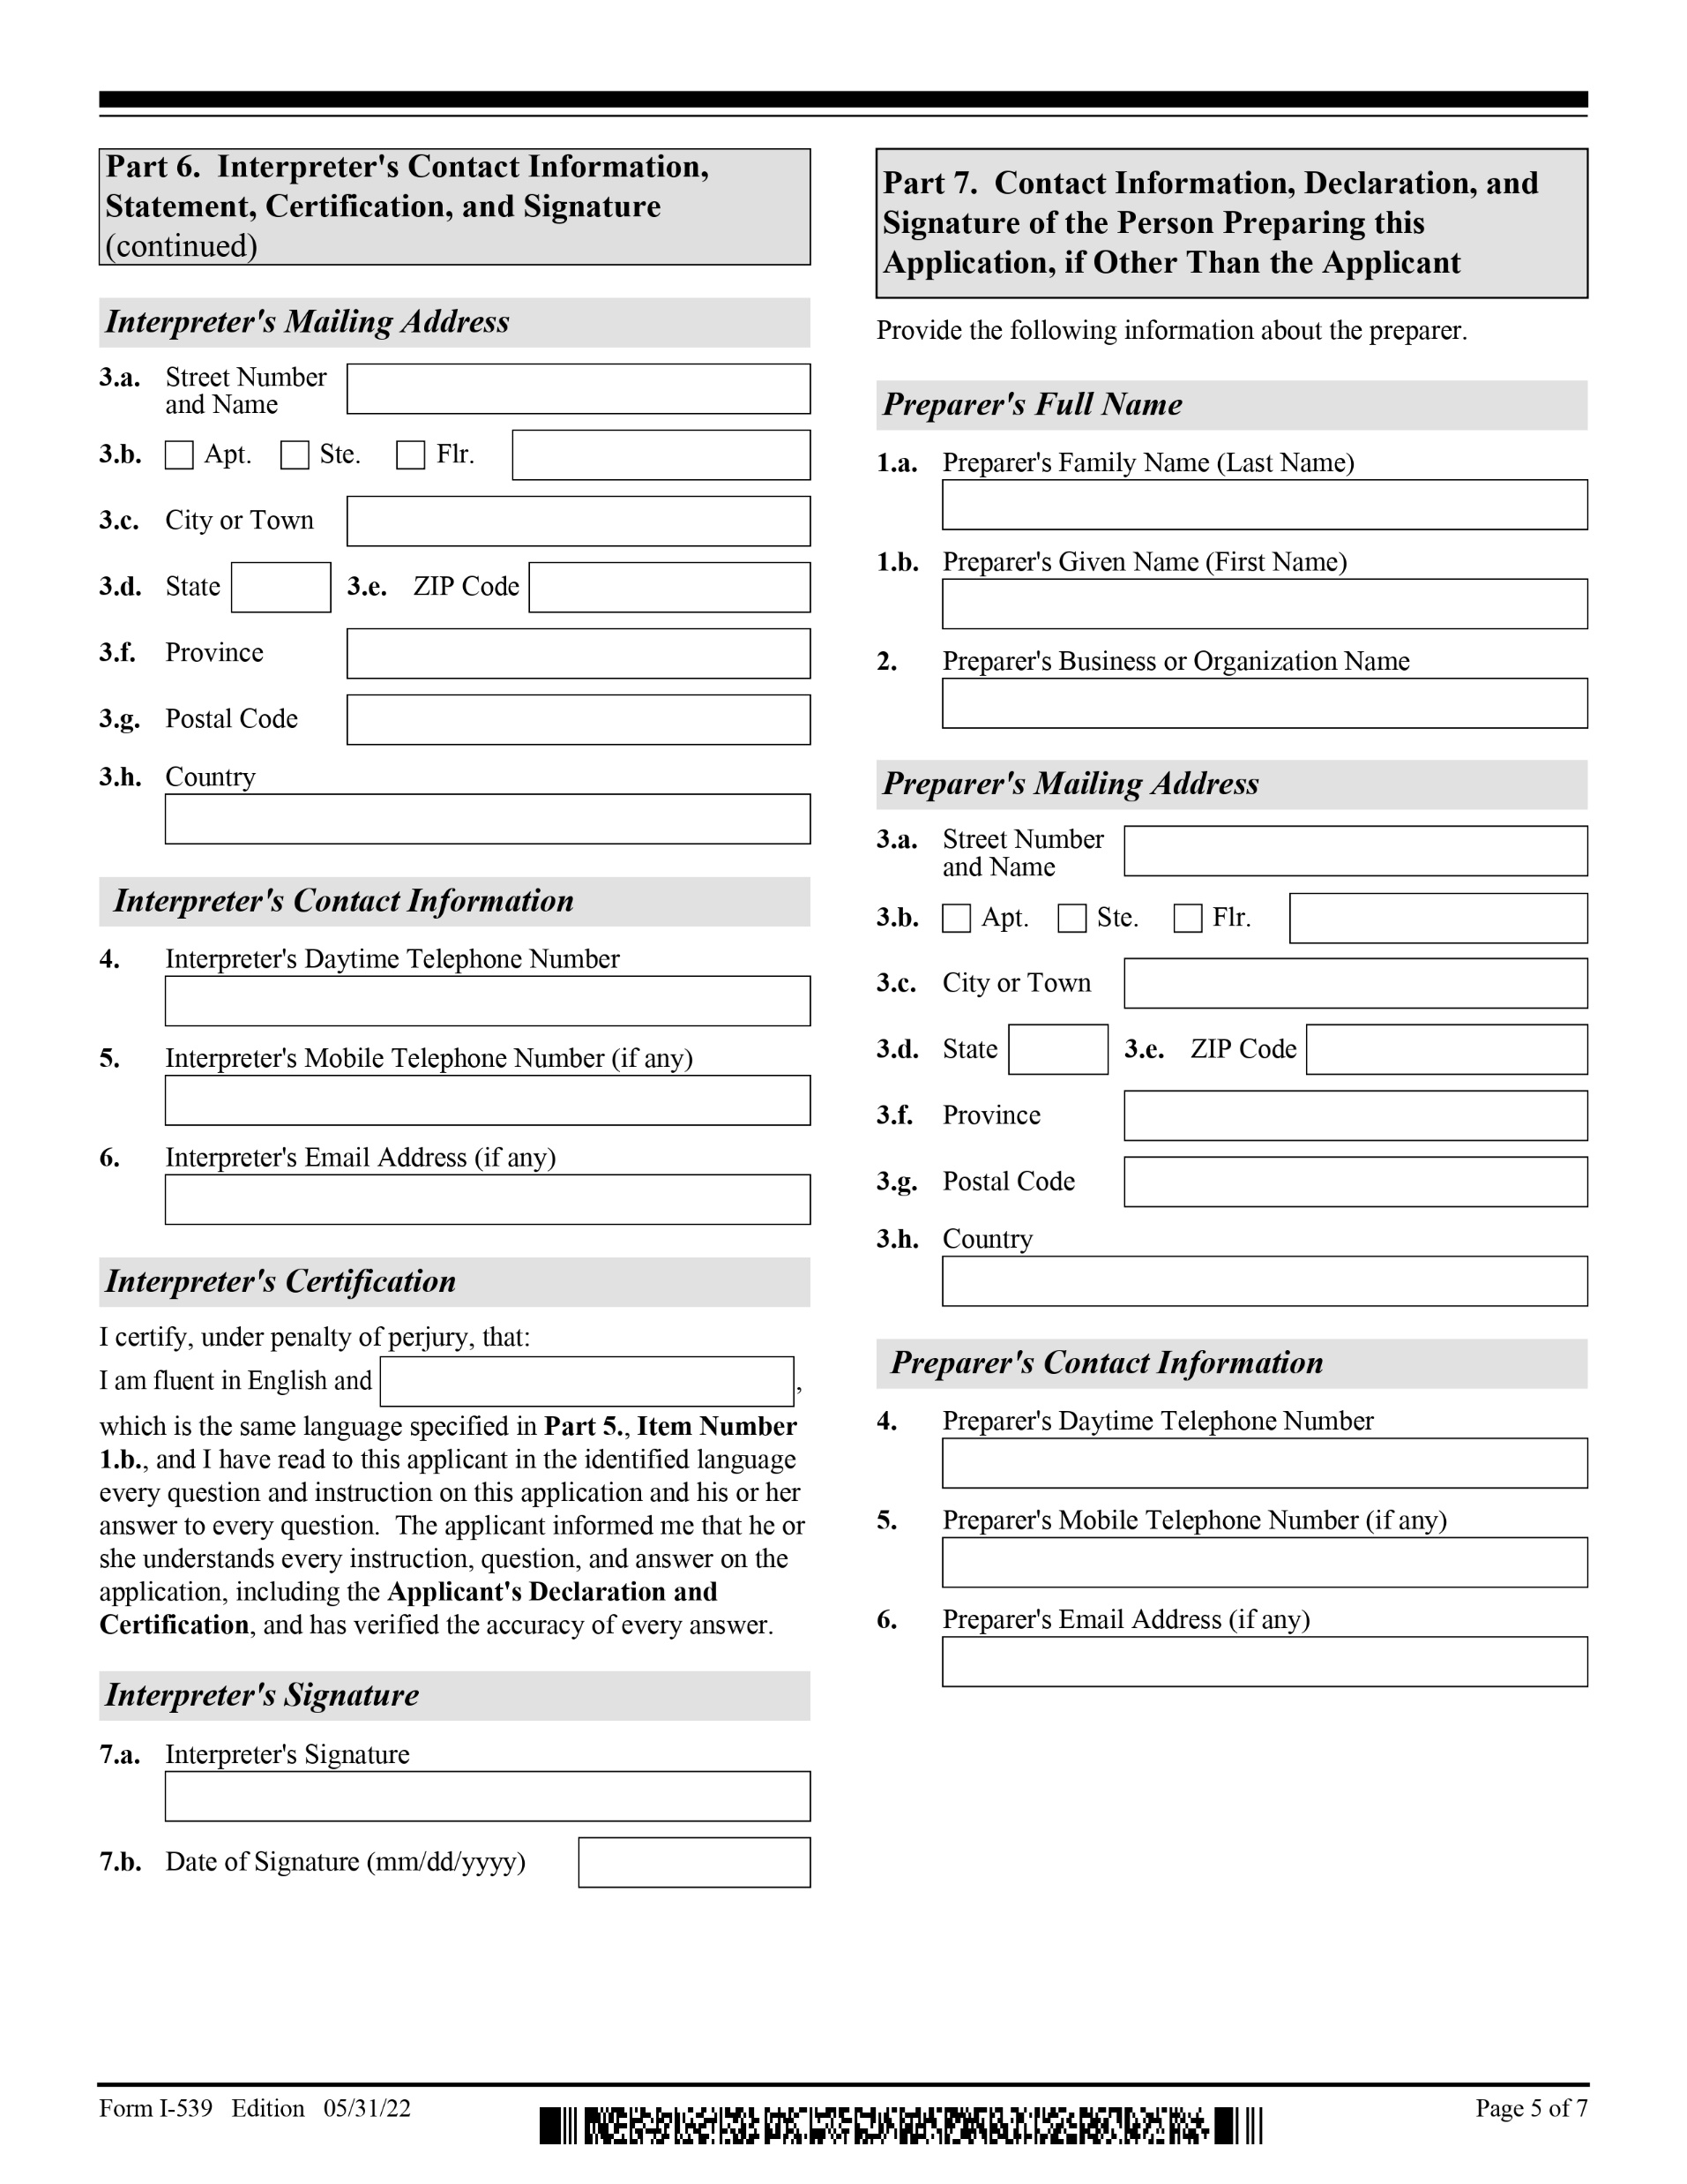
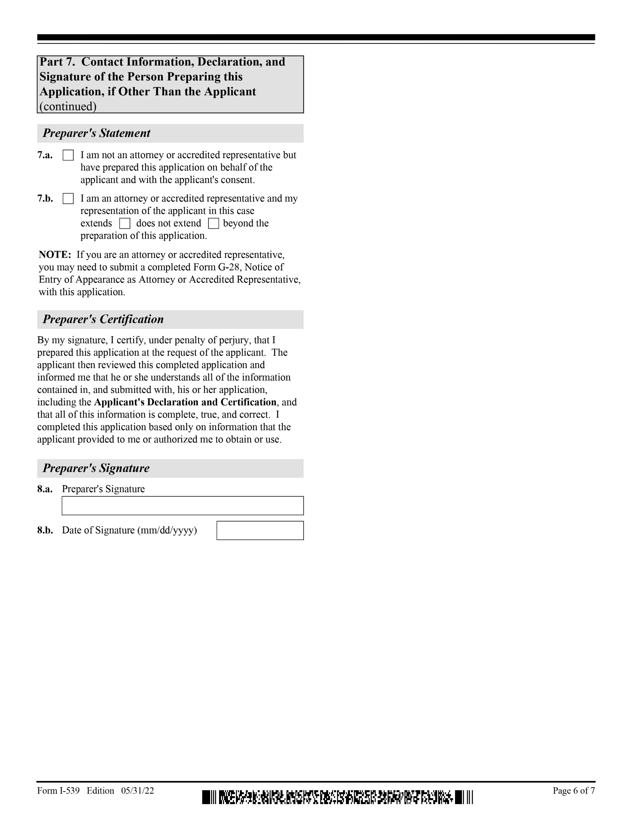
Temporary Visas Visitors for Business (B-1) and Pleasure (B-2)
Form I-539

Slide 20
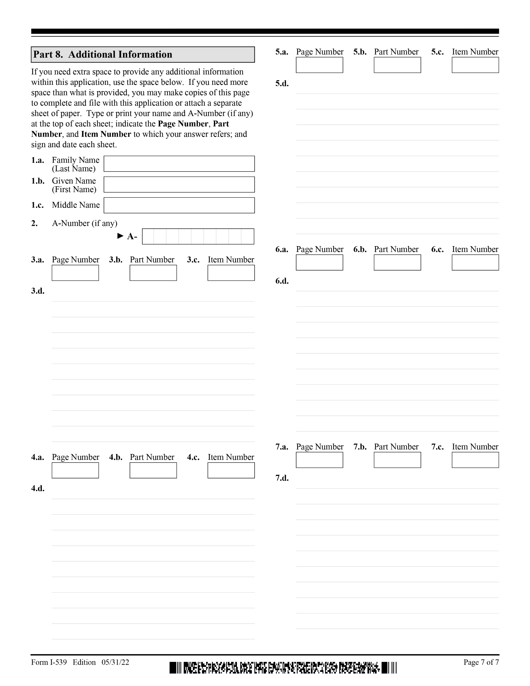
Temporary Visas Visitors for Business (B-1) and Pleasure (B-2)
Form I-539

Slide 21
To request the full deck of 194 slides, please email Beth Hall at bhall@cap-press.com with proof of adoption.

