Slide 1
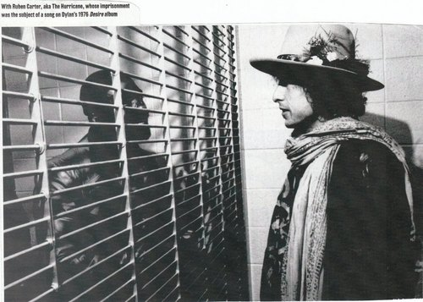
The Writ of Habeas Corpus is not just a piece of paper, not just a quaint Latin phrase. It was the key to my freedom. - Rubin “Hurricane” Carter

Slide 2
Adams v. Carlson (7th Cir. 1973)
“An inmate’s right of unfettered access to the courts is as fundamental a right as any other he may hold . . . All other rights of an inmate are illusory without it.”

Slide 3
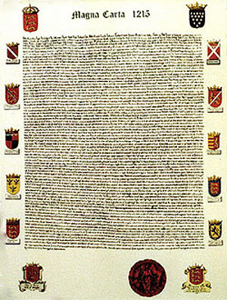
Writ:
a court order directing somebody to do something
Habeas Corpus = “you have the body”
Individual’s physical presence before a tribunal was key
Notes:
Literally, a petition for a writ of habeas corpus is a request by – or on behalf of – a person in custody for the court to order (that is, issue a writ) directing the custodian to produce the detainee’s body in court so that the court may resolve some issue or conduct proceedings that depend on the detained person’s presence.

Slide 4
Article 1, Section 9, United States Constitution
The privilege of the Writ of Habeas Corpus shall not be suspended, unless when in Cases of Rebellion or Invasion the public Safety may require it.
No Bill of Attainder or ex post facto Law shall be passed.
Notes:
(also the emolument clause – no person holding any office of profit or trust under them shall accept any present, emolument… from any foreign state)(salary or fees from employment)

Slide 5
U.S. Historical Notes
American Independence
Judiciary Act of 1789
Writ is available to those in federal custody only; could NOT be issued after trial and conviction
Civil War
Habeas Corpus Act of 1867
Expanded power of federal courts to judge the validity of state prisoners’ detention, including post-conviction detention

Slide 6
Inmates as Petitioners: Prisoners Right of Access to Courts
Habeas Corpus
42 U.S.C. s. 1983
“Every person who under color of any statute. . .subjects . . . any citizen . . . or other person . . . to the deprivation of any rights, privileges, or immunities secured by the Constitution and laws, shall be liable to the party injured in an action at law . . .”
Civil Disputes
Notes:
Innocence work is habeas work, in general.
Section1983- civil rights, treatment in prison, conditions of confinement; from Civil Rights Act of 1871, KKK Act- a civil remedy to KKK actions
What would be civil disputes? Divorce, child custody, inheritance

Slide 7
Right of Access to Courts
Ex Parte Hull (1941)
Procunier v. Martinez (1974)
Johnson v. Avery (1969)

Slide 8
Right of Access to Courts
Ex Parte Hull (1941)
The right of access to the courts cannot be abridged.
Notes:
Hull: prison officer refused to send or mail or file petitioner’s petition for writ of habeas corpus. Tried through his father as well, mail was confiscated/intercepted by guards.
Holding: regulation limiting prisoners from filing with court is invalid. Can’t abridge right to apply for writ of habeas corpus. Does NOT mean right to appear in court, Price v. Johnson, (1948), no absolute right to argue own appeals or be present during oral arguments for appellate court. Considerations: distance, does petitioner have an attorny, is in-court testimony needed, length of sentence and deferring case until he is free, is prisoner dangerous or an escape risk, availability of alternatives (video conferencing)
Why does this matter?
As Procunier v. Martinez demonstrates, the decisions try to balance access to court – the main consideration is burden v. restriction

Slide 9
Right of Access to Courts
Procunier v. Martinez (1974):
Restriction imposes a substantial burden on the right of access to the courts, and outweighs the penal interests in the restriction.
Notes:
Procunier v. Martinez (1974) – balance of access to court: main consideration is burden v. restriction
So which factors go to the burden, and which go to the need of restriction; 1974 case; class action against ban on using law students and legal paraprofessionals for attorney client inmates
Facts: couldn’t get signatures, attorneys couldn’t use paralegals or students; this “obstructs the availabiltiy of professional representation and other aspects of the right of access to the courts”
Restriction imposes a substantial burden on the right of access to the courts; weigh this against penal interests (security and order), restriction is too sweeping and restricting. SCt rules inmates can have paralegals and law students to help in their cases.

Slide 10
Right of Access to Courts
Johnson v. Avery (1969):
“. . .unless and until the State provides some reasonable alternative to assist inmates in the preparation of petitions for post-conviction relief, it may not validly enforce a regulation such as that here in issue, barring inmates from furnishing such assistance to other prisoners.”
Notes:
Johnson v. Avery (1969) – Prison regulation, no jailhouse lawyers: what about illiterate prisoners (court brought up); can’t obscure right to writ of habeas corpus; “unless and until the State provides some reasonable alternative to assist inmates in the preparation of petitions for post-conviction relief, it may not validly enforce a regulation such as that here in issue, barring inmates from furnishing such assistance to other prisoners.”
SCt rules inmates can have jailhouse lawyers
Also: is it meaningful access to only have a jailhouse lawyer? What if no one in the jail will help you? Or they are incompetent?

Slide 11
A full set of 392 slides, as well as other teaching materials, is available upon adoption of this book. If you are a professor using this book for a course, please contact rachael at remeier@cap-press.com to request your slides.

