Slide 1
The Criminal Justice System
The parts of the justice systems that impact the elderly who are abused consist of;
The legislatures of both the federal government and states,
Law enforcement,
The criminal courts,
The civil courts and
The administrative regulatory agencies.

Slide 2

Legislatures and Elder Protection
There are one set of laws that apply to the whole country;
Federal laws passed by Congress, and then each state legislature gets to establish additional laws to apply to the individuals in their own states.
Various agencies pass regulations or administrative laws which will apply to the areas of their control.
Providing elderly with protections and an avenue to recover from their victimizations is almost exclusively the role of the state government and its justice systems.
This Photo by Unknown Author is licensed under CC BY-NC-ND

Slide 3
Federal Legislation
The Social Security Act
The Older Americans Act was first passed and put into law back in 1965.
  It established the Administration on Aging. The Act provides funding for over 50 state agencies, more than 600 area agencies on aging and some 20,000 local service providers.
The Elder Justice Act
  Passed, but never funded

Slide 4
State Legislation
The laws of the individual states and how they are enforced are the most important protections to the potential victims and current victims of elderly abuse.
Many states have established special laws or special sanctions if the laws that are violated apply to elderly victims.
Between states, there is great variety in the definitions of abuse, investigative agencies, training, and intervention approaches, all of which impact the way that professionals, such as social workers, respond to potential abuse.

Slide 5
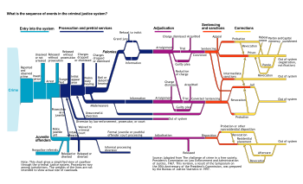
The Criminal Justice System
The criminal justice system’s components that apply to elder victims are law enforcement, prosecutors, and criminal court.
This Photo by Unknown Author is licensed under CC BY-SA-NC

Slide 6
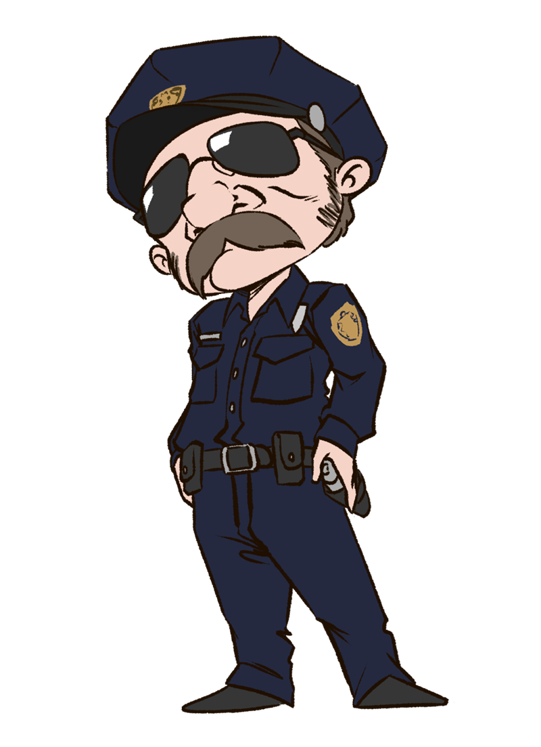
Law Enforcement
law enforcement are often the first responders in cases of elder abuse and therefore extremely important to ensure the wellbeing of the victim and the conclusion of the case.
The cooperation of crime victims with the criminal justice system is essential for optimum law enforcement. Additionally, proper responses by law enforcement to crime victims’ needs may go a long way toward providing recovery from the trauma of the victimization.
The TRIAD Program
This Photo by Unknown Author is licensed under CC BY-NC

Slide 7
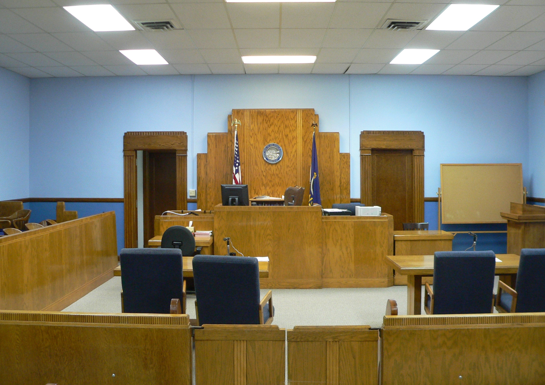
Courts
In the United States there are two separate court systems, the criminal courts and the civil courts.
The steps taken in the criminal court are slow and arduous for many elderly crime victims
This Photo by Unknown Author is licensed under CC BY-SA

Slide 8
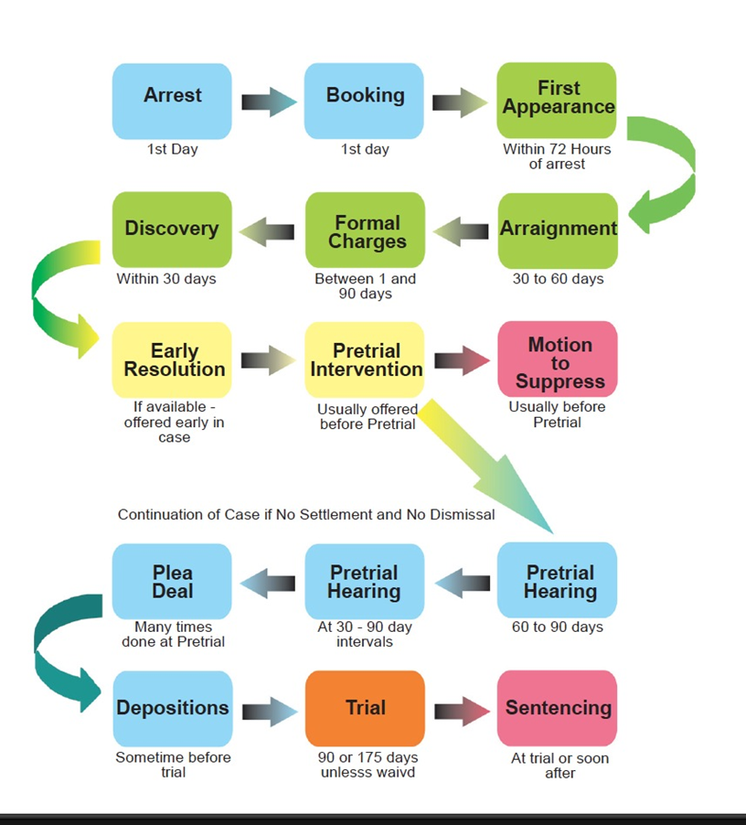
Steps in the Criminal Court

Slide 9
Victim’s Rights
States have passed crime victims’ bills of rights which have been formalized into statutes or state constitutional amendments which requests that the individual state criminal justice systems treat crime victims with fairness and respect and try to take into consideration their wishes.
This legislation establishes guidelines for the criminal justice system for a number of considerations that should be afforded to all crime victims.

Slide 10
The full set of 306 slides is available upon adoption. If you are a professor using this book for a class, please contact Beth at bhall@cap-press.com to request your slides.

