Slide 1

Leading in the Law
Notes:
Note to the Teacher:
We have included notes that we have used for years teaching this course to assist you in presenting these slides. For each slide, you will see two sections, “Preparation Notes”, and “Presentation Notes”. The Preparation notes are just that! They are there to help you prepare. The Preparation notes are for you to read and not share directly with the participants. This section focuses on how we present the material, thoughts about how to facilitate the course, and suggestions to consider prior to teaching. The Presentation Notes are verbatim words you can use to introduce the slides and material. We hope you find both useful as you teach leadership to your law students. For some slides, after the Presentation Notes, you will see a third section titled Transition notes, which are part of the “Presentation Notes” but aim to smooth the transition to the next slide.
Preparation Notes Slide 1:
We start the course by emphasizing that this course is a little bit different from other courses they have received in their legal education. The focus should be on setting a positive, upbeat tone about the material, immediately driving home how these skills are essential to success as a lawyer and in life generally, and building trust in classroom. We also highlight the importance of Emotional Intelligence to get buy in from the students. Help the see the relevance to their personal well-being and also to success as a lawyer, no matter their area of practice.
Presentation Notes Slide 1:
Welcome to leading in the law!
We are so glad you decided to take this class and think we have a wonderful class in store for you that can truly impact your life personally and professionally
Where a lot of your other courses focus on helping you develop the technical and intellectual skills required for you to thrive as a lawyer, this class is geared toward helping you round out your education by developing your self and “people skills”
This will be a very different class than what you are used to in law school.
It is really much bigger than just a “leadership” class. We are going to stretch your concept of leadership.
We are really beginning a “JOURNEY” together today that will hopefully change the way you approach and live your life, both personally and professionally.
By leadership we certainly mean inspiring others, capitalizing on strategic agendas, or managing through crisis. This necessarily means that we have to focus on and help you build how you respond to people and events in your life
The concepts we will discuss are relatively simple. They are straightforward. You can and will build and develop them. Just know that this will be difficult in the sense that they will challenge you to think and rethink about yourself, your responses, your relationships, and the organizations in which you work. All of this comes from increasing your emotional intelligence, or EI.

Slide 2
Add some personal slides here to share about yourself as a teacher; model self-awareness and vulnerability
Notes:
Preparation Notes:
We recommend adding some personal photos here. Show a little bit about yourself. This will allow you to start the course off modeling self-awareness and vulnerability. It also helps them start to build rapport with you.
Presentation Notes:
This is who I am in all walks of life and as we get into leadership this semester, we will keep talking about knowing yourself on a deep level
Self-awareness, and how that self-understanding allows you to be your true and authentic self
Leading is all about authenticity – that is, finding your true self and pursuing your passions and interests with purpose
Leadership success starts with authenticity — doing our jobs without compromising our values and personality. People trust us when we are true to ourselves, and that trust makes it possible to get things done.
So, how is who you are part of your work?

Slide 3

Partner Interview
Pair up and interview each other:
  1. Where you were born
  2. What year are you? Program?
  3 . Have you ever taken a leadership course/program?
  4. What experience, if any, have you had with Emotional Intelligence?
  5. What’s one little known fact about you that most law students don’t know?
Notes:
Preparation Notes:
We like to start the course off with several interactive exercises and have found the partner interview to be a good way to help students start to get to know each other beyond the typical law school conversations. This will help facilitate social and emotional skills as they learn to share and inquire about their fellow students.
Presentation Notes:
FIRST step-
We need to get to know each other in an effort to build a culture of trust and support. We must create a space of respect, understanding, and open communication.
I want you to pair up and each of you share a LITTLE KNOWN FACT with the other person - one little known fact about yourself
[pause for 2-3 minutes while they share then regroup together. This "little known fact" becomes a humanizing element that can help break down differences such as grade/status in future interaction.]
Come back to larger group – please share your partner’s name and their one little known fact. Who would like to start?

Slide 4
Let’s break some ice!
Groups of 3
What has been your biggest law school fear?
Biggest fear post graduation?
  Share with each other and then be ready to share to class
Notes:
Preparation Notes:
It is important to create a sense of trust and camaraderie in the class because you will be discussing more sensitive matters than typically discussed. We do a second exercise to encourage a classroom of trust and acceptance so all feel safe to share. How long the second part of the lasts is your call. The more they share, agree with what is shared, and discuss these, the more trust, vulnerability, and understanding that they share so much will build trust and support further conversation.
Presentation Notes:
This class is about leadership, and both trust and vulnerability are the biggest characteristics needed for good leadership.
Let’s divide into groups of 3 and I want you to share your biggest law school fear - it can be law school related as well. Then share your biggest fear post-graduation.
[pause for 5 minutes - this will take a bit longer and you want them to be able to talk more, if they are willing, then regroup and have each person share their own answers]
Let’s regroup and share your own answers. Who would like to start? (Or [blank], can you get us started?)

Slide 5

1.) What past leadership roles have you had? (These do not need to be formal)
2.) What did the experience teach you about leadership?
More ice breaking…
Notes:
Preparation Notes:
It’s important to get them to start thinking about their prior experience with leadership. What do they think of when they hear the word leadership? What does that mean to them? Once their concept of leadership is understood by you and by others, then you will be able to work on expanding the concept and how the skills taught fit. Have them reflect in writing on this. Reflection will be a key aspect of the course to help them gain self-awareness of their preconceived notions of leadership.
Presentation Notes:
Individually I want you to think about your past leadership roles, whether formal or informal - a place where you led others. And think about what the experience taught you about leadership. Let’s take 3-4 minutes and please take notes in some form that you will be able to go back to.
Now, let’s divide into groups of 3 with different people. I want you to share your responses with others. Be curious about what others share and be open to rethinking or adding to your initial responses.
[take 5-10 minutes for this - sometimes this generates a great deal of discussion and further self-reflection as students think about other experiences.]
Let’s come back together and hear from a few of you.
I asked you to record your thoughts because you will include this in your reflection paper for this week.

Slide 6

What does leadership mean to you?
Notes:
Preparation Notes:
To prepare for this sort of slide in your course, think about the value of asking them to reflect first on what leadership means to them. We want to help them start to gain self-awareness about what being a good or strong leader means to them. You can practice on yourself. What comes to mind when you think of Leadership? Great leadership?
With clarity of what they associate with leadership, they will be able to rethink if their preconceived notions and underlying beliefs, which have been developed from their experiences, align with what they really believe leadership to be all about, and what the research suggests leadership is really all about if done effectively.
Presentation Notes:
I’d like to start by asking you to think for a second about what leadership means to you? Reflect for a second about the idea of leading and leadership. What comes to mind for you? What does it mean to lead?
[pause for a minute or two here to let them reflect and go to the next slide]

Slide 7

Reflect on your own experiences of great leadership

Slide 8

Reflect back over your life and career about WHO moved you…
1. List a few people whom you have known or worked for and who epitomize great leadership – who brought out the best in you, inspired, and motivated you.
2. Write some notes about what these people typically said or did that moved you.
3. Then write about how each of these people affected you. What was the impact? How did they make you and others feel?
Notes:
Preparation Notes:
This is the best boss exercise from the book. Reference text for more set up. You are trying to utilize this exercise to help them see that the most influential leaders in their life had high EI, the other stuff does not matter as much. That is much like law school in that everyone is smart or they would not have been admitted - so what will separate them? That will come in a few slides.
You will need a board of some sort and a writing implement to write their answers on the board in two unlabeled columns. Do not identify the columns to start, but one is technical skills and other is emotional and social competencies. You will build the lists as they identify reasons why someone was a good boss. Your technical list should be short and the emotional and social competencies long.
Presentation Notes:
EXERCISE: Find somewhere to write
I’d like for you to reflect back over your life and career.
1. List a few people whom you have known or worked for and who epitomize great leadership – who brought out the best in you
2. Write some notes about what these people (good and bad) typically said or did. How did they make you and others feel?
3. Then write about how each of these people affected you. What was the impact?
[GIVE 5 minutes to complete]
What was it about these people that made you list them as great leaders?
[solicit answers and build the two columns on the board]
What conclusions can you draw from your notes?
TRANSITION: These characteristics grouped together form what is referred to as Emotional and Social Competencies.
Take a moment to jot down behaviors associated with best and worst bosses
Follow up – why? How did they make you feel?
[solicit answers, many of which are about the affirmations or self-affirmations that came from this person]

Slide 9
Emotional Intelligence
The ability to monitor one’s own and others’ feelings and emotions, to discriminate among them and to use this information to guide one’s thinking and actions.
Peter Salovey and John D. Mayer
Notes:
Preparation Notes:
We immediately go into what EI is and how it translates to successful leadership.
Presentation Notes:
The best definition of EI comes from the two men widely regarded as the fathers of its theoretical framework, Peter Salovey and John Mayer
They define it as ]read slide]
Goleman’s definition that you read is very similar
That was a couple of decades ago….
What Goleman brought to light at that point is that leadership is not just about technical skills and intellect.

Slide 10
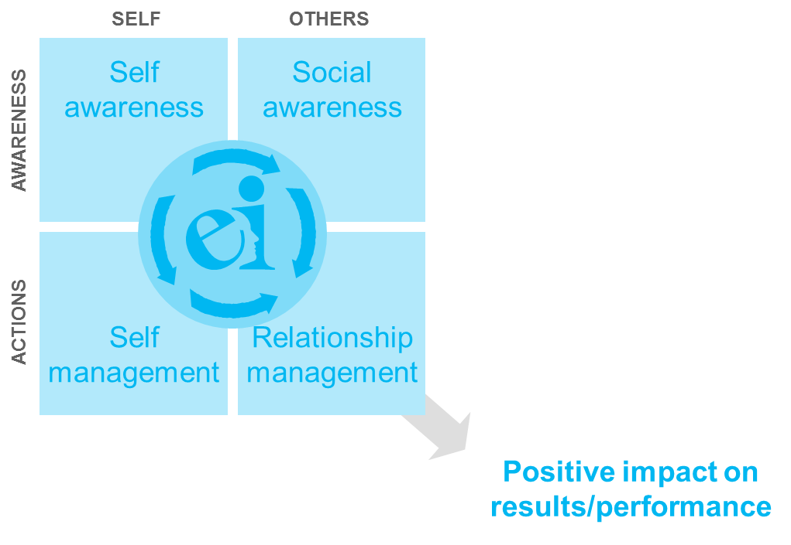
The Emotional and Social Competency Framework
  Emotional self-awareness
  Empathy
  Organizational awareness
  Emotional self-control
  Adaptability
  Achievement orientation
  Positive Outlook
  Influence
  Inspirational leadership
  Coach and mentor
  Conflict management
  Teamwork
Notes:
Preparation Notes:
Here’s the basic Goleman model. We show it as a road map for the course (even though we add to it). We received permission to reprint it in the book. This is one of several slides that you may want to seek approval to use given the copyright.
Presentation Notes:
Let’s really think about this model for a minute
Again, it’s a fairly straightforward idea we are teaching today
It begins in this upper left corner with self awareness, continues down into self-management which is also called emotion regulation, then continues in the upper right corner with other or social awareness, then ends in the lower right corner with relationship management.
Transition – Obviously, you have to be talented, smart, and experienced to lead a complex organization or social system. These are key skills to do so. But this is not enough …

Slide 11
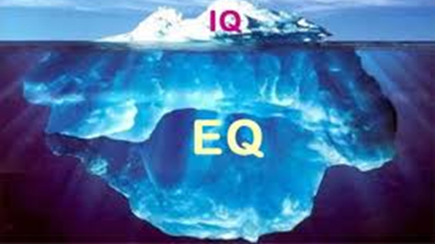
Does EI really matter?
Notes:
Preparation Notes:
This slide highlights the relationship between IQ and EQ.
Presentation Notes:
The research tells us that cognitive intelligence- IQ – is simply baseline. In other words, you have to be smart to get in the door. Competencies related to emotional and social intelligence, as opposed to IQ, college degrees, and technical experience, are the single most important factors in distinguishing great leadership from average leadership.
EI accounts for about 85 to 90 % of the difference between outstanding leaders and their more average peers.
If you take the pool of intelligent people and map it on students like yourselves at this level, or anywhere else that places a premium on intellect, you will see that you are basically skimming the top - in other words, your IQ makes a very small difference.
The larger difference, or differentiating factor, among all of you (law students or when you are lawyers) is in EI, so EI matters more in a unit. It leads us to see that there is a “floor effect” for IQ, because IQ does not vary much on the floor when surrounded by talented pool of candidates within an intellectually demanding profession.
The “Floor Effect” means that everyone at the top echelons of a given profession, or at the top levels of a large organization, has already been sifted for intellect and expertise. At those lofty levels a high IQ becomes a “threshold” ability, one needed just to get into and stay in the game.
IQ and technical skill drop toward the bottom of the list when deciding who should advance and who should lead in the organization. To be fair, this is how positive differentiation should happen. We acknowledge that there are plenty of instances where sometimes that is not the case and the organization ends up with a much less effectiveleader.

Slide 12

A little history…
Notes:
Preparation Notes:
INSTEAD of lecturing on this, consider asking the students what think about this class. You can share why you are teaching the course - that is, how you came to be interested in teaching about leadership. The presentation notes are about how we came to do so, which you can adapt to your own journey. Then, after the brief intro, ask about why they are in the class and what they hope to get out of it. They can write a reflection on it during or after class.
Presentation Notes:
I can remember first starting to work with law students and seeing some general themes
We were faced with very smart and capable students who were struggling to manage the work and manage their reactions to common stressors inherent in legal education and the practice of law.
When we looked at what the essential competencies were that separated outstanding law students from the typical, key competencies started to emerge.
We share the same mission – to prepare becoming lawyers with the tools and insight to thrive personally and professionally, in order to humanize the legal profession.
While the goal is simple, the journey will not always be easy; we are not here to present a sampling of leadership “flavors of the month”
You may feel challenged as you read the book and work through the exercises.
If this is the case, you are on the right track.
SO A FEW MORE ABOUT WHY THIS CLASS
Becoming a real leader requires a deep dive into your hopes, dreams, fears, and sorrows.
The first step is to realize or reconnect with what is most important to you and who you are.
You’ve read the book, what do you think about our work and advocacy for this class?

Slide 13
Key Reasons for the Course
1. A large proportion of what determines success and happiness is E&SI
2. Organizations thrive with an EI culture
3. Mental health rates of lawyers
4. A need for 21st century leadership
Notes:
Preparation Notes:
One of the reasons we wanted to teach this course and offer it at ___ is the growing consensus in the legal community that these are the “DISTINGUISHING CHARACTERISTICS” of successful lawyers in general, not just those at the top or in a traditional leadership position
Presentation Notes:
These are the traits that lead to better performance and career satisfaction for lawyers
And graduates need these characteristics now more than ever in their legal career to achieve balance and success
We also agree that leadership happens at all levels of an organization and not just in a or the top position – these are the traits that help lawyers be more effective throughout their career
Because of this growing consensus, we/I have been working for the past x years now with a larger community of faculty and lawyers across the country to develop curriculum to help students develop these traits.
When we’ve done the Best Boss exercise we continually come up with a very similar list
This course is a new approach to helping you start to develop these traits
There are a few other key reasons we are introducing leadership and EI skills to you now:
You are going to be in positions out of school that will require EI and leadership traits as much, if not more, than intellect, RIGHT OUT of the gate.
You will be expected to perform at a high level, immediately.
Mental health of lawyers has not been great.
As we said, leadership happens at all levels, not just the top positions- we want to expand your notion into what is needed for the 21st century.

Slide 14

Employee Stress Costs on the Rise
65% of employees cite work stress as significant (American Psychological Association (APA))
In 2013 Gallup announced 70% of the American workforce was disengaged, and the World Health Organization estimated workplace stress costing American businesses up to $300 billion a year.
Despite growing awareness of the importance of a healthy workplace, few employees said their organizations provide sufficient resources to help them manage stress (36 percent) and meet their mental health needs (44 percent).
Notes:
Preparation Notes:
We periodically update these stats on challenges facing legal profession to make the case for EI, and recommend you look for data that is meaningful to you and your students.
Presentation Notes:
People are being asked to do more with less and at a faster pace
That leaves less time to build relationships with colleagues and others
People are more isolated than ever, in large part due to the use of their technologies to work (remotely, by IM/DM and email).
Worker absenteeism on the rise (for a variety of reasons)
There is more knowledge and information to keep up with, more devices to check, and more time spent on work progress measurements - almost all of which are not billable
Turnover is higher than ever leading to career changes
A 2012 Global Workforce Study provided a snapshot of the attitudes and concerns of 32,000 workers around the world. Globally, nearly two-thirds (65%) of the more than 32,000 full-time workers participating in the study are not highly engaged.
What have you seen from your experience?
[solicit answers given their pre-law school law-related work and their during law school law work]

Slide 15
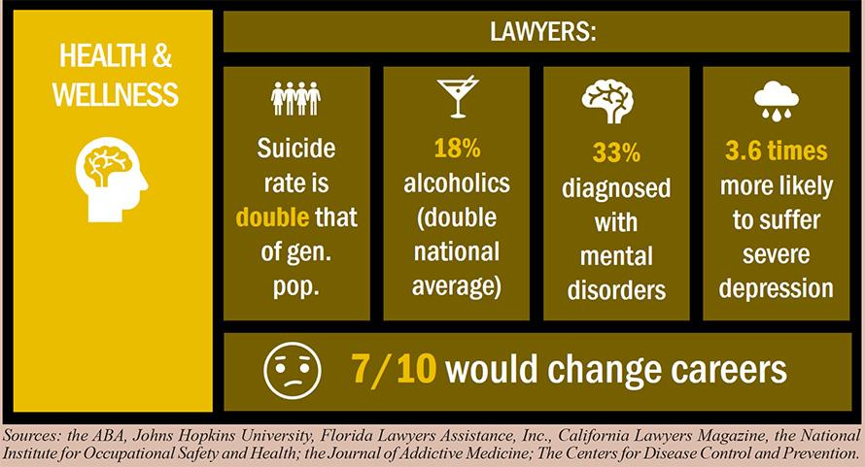
Notes:
Preparation Notes:
Continuing from previous slide.
Presentation Notes:
What do you think about this data?
What comes to mind?
That’s the underlying theme of a report from the National Task Force on Lawyer Well-Being titled “The Path to Lawyer Well-Being: Practical Recommendations for Positive Change.”
The 72-page report released in August of 2017 — initiated by the ABA Commission on Lawyer Assistance Programs, the National Organization of Bar Counsel, and the Association of Professional Responsibility Lawyers — outlines recommendations for taking action. Those recommendations are customized for judges, regulators, legal employers, law schools, bar associations, professional liability carriers, and lawyer assistance programs.
Using data from the 2016 research, here’s a snapshot of the lives of too many lawyers:
The collaborative research project marks the first nationwide attempt to capture such data about the legal profession. Approximately 15,000 attorneys from 19 states and across all regions of the country participated in the study.
• Between 21 and 36 percent of practicing lawyers qualify as problem drinkers.
• Approximately 28 percent, 19 percent, and 23 percent are struggling with some level of depression, anxiety, and stress, respectively.
• Difficulties for lawyers include suicide, social alienation, work addiction, sleep deprivation, job dissatisfaction, complaints of work-life conflict, and incivility.
• There’s a documented “narrowing of values so that profit predominates,” accompanied by a negative public perception.
Younger lawyers in the first decade of practice and those working in private law firms experience the highest rates of problem drinking and depression.
“The budding impairment of many of the future generation of lawyers should be alarming to everyone,” the report said. “Too many face less productive, less satisfying, and more troubled career paths.”
The mental-health picture is not much better for law students:
• 17 percent of law students experienced some level of depression, 14 percent experienced severe anxiety, 23 percent had mild or moderate anxiety, and 6 percent reported serious suicidal thoughts in the past year.
• 43 percent of law students reported binge-drinking at least once in the prior two weeks, and 22 percent reported binge-drinking two or more times during that period.
• One-quarter fell into the category of being at risk for alcoholism for which further screening was recommended.
One of the first orders of business suggested is simply to get to know each other a little bit and create a culture of openness and respect - these align with core aspects of EI

Slide 16



And the research says…
Those with higher EI scores are more likely to be highly profitable
Higher EI scores are related to improved teamwork and conflict management
EI can predict performance above and beyond personality and cognitive ability
Notes:
Preparation Notes:
Show value in EI through research.
Presentation Notes:
The research really supports EI skills as essential to navigate these challenges
When 95 Harvard students (graduating in the 1940s) were followed into middle age, the men with the highest test scores in college were not particularly successful compared to their lower scoring peers in terms of salary, productivity or status in their field (Vaillant, 1977).
At best, IQ accounts for only 25% of variance in performance (Hunter & Hunter, 1984), and some have argued it is even less.
When IQ is considered alongside “EQ,” a far greater proportion of variance can be explained.
Emotional intelligence is particularly important for those in leadership positions. According to Goleman (2004), the most effective leaders are those who have the traditional leadership skills coupled with high EI.
Research has shown that emotional competencies account for up to two-thirds of the distinctive characteristics of top performers (Mines et al., 2004), and the most effective decisions are made when both emotional and intellectual aspects of the brain are engaged (Brushfield, 2012).
In another study, Experienced partners in a multinational consulting firm were assessed on EI competencies. Partners who scored above the median on nine or more of the 20 EI competencies delivered $1.2 million more profit from their accounts than did other partners – a 139% incremental gain (Boyatzis, 1999).
In another analysis of more than 300 top-level executives from fifteen global companies showed that six emotional competencies distinguished stars from the average: influence, team leadership, organizational awareness, self-confidence, achievement drive and leadership (Spencer, L. M., Jr., 1997).
As you read and hear this, what is your reaction to research supporting this differentiating role of EI?
TRANSITION: So, is there data on EI and work performance?

Slide 17
EI has been empirically linked to…
Academic and job performance
Leadership
Physical health
Citizenship
Subjective well-being
Psychological Health
Life Satisfaction
Lower stress levels
Decision-making and problem-solving
Trust
Notes:
Preparation Notes:
Continuation from last slide
Presentation Notes:
And the research is pretty clear that EI is strongly tied to several key outcomes (Elieas et. Al, 1997, Weissberg et al., 2004)
A meta-analysis of 18 studies reported high correlations between EI scores and assessments of both verbal and spatial intelligence (Van Rooy et al, 2005).
EI has been found to be positively associated with psychological health (Schutte, Malouff, Thorsteinsson, Bhullar, & Rooke, 2007), with indices of well-being such as life satisfaction, and with lower stress levels (Austin et al., 2010).
Another meta-analysis by focused on emotional intelligence issues in the workplace. (Zhang and Wang, 2011)
The study purpose was to assess quantitatively the impact of individual emotional intelligence on workplace performance.
Seventy-five studies, which included a total of 87 independent samples and 12882 participants, met the criteria for inclusion in the meta-analysis.
The results showed overall, the correlation between individual emotional intelligence and workplace performance was moderately strong (r = 0.28).
TRANSITION: SO, how do you develop EI?

Slide 18

A century of empirical research on leadership has produced some very clear findings…
What makes an effective leader?
Self-Awareness (SA) is the cornerstone of great leadership.
SA manifests as Authenticity - the healthy alignment between internal values and beliefs and external behavior.
SA and authenticity allow for purpose driven leadership and resonance with others.
Notes:
Preparation Notes:
Authenticity helps organizations. People who have an authentic leadership style bring their whole selves to their jobs and participate fully and honestly in the workplace. Organizations that foster authentic behavior are more likely to have engaged, enthusiastic, motivated employees and psychologically safe cultures.
Authenticity is the healthy alignment between internal values and beliefs and external behavior. Authenticity comes from finding your style and your way of leading — and making life decisions that reflect your ethics, values, and your personality.
Presentation Notes:
There are some very clear findings from the past 100 years of research on leadership.
Deep self-awareness, or knowing WHO YOU ARE (your story – like how you arrived here right now), WHAT MATTERS MOST TO YOU (your values), what you are good at doing (skills) and interested in (interests) matter greatly
In the moment Self-Awareness is the cornerstone because it leads to the ability to be authentic in leadership
When leaders possess high levels of both parts of self-awareness (SA) and become authentic, they follow what matters most to them, live congruently with their values, and stay driven toward their purpose.
SA allows leaders to stay focused on the work they want to do, with optimism and vision.
SA also allows leaders to build meaningful relationships and resonate with others.
When we lead authentically with self-awareness, we can keep our focus on keys to relationship development, such as staying empathic, managing our own default tendencies in coping and interpersonal habits, and help others see their true potential.
Authenticity culminates in Relationships!

Slide 19
Leadership is all about relationships!
It’s about how you make others feel
What you bring out in them
Helping them see their best self and aspire to find their calling in the mission or strategy
When you see others and identify their potential, you can help them self-actualize in the organization
Notes:
Preparation Notes:
Start to highlight importance of building relationships and how that is key to leadership success.
Presentation Notes:
The importance of relationships can never be understated. In the longitudinal results from The Good Life: Lessons from the World's Longest Scientific Study of Happiness, the authors found that the key factor is living a good life (happiness, health, etc.) is relationships - the building and maintenance of them. (Schulz and Waldinger 2023)
Our lives are all about the work of building and maintaining relationships with friends, family, loved ones, and especially at school and work
many leadership programs focus on relationships as well, but often not about their ubiquity, the work you need to build them, and how you maintain them
many are also about advancing yourself and not considering that leadership is very much about supporting and advancing those around you

Slide 20
Traditional notion of leadership 🡪 Self-Leadership
Traditional Notion
Self-
Leadership
Notes:
Preparation Notes:
One of the things that is really important for us to do right off the bat is expand our notion of leadership.
Presentation Notes:
When most of us think about leading, we still conjure images of leading in a traditional sense.
That is, literally being the official or formal leader of a group. In a position of leadership.
What we call SELF-LEADERSHIP
Actually managing yourself to be your best self, not lose sight of what matters most to you, bring the attitude and vibe you want to bring, and live out your values. This is easier said than done, but that’s why we are here to help you!
This is leading with emotional intelligence in every aspect of your life.
REAL Leaders emerge in many forms, in various roles, throughout their day.
This brand of self-leadership is about championing the best in yourself when no one is looking, when everyone is looking, and all the places in between.
It’s about leading with integrity and with the EI skills to create psychological safety in the teams you work with
So as we go through this tonight, let’s try to expand the notion of LEADERSHIP to include the way you carry yourself on a daily basis.
TRANSITION --
This is an important distinction because it is a subtle cognitive shift away from thinking about leadership only when you are officially the lead of a group of people
It shifts us to think about leading all the time in everything we do and a necessary outlook to meet the demands of 21st century health care.
Self-leadership is so important because many of the challenges health care workers face happen throughout their day on a personal level.

Slide 21
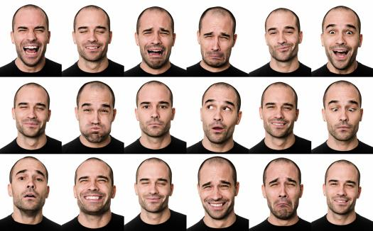
Two key aspects of developing Emotional Intelligence: Cognitive and Emotional
Notes:
Preparation Notes:
Here we start to dig into the more technical side of EI, unpacking the two types of learning required in this course: emotional and cognitive.
This will reinforce how this course will be different from others, with another emphasis on reflection and experiential, and the importance of participation.
Presentation Notes:
How do you develop EI? That’s what this class is about as much as providing a grounding in EI theory and knowledge
We expect you to leave more emotionally intelligent.
Unlike other development initiatives, developing EI requires two distinct types of learning, cognitive and emotional.
It is essential that any EI development process distinguish between these two distinct types of learning so participants not only understand the concepts and competencies but also can use them.
For example, a law firm leader may know they should be aware of how their emotions play out in leading their team, and care about how their actions make others feel, but not know how to do that.
In developing EI, it is often necessary to facilitate a more complex type of learning known as emotional learning.
This entails experiential practice opportunities that allow participants to identify old habits established previously in life in terms of relating to oneself and to others, then learning new ways of managing emotional and social life. This relearning can assist a good lawyer grow into an exceptional one as they are better able to win-over judges, juries, and clients.
TRANSITION – so what’s the plan to develop your social and emotional competencies?

Slide 22

Road Map
Class 1
  Introduction to EI
  ESCI-U Assessments
Class 2
  The Need for EI Lawyers
  The Self-Aware Lawyer
Class 3
  The Composed & Strategic Lawyer: Self-Management
Class 4
  The Empathic Lawyer
  Teamwork/Cultural competence (time permitting)
Class 5
  The Inspiring Lawyer: Building & Maintaining Relationships
Class 6
  The 21st Century Leader
  Group Presentations
Notes:
Preparation Notes:
You should edit this slide depending on the number of class sessions and weeks you will be teaching. The “Class” titles in the current slide match up with Chapters 2-7 in the book. See the ™ for more detail on how to divide the course and book.
Presentation Notes:

Slide 23
To request the full slide deck, please email proof of adoption to Kerri Hughes at kerri.hughes@cap-press.com

