Slide 1
Tangible vs. Intangible Property
Tangible Property
Intangible Property
property that can be physically touched
(ex. house, car, and jewelry)
property that represents an ownership interest in something and has no physical substance
(ex. stocks, mineral rights, and bank accounts)

Slide 2
Legal vs. Equitable Property
Legal Property
Equitable Property
property in which one has absolute ownership or title, including the right to manage and control it.
property in which one has the right to use or enjoy it, but does not possess absolute ownership
also known as
beneficial property

Slide 3
Several vs. Joint Property
Several Property
Joint Property
property that has one owner
property that has two or more concurrent owners
In Georgia, joint property owners can either be tenants in common (by default) or joint tenants with the right of survivorship (if expressly stated in the deed or will, or other instrument of conveyance)

Slide 4
Several vs. Joint Property (cont’d)
Tenants in Common
Joint Tenancy
undivided interest in entire property, with each owner having an agreed upon percentage of ownership
upon death, owner’s interest is distributed according to his/her will or trust or by the laws of intestate succession, if none
undivided interest in entire property, with owners enjoying four unities of:
Possession
Interest
Time
Title
upon death, owner’s interest goes to surviving joint tenant(s)

Slide 5
Separate vs. Marital Property
Separate Property
Marital Property
real or personal property owned by an individual prior to marriage or acquired during marriage solely in one’s name by gift or inheritance
real or personal property that is acquired by either partner or jointly or gifted to the couple during their marriage

Slide 6
Probate vs. Nonprobate Property
Probate Property
Nonprobate Property
property that is owned solely by the decedent or by the decedent as a tenant in common at the time of his or her death
such property will be distributed as decedent indicated in his or her will or by the laws of intestate succession
property that is not considered part of the decedent’s estate
such property cannot be transferred by will or by the laws of intestate succession, but rather, it goes directly to the decedent’s named beneficiaries

Slide 7
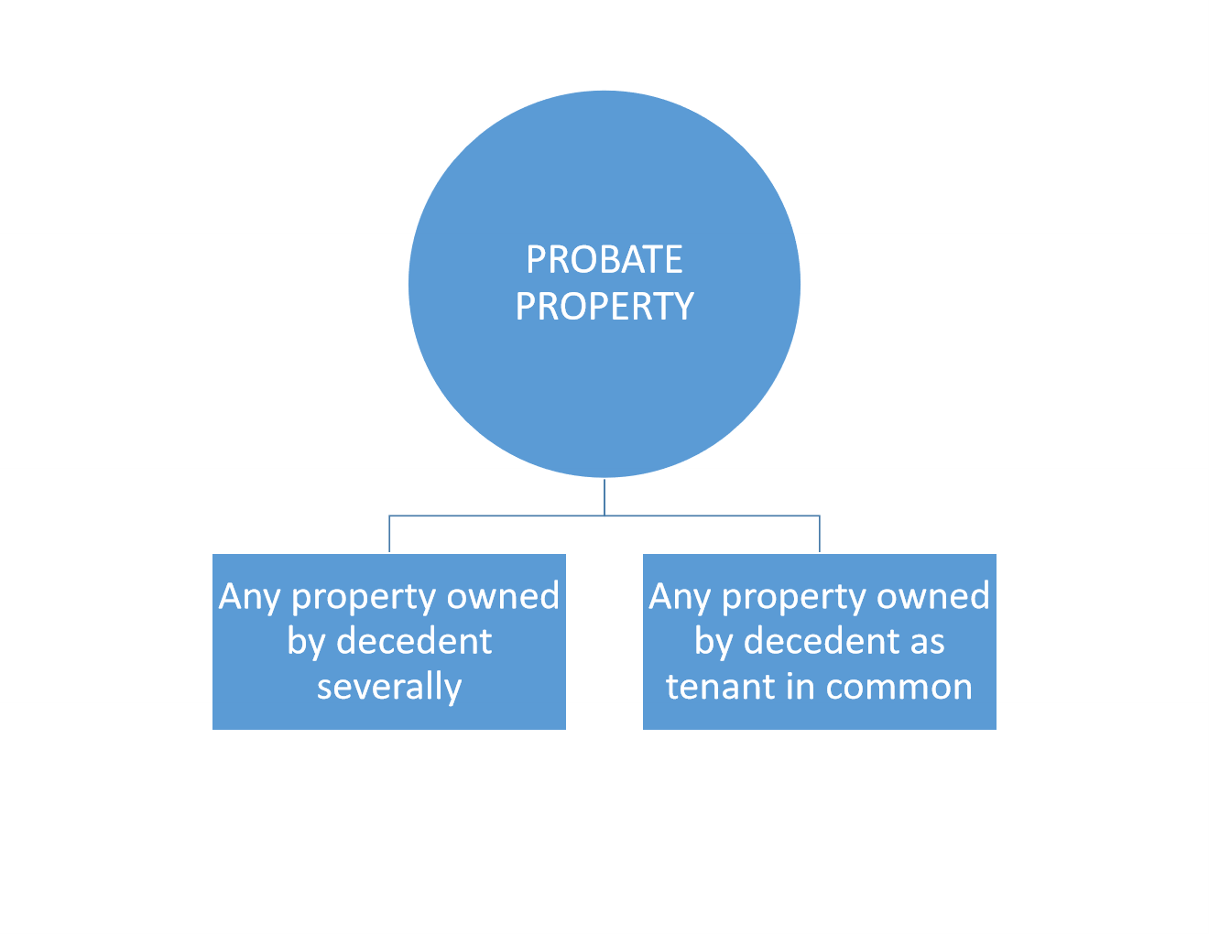
Probate vs. Nonprobate Property (cont’d)

Slide 8
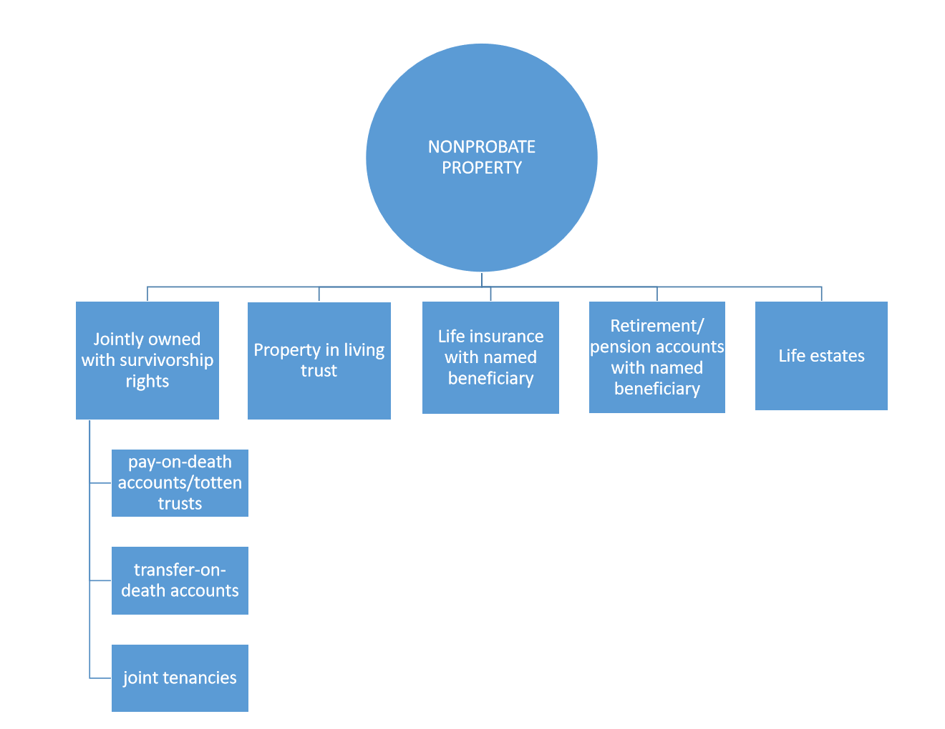

Slide 9
The full set of 193 PowerPoint slides is available upon adoption of this book. If you are a professor using this book for your class, please contact Beth Hall at bhall@cap-press.com to request your slides.

