Slide 1
Learning Objectives
After reading this chapter, students should be able to…
Explain how victimization differs by race and gender.
Describe how the perpetration of crime differs by race, gender, and immigration status.
Demonstrate an understanding of how racial minorities and women are represented in the criminal justice system.
Explain how various legislation (both state and federal) affects immigration enforcement in California.
Copyright © 2018 Carolina Academic Press. All rights reserved.

Slide 2
Why Demographics?
There is a relationship between race, ethnicity, gender and immigration status and the criminal justice system.
Sheer numbers of detentions, arrests, and incarcerations belie deeper biases and prejudices within society that affect the criminal justice system.
Copyright © 2018 Carolina Academic Press. All rights reserved.

Slide 3
“Minority” Defined
Minority:
A group numerically inferior to the rest of the population of a State, in a non-dominant position, whose members – being nationals of the State – possess ethnic, religious or linguistic characteristics differing from those of the rest of the population and show, if only implicitly, a sense of solidarity, directed towards preserving their culture, traditions, religion or language (United Nations Human Rights, 2014).
Copyright © 2018 Carolina Academic Press. All rights reserved.

Slide 4
“Ethnicity” Defined
Ethnicity
Derived from the Greek “ethnos” or “nation
Relates to the shared cultural factors such as nationality, language ancestry, and culture.
Copyright © 2018 Carolina Academic Press. All rights reserved.

Slide 5
“Race” Defined
Race
A biological term
Race refers to a person’s physical appearance such as skin color, eye color.
Race is a social construct, attached to groups based on historical context, and influenced by racial dynamics and politics.
Copyright © 2018 Carolina Academic Press. All rights reserved.

Slide 6
Minorities as Victims
Racial minorities are significantly overrepresented as victims of violent crime, including homicide
Copyright © 2018 Carolina Academic Press. All rights reserved.

Slide 7
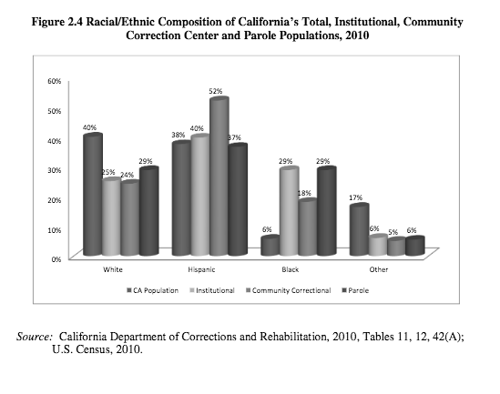
Copyright © 2018 Carolina Academic Press. All rights reserved.

Slide 8
Copyright © 2018 Carolina Academic Press. All rights reserved.

Slide 9
Copyright © 2018 Carolina Academic Press. All rights reserved.

Slide 10
The full set of 295 slides is available upon adoption. If you are a professor using this book for a class, please contact Beth at bhall@cap-press.com to request your slides

