Slide 1
When does deliberate listening apply?
Deliberate Listening applies fully to the attorney-client relationship, so everything you’ll learn applies fully to this class.
But as you’ve likely discerned throughout your lives, deliberate listening transcends the attorney-client relationship to all relationships.
But just because you know this intellectually doesn’t mean you are in fact deliberately listening.

Slide 2
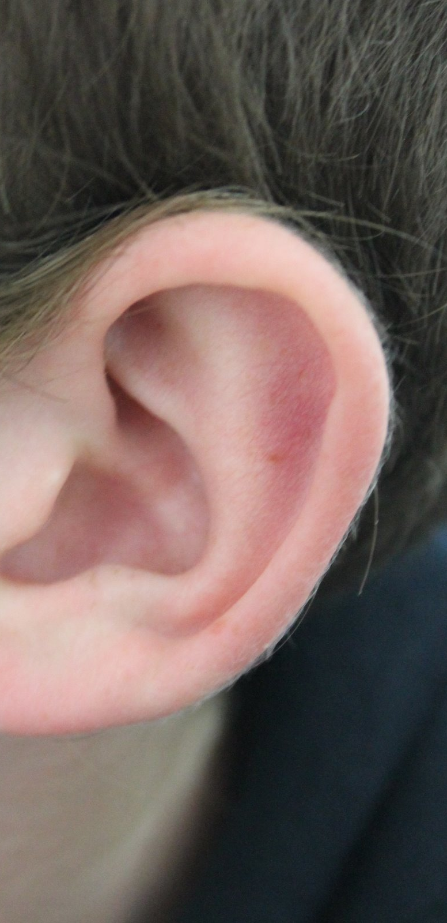
What is listening?
If you ask a group of people to give a one-word description of listening, most people would say hearing.

Slide 3
Definition of Listening
The process of receiving,
constructing meaning from,
and responding to spoken and/or nonverbal messages;
to hear something with thoughtful attention

Slide 4
Hearing vs. Listening
Hearing: physical process; natural; passive
Listening: physical & mental process; active; learned process; a skill
You must choose to participate in the process of listening. Lawyers must learn to listen. Great lawyers listen.
Listening is hard!

Slide 5
Listening is a conscious activity based on three basic skills:
1. Attitude: Maintain a constructive attitude—if you despise your job and/or clients, this won’t happen
2. Attention: Strive to pay attention—focus
3. Adjustment: Cultivate a capacity for adjustment

Slide 6
Empathy
What it is:
Reflection of content and feeling at a deeper level
Purpose:
To try and get an understanding of what may be deeper feelings. You must discern these to better identify a client’s legal and non-legal objectives.

Slide 7
Empathizing
Empathizing does not mean you need to agree with your client
Empathizing does not mean you need to “feel sympathy” for your client
What is the difference between sympathy and empathy?

Slide 8
It is easy to know when you are being empathic because:
1. Your body language and tone match
2. Your tone and your feelings match
3. You are focused on what your client is saying and meaning.

Slide 9
Listening is needed everywhere…
Listening skills form the basis of:
Continued learning
Teamwork skills
Management skills
Negotiation skills
Emotional intelligence

Slide 10
The full set of 100 PowerPoint slides is available upon adoption. If you are a professor using this book for a course, please contact Rachael Meier at remeier@cap-press.com to request your slides.

