Slide 1
Business Fundamentals for Law Students: Current Session
Cash Flow Statement - Overview Module
Cash Flow Statement - Detailed Module
Notes:
This week we are discussing overview of the business structure. Every week there will be at least 2 modules.
Click – The first module provided you an overview of a corporation, the creation of the corporation, corporate purpose and corporate management.
Click - The second module will discuss this in more detail. This session is going to provide you an overview of accounting. Accounting is how the business tracks its income, expenses and determines its profit.
Click – Let’s get started

Slide 2
Four Major Financial Statements
Statement of Stockholder's Equity
Cash Flow Statement
Income Statement
Balance Sheet
Notes:
Of the 4 major financial statements, today we will spend time going through the Cash Flow Statement.
It tells the viewer how the company generated and expended its cash.

Slide 3
Assets = Liabilities + Owner's Equity
Cash Balance at beginning of fiscal year + Cash flow from Operations, Financing and Investments = Cash Balance at end of current fiscal year
Balance Sheet Formula
Revenue - COGS - Expenses = Net Income
Income Statement Formula
Cash Flow Statement Formula
Notes:
Reminder of basic Balance Sheet formula.
Basic Income Statement formula.
Basic Cash Flow Statement formula.

Slide 4
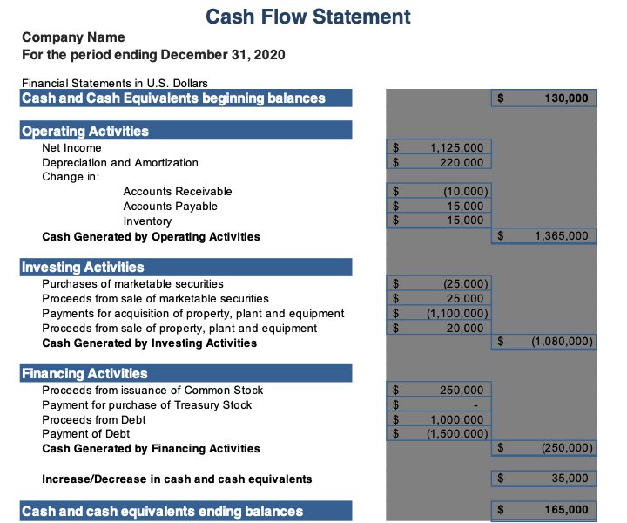
Cash Flow Statement Big Picture
Notes:
Start with the top of the Cash Flow Statement.
Title of the Financial Statement telling you which financial statement you’re viewing.
Next, name of company
Next, fiscal period.
Thinking of the Cash Statement formula, you
Start with Cash balance from end of previous fiscal year (same as cash balance at end of current fiscal year)
Then the three major sections of Cash Flow Statement
Cash flow from operations
Cash flow from investing
Cash flow from financing
End with the cash balance at the end of the current fiscal year

Slide 5
Cash Flow Statement Three Major Sections
Operating Activities
Cash generated and expended by company's day-to day operations.
Items that generated Revenue and Expenses
Investing Activities
Cash generated and expended by company’s investments.
Purchase of property and equipment
Purchase and sale of marketable securities
Financing Activities
Cash generated and expended by company’s financing.
Borrowing and repayment of Debt
Issuance and purchase of Equity
Notes:
Three major sections
Operations
Investing activities
Financing activities

Slide 6
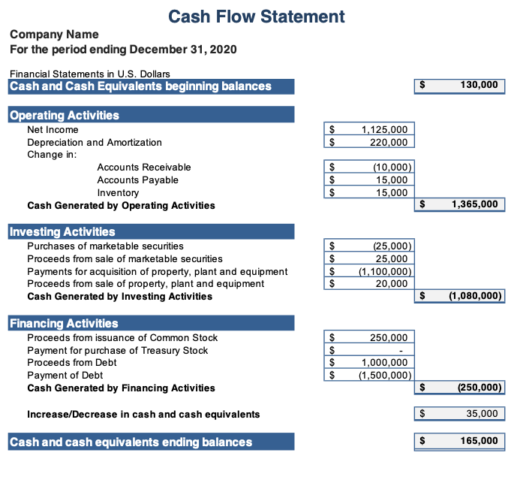
Cash Flow Statement in Detail
Start with cash balance at beginning of current fiscal year
Add in cash flow from operations
Add in cash flow from Investing
Add in cash flow from financing
Results in cash balance at end of current fiscal period

Slide 7
Highlights
Four Major Financial Statements
Balance Sheet
Income Statement
Statement of Cash Flows
Statement of Stockholder’s Equity
Cash Flow Statement shows a company’s cash flow from:
Operations
From company’s day to day business
Investments
From company’s purchase and sale of PPE and marketable securities
Financing
From sale and repurchase of Equity and receipt and repayment of Debt
Company’s gotta have cash to survive.
Notes:
What are the Financial Statements?

Slide 8
The full set of 243 slides is available upon adoption. If you are a professor using this book for a course, please contact Rachael Meier at remeier@cap-press.com to request your slides.

