Slide 1

Chapter 2: Intentional Harms to Persons

Slide 2

Defenses and Privileges

Slide 3
Consent

Slide 4

Actual Consent
David asks Paul if he wants to fight. Paul nods his head. David hits Paul, shattering several bones Paul’s face. Paul sues for battery. Actual consent?

Slide 5
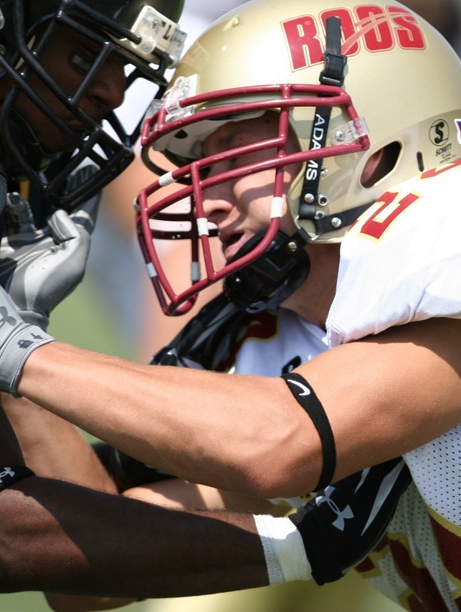
Actual Consent
Football practice hypo: When it was Paul’s turn to hold the blocking pad for David, David proceeded at full speed, pushed Paul back fifteen yards, and gave him a violent shove at the end, causing David to fall backward and break his arm. Paul sues for battery. Did Paul give actual consent to David?

Slide 6

Apparent Consent: O’Brien v. Cunard S.S. Co.
Facts
Holding

Slide 7
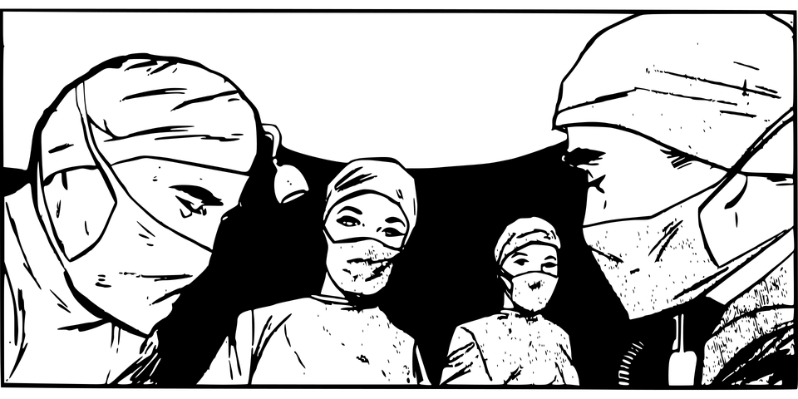
The Special Case of Medical Battery

Slide 8
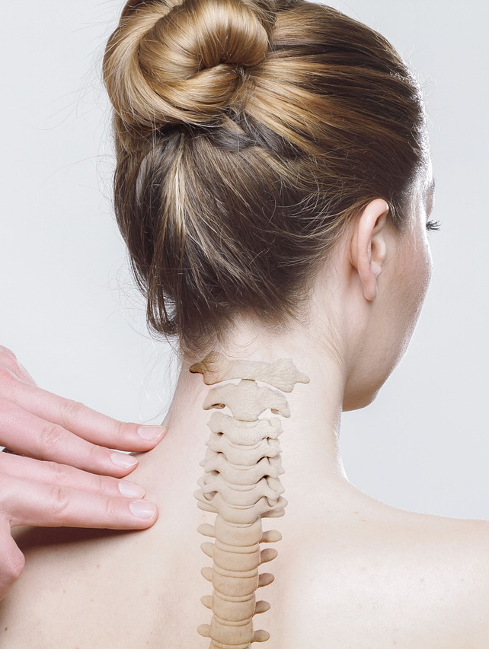
Capacity
(i) Plaintiff is 17 years old. She received treatment from a licensed osteopath for her back pain. The osteopath performed spinal manipulation upon Plaintiff, which allegedly results in injury to Plaintiff. The osteopath did not obtain consent from Plaintiff’s parents prior to performing the manipulation. Did Plaintiff have capacity to consent?

Slide 9

Capacity
(ii) Plaintiff is 15 years old. Defendant is 40. The two parties engage in “consensual” sexual intercourse. A criminal statute prohibits an individual from having sex with anyone who is at least 15 years of age but less than 17 years of age where the actor is at least ten years older than the victim and is not the spouse of the victim. Plaintiff has now sued Defendant for battery. Did the plaintiff have the capacity to consent? What if the defendant had only been 18?

Slide 10

Mistake, Misrepresentation, or Duress
Neal v. Neal (Mistake or misrepresentation)
  Facts
  Holding
  Nature of the contact
  Duress

Slide 11

Consent Review: Problem 2.14
Problem 2.14
  Harold and Isaiah begin arguing.
  Challenge each other to a fistfight.
  Harold accepts Isaiah’s challenge.
  Unbeknownst to Isaiah, Harold slips on a pair of brass knuckles. Breaks his nose.
  Isaiah sues for battery. Harold argues consent.
  Is Harold’s defense likely to succeed?

Slide 12
Self-Defense

Slide 13

Self Defense
Hagopian v. Fuchs
  Facts
  Self defense in general
  Self defense involving the use of force intended to cause or likely to cause death or serious bodily harm
  Problem 2.15

Slide 14
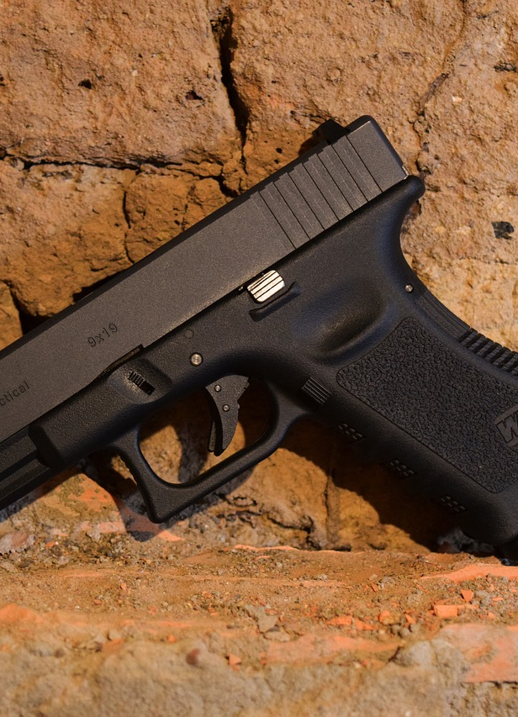
Self Defense
Problem 2.15
  Self defense involving the use of force intended to cause or likely to cause death or serious bodily harm
  Could Kevin reasonably believe he was at risk of the “death or serious bodily injury” that Hagopian talks about?

Slide 15
Duty to Retreat
Stand Your Ground Laws

Slide 16
Tennessee’s “Stand Your Ground” Law (T. C. A. § 39-11-611)
[A] person who is not engaged in unlawful activity and is in a place where the person has a right to be has no duty to retreat before threatening or using force intended or likely to cause death or serious bodily injury, if:
(A) The person has a reasonable belief that there is an imminent danger of death or serious bodily injury;
(B) The danger creating the belief of imminent death or serious bodily injury is real, or honestly believed to be real at the time; and
(C) The belief of danger is founded upon reasonable grounds.

Slide 17
Tennessee’s “Stand Your Ground” Law (T.C. A. § 39-11-622)
(a)(1) A person who uses force as permitted in §§ 39-11-611-- 39-11-614, or § 29-34-201, is justified in using such force and is immune from civil liability for the use of such force, unless …
(b) The court shall award reasonable attorney’s fees, court costs, compensation for loss of income, and all expenses incurred by a person in defense of any civil action brought against such person based upon the person’s use of force if the court finds that the defendant was justified in using such force pursuant to §§ 39-11-611--- 39-11-614, or § 29-34-201.

Slide 18
Tennessee’s “Stand Your Ground” Law (T. C. A. § 39-11-611)
(c) Any person using force intended or likely to cause death or serious bodily injury within a residence, dwelling or vehicle is presumed to have held a reasonable belief of imminent death or serious bodily injury to self, family, a member of the household or a person visiting as an invited guest when that force is used against another person, who unlawfully and forcibly enters or has unlawfully and forcibly entered the residence, dwelling or vehicle, and the person using defensive force knew or had reason to believe that an unlawful and forcible entry occurred.

Slide 19
Tennessee’s “Stand Your Ground” Law (T.C. A. § 39-11-611)
(d) The presumption established in subsection (c) shall not apply if:
(1) The person against whom the force is used has the right to be in or is a lawful resident of the dwelling, residence, or vehicle, … provided such person is not prohibited from entering the dwelling, residence, or occupied vehicle by an order of protection, injunction for protection from domestic abuse, or a court order of no contact against that person;
(2) The person against whom the force is used is attempting to remove a person or persons who is a child or grandchild of, or is otherwise in the lawful custody or under the lawful guardianship of, the person against whom the defensive force is used;
(3) … the person using force is engaged in an unlawful activity or is using the dwelling, residence, or occupied vehicle to further an unlawful activity; or
(4) The person against whom force is used is a law enforcement officer .. who enters or attempts to enter a dwelling, [etc.] in the performance of his or her official duties, and the officer identified himself or herself in accordance with any applicable law, or the person using force knew or reasonably should have known that the person entering or attempting to enter was a law enforcement officer.

Slide 20
Defense of Others

Slide 21
Shopkeeper’s Privilege

Slide 22
Historical Approaches
Older Shopkeeper’s Privilege
Applies to shopkeepers and agents.
Actor may detain any person for the purpose of preventing theft or recapturing property. However, the person must actually have the property in his possession
Citizen’s arrest
Applies to non-merchants or agents
Actor has actually committed
  a felony and DEF had reasonable grounds to believe PL committed it
  or a misdemeanor in the DEF’s presence that constitutes a breach of peace

Slide 23

The Modern Shopkeeper’s Privilege
Statutory Privilege and Restatement

Slide 24
The Modern Shopkeeper’s Privilege
Probable cause (reasonable belief)
Holguin v. Sally Beauty Supply Inc.
  Facts:
  Holding:

Slide 25
The Modern Shopkeeper’s Privilege
In a Reasonable Manner and for a Reasonable Time
Hobson v. Dolgencorp, LLC
  Facts:
  Holding:
  Reasonable manner?
  Reasonable time?
  The merchant’s purpose

Slide 26
To request the full slide deck, please email Kerri Hughes at kerri.hughes@cap-press.com with proof of book adoption.

