Slide 1
Act with Intent

Slide 2
Garratt v. Dailey
PL’s version of facts
DEF’s version of facts
Act
Definition of intent
Holding

Slide 3
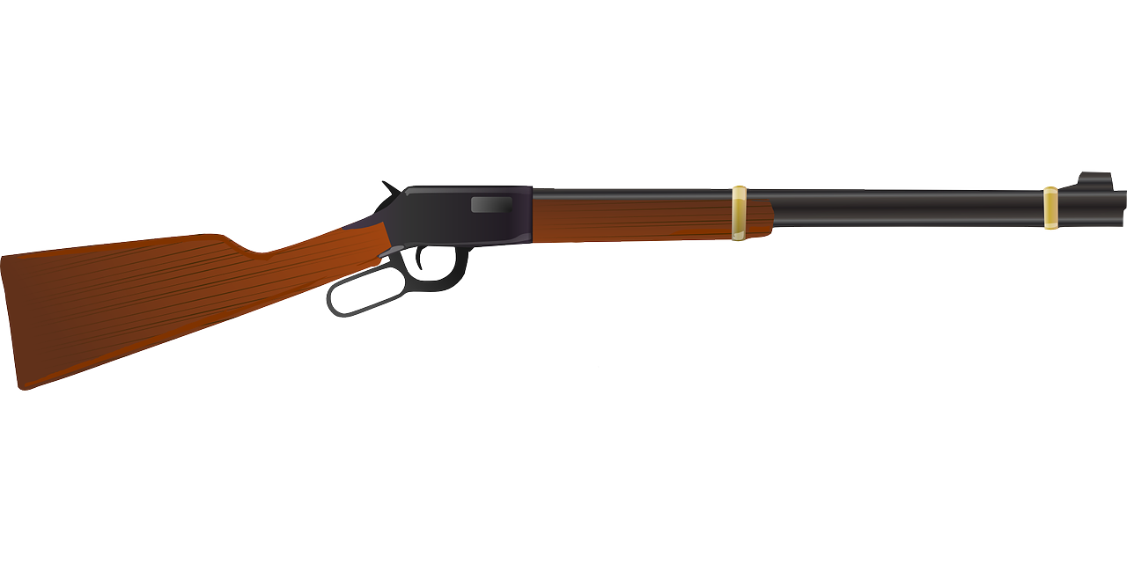
Polmatier v. Russ
Facts
Issue
Act
Definition of intent
Holding

Slide 4
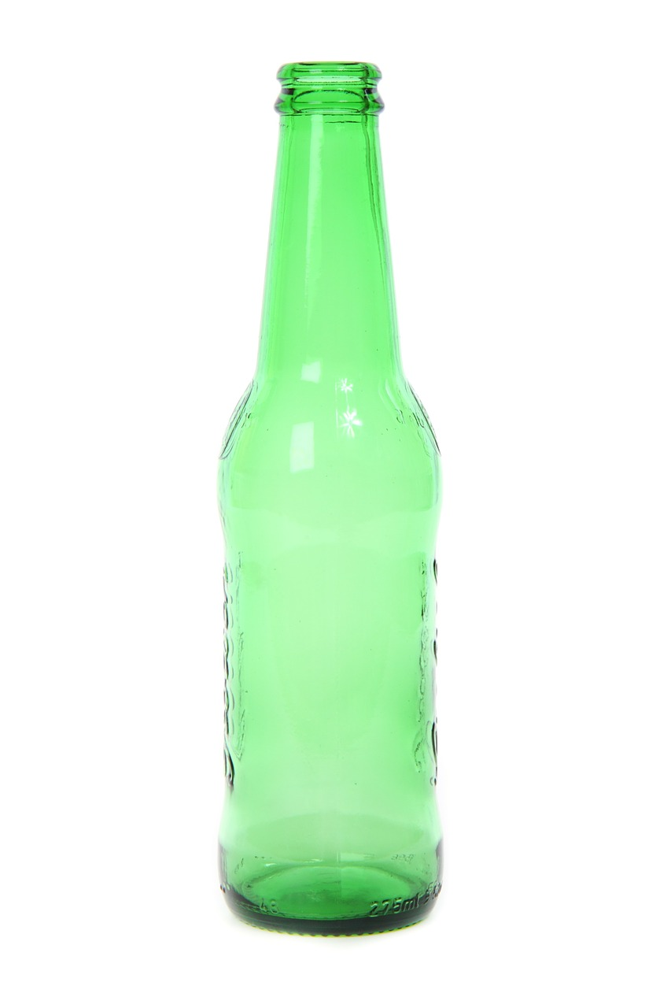
Act with Intent
Problem 2.1
Bobby loosens his shoulder by swinging his arm.
Misses Carly, but hits Alice.
Can Alice establish that Bobby acted with intent to cause a contact?
Problem 2.2
Did Dennis act with the intent to cause a contact with respect to Alan?

Slide 5
Intent to Cause Harmful or Offensive Contact

Slide 6
White v. Muniz
Facts
Issue
Single intent vs. Dual intent
Holding

Slide 7
Such Contact Results

Slide 8
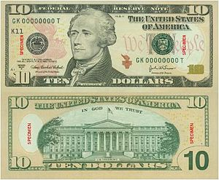
Such Contact Results
Causation
Contact
Harmful or offensive contact
Reynolds v. MacFarlane
Facts
Issue
Holding

Slide 9
Problem 2.3
Edward thrusts his placard about an inch from Edward’s face.
The breeze from the sign blew back Edward’s hair a little bit.
Could Edward establish the contact requirement?

Slide 10
The set of 486 PowerPoint slides is available upon adoption. If you are a professor using this book for a class, please contact Rachael Meier at remeier@cap-press.com to request your slides.

