Slide 1
State power
Applications of state power (control contagious diseases & civil commitment)

Slide 2
Review: What is Law?
A system of principles and rules devised by organized society
for the purpose of ordering human conduct by defining and enforcing rights and duties.
Public policies become laws that government can enforce.
Private policies are rules of private organizations, not law, which may complement public policy (or not).

Slide 3
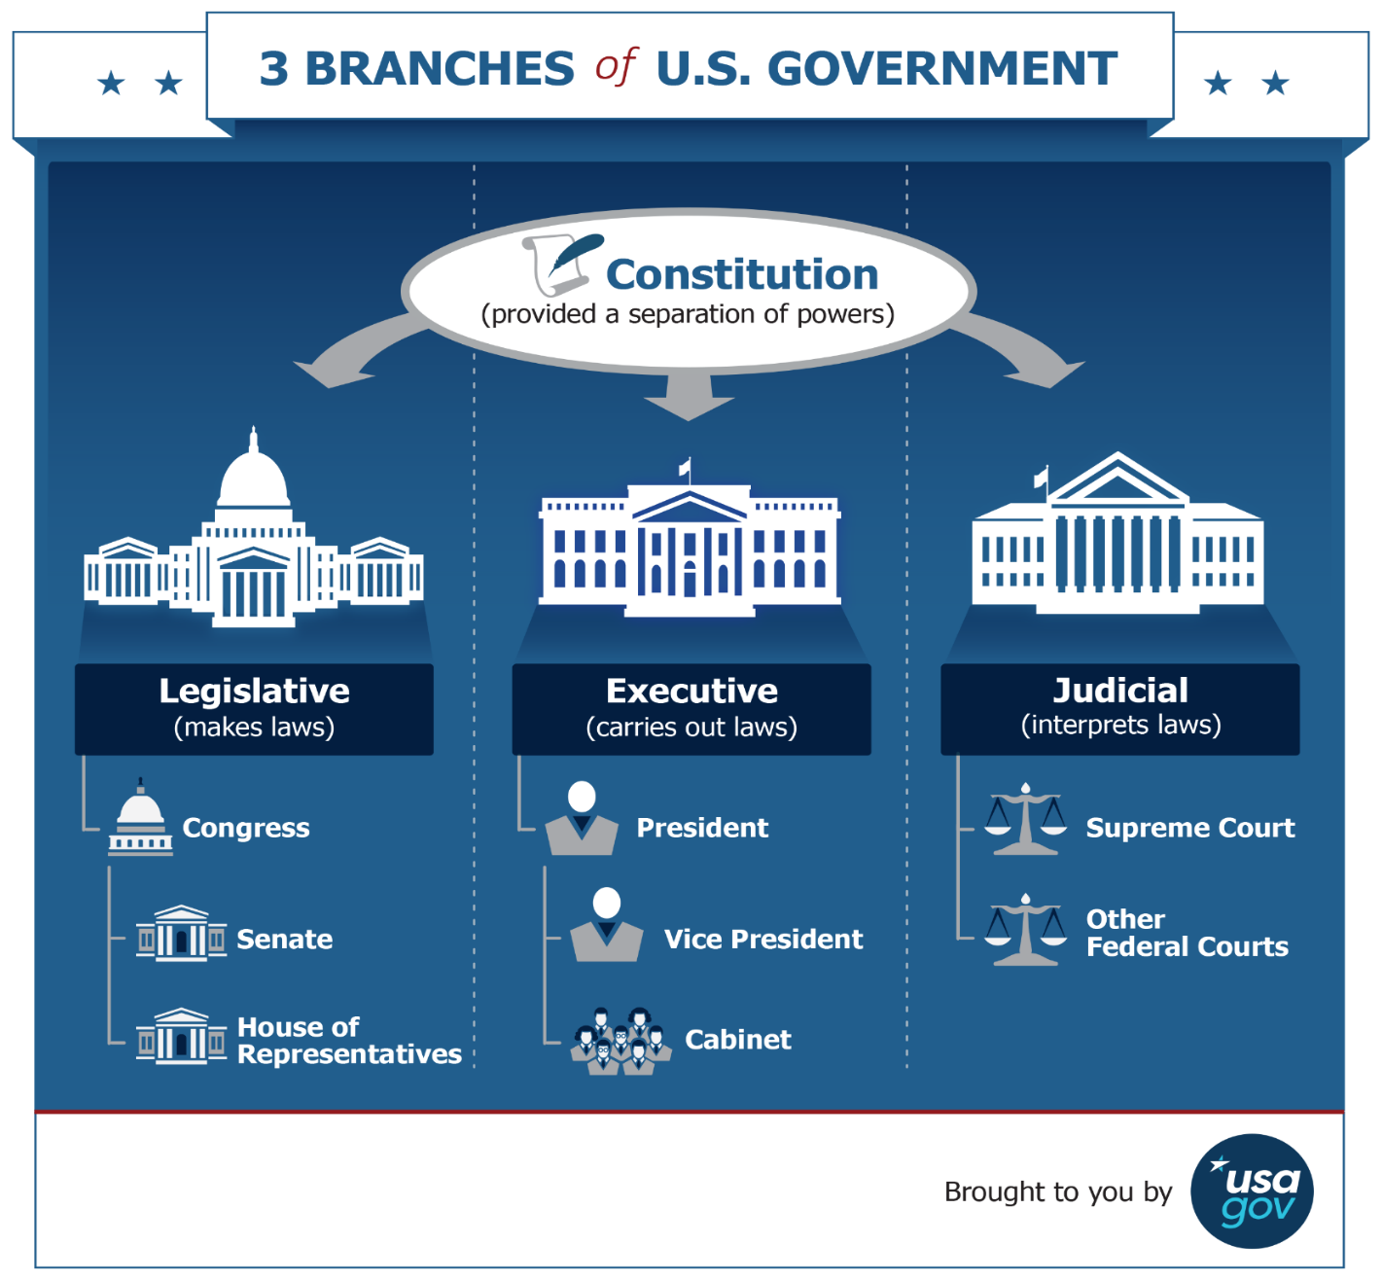
Review
Federalism
STATES

Slide 4
AMERICAN HEALTH “SYSTEM”
Individual Medical Care
(preventive, curative, palliative)
Population Health
(behavior, public initiatives/policies)
Social Determinants of Health
(income, housing, environment, food)
Patient
Provider
Finance
Government – federal/state
(Medicare, Medicaid, TriCare, VA)
Private Insurance
(employer, small group, nongroup)
Out of pocket
(self-pay, insurance co-pay, deductibles, premiums)
Professionals
(physician, nurse, physician assistant, counselor)
Institutions
(hospital, nursing facility, clinic, lab)
Suppliers
(pharma, device manufacturers)
Education
Research

Slide 5
Simon v. Sargent
1. What type of court is deciding this case?
2. Who is the plaintiff in this case?
3. Who is the defendant?
4. What does the plaintiff want the court to do?
5. What is the plaintiff’s argument that he is entitled to what he wants?
6. Who wins? What does the court decide?
7. What is (are) the legal principle(s) that the court relies on to make its decision? (This is the “holding” of the case.)

Slide 6
Police Power
authority states retain within their borders
US Supreme Court repeatedly has held that Congress/federal government does not have police power
states exercise police power by enacting legislation (may include giving authority to counties, towns, localities)
courts generally defer to legislative judgment regarding reasonable means to a legitimate end
as long as the state action does not violate constitutional rights

Slide 7
Police Power contd
police power is generally limited to protecting other people
parens patriae power = state power to protect individuals who are not capable of protecting themselves from harm

Slide 8
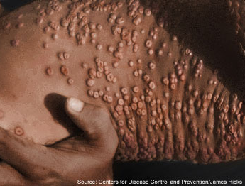

Slide 9
Jacobson v. Massachusetts State Law at Issue
c. 75, sec. 137: “the board of health of a city or town, if in its opinion, it is necessary for the public health or safety shall require and enforce vaccination and revaccination of all the inhabitants thereof and shall provide them with the means of free vaccination. Whoever, being over twenty-one years of age and not under guardianship, refuses or neglects to comply with such requirement shall forfeit five dollars.”
c. 75, sec. 139 exempts children unfit for vaccination

Slide 10
The full set of 331 slides is available upon adoption. If you are a professor using this book for a class, please contact Rachael Meier at remeier@cap-press.com to request your slides.

