Slide 1
Environmental Criminology and Crime Science
Basics of environmental criminology:
Temptation and opportunity are central to explaining crime
Focus on criminal acts rather than criminal disposition
Regardless of the dispositional factors that may drive individuals, situational elements still need to be conducive in order for crime to occur
All crimes require an opportune situation

Slide 2
Environmental Criminology and Crime Science
Theoretical foundation of environmental criminology:
Routine activity approach
Geometric theory of crime
Rational choice perspective
Crime pattern theory

Slide 3
Criminology, Criminal Justice, and Crime Science
Routine activity approach:
Criminal opportunities arise through the everyday movement and routines of individuals
Crime occurs through the intersection in time and space of suitable targets and motivated offenders in the the absence of capable guardians

Slide 4
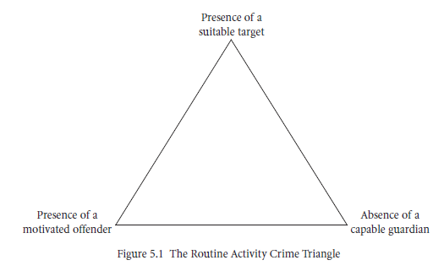
Criminology, Criminal Justice, and Crime Science
Routine activity approach:

Slide 5
Criminology, Criminal Justice, and Crime Science
Group exercise:
Discuss the implications of Moreto and Lemieux’s (2015b) study on ranger perspectives on poaching on the crime triangle and understanding the activities of offenders, targets, and guardians.
Can you think of other crimes that may be relevant to this alteration?

Slide 6
Criminology, Criminal Justice, and Crime Science
Geometric theory of crime
All crime will occur at some place and at a specific time
In other words, all crime will have a spatial and temporal component
Many criminal activities can be viewed as a byproduct of normal, non-criminal activities
Activity nodes, pathways, and the development of:
Activity spaces
Awareness spaces

Slide 7
Criminology, Criminal Justice, and Crime Science
Rational choice perspective
All crime will occur at some place and at a specific time
In other words, all crime will have a spatial and temporal component
Many criminal activities can be viewed as a byproduct of normal, non-criminal activities
Activity nodes, pathways, and the development of:
Activity spaces
Awareness spaces

Slide 8
Criminology, Criminal Justice, and Crime Science
Rational choice perspective
Heuristic device to assess offender decision-making as it pertains to a bounded cost-benefits assessment
Facilitates a crime specific approach due to the scripted nature of activities and the available choice-structuring properties
Attempts to explain why specific locations, times, and targets are most suitable for offenders

Slide 9
Criminology, Criminal Justice, and Crime Science
Crime pattern theory
Meta-theory
Highlights process of crime commission, crime templates, offender willingness, and the interaction of these factors within an environmental backcloth
Triggering incident leads to actual decision to offend

Slide 10
Criminology, Criminal Justice, and Crime Science
Another consideration that is relevant to environmental criminology, particularly within the scope of prevention, is the precipitating nature of situations
Situational precipitators: situations can foster criminal activity by prompting, pressuring, permitting, and provoking individuals

Slide 11
Criminology, Criminal Justice, and Crime Science
Crime science: outcome-focused discipline; prevention, identification, and apprehension
Multi-disciplinary in nature and incorporates the use of scientific methodology
Applied science

Slide 12
The full set of 137 slides is available upon adoption of this book. If you are a professor using Wildlife Crimes for a class, please contact Beth at bhall@cap-press.com to request your slides.

