Slide 1
Chapter 1
What Is a Contract?

Slide 2
After completing Chapter 1, you will be able to:
Identify the sources of contract law and discuss how they reflect contract policy.
Define a contract (R2d 1) and promise (R2d 3) and explain when a promise becomes legally binding.
Distinguish a contract for services from a contract for goods and recognize which raise a common law issue or a U.C.C. Article 2 contract issue.
Differentiate between agreements (R2d 3), bargains (R2d 3), and contracts (R2d 1) and discuss why these differences exist.
Analyze whether a person’s words or actions constitute the manifestation of a promise.

Slide 3

Definitions
§ 1 Contract Defined
§ 2 Promise; Promisor; Promisee; Beneficiary
§ 3 Agreement Defined; Bargain Defined
§ 4 How a Promise May Be Made
Notes:
Our first lesson is on the meaning of terms…

Slide 4

§ 1 Contract Defined
A contract is a promise or a set of promises for the breach of which the law gives a remedy, or the performance of which the law in some way recognizes as a duty.

Slide 5
§ 1 Comments
a. Other meanings.
b. Act and resulting legal relations.
c. Set of promises.
d. Operative acts other than promise.
e. Remedies.
f. Varieties of contracts.
g. “Binding promise.”

Slide 6
§ 1 Contract Defined, e. Remedies – Illustration 1
A orally agrees to sell land to B; B orally agrees to buy the land and pays $1000 to A.
The agreement is unenforceable under the Statute of Frauds.
B’s right to restitution of the $1000, however, is governed by the same rules as if the agreement were enforceable.
B has a right to recover the $1000 paid if A refuses to convey the land, but not if A is ready and willing to convey.
By virtue of this indirect recognition of the duty to convey, the agreement is a contract.

Slide 7
§ 1 Contract Defined –
Illustration A
On Monday, A offers to mow B’s front lawn for $20.
On Tuesday, A offers to mow B’s back lawn for $20.
On Wednesday, B accepts both offers.
A and B have formed one contract whereby A made a set of two promises: (1) mow B’s front lawn, and (2) mow B’s back lawn.
If the promises were not related in subject matter, however, they might not be considered and enforced together by a court.

Slide 8
§ 1 Contract Defined –
Illustration B
On Monday, A offers to mow B’s front lawn for $20.
On Tuesday, A offers to drive B to the airport for $20.
On Wednesday, B accepts both offers.
A and B have formed two separate contracts.
These promises are not sufficiently related in subject matter for a court to consider and enforce them together by a court.

Slide 9
§ 2 Promise; Promisor; Promisee; Beneficiary
(1) [Promise]
(2) [Promisor]
(3) [Promisee]
(4) [Beneficiary]

Slide 10

§ 2(1) Promise
A promise is a manifestation of intention to act or refrain from acting in a specified way, so made as to justify a promisee in understanding that a commitment has been made.

Slide 11

§ 2(2) Promisor
The person manifesting the intention is the promisor.

Slide 12

§ 2(3) Promisee
The person to whom the manifestation is addressed is the promisee.

Slide 13

§ 2(4) Beneficiary
Where performance will benefit a person other than the promisee, that person is a beneficiary.

Slide 14
§ 2 Promise; Promisor; Promisee; Beneficiary
a. Acts and resulting relations.
b. Manifestation of intention.
c. Promise of action by third person; guaranty.
d. Promise of event beyond human control; warranty.
e. Illusory promises; mere statements of intention.
f. Opinions and predictions.
g. Promisee and beneficiary.

Slide 15
§ 2 Promise, d. Words of warranty – Illustration 1
A, the builder of a house, or the inventor of the material used in part of its construction, says to B, the owner of the house, “I warrant that this house will never burn down.”
This includes a promise to pay for harm if the house should burn down.

Slide 16
§ 2 Promise, d. Words of warranty – Illustration 2
A, by a charter-party, undertakes that the “good ship Dove,” having sailed from Marseilles a week ago for New York, shall take on a cargo for B on her arrival in New York.
The statement of the quality of the ship and the statement of her time of sailing from Marseilles include promises to pay for harm if the statement is untrue.

Slide 17
§ 2 Promise, e. Illusory promise – Illustration 3
This is a promise, even though it is wholly optional with A to go into business or not.
A says to B, “I will employ you for a year at a salary of $5,000 if I go into business.”

Slide 18
§ 2 Promise, f. Opinions and prediction – Illustration 4
A, on seeing a house of thoroughly fireproof construction, says to B, the owner, “This house will never burn down.”
This is not a promise but merely an opinion or prediction.
Notes:
If A had been paid for his opinion as an expert, there might be an implied promise that he would employ reasonable care and skill in forming and giving his opinion.

Slide 19

§ 3 Agreement Defined;
Bargain Defined
An agreement is a manifestation of mutual assent on the part of two or more persons.
A bargain is an agreement to exchange promises or to exchange a promise for a performance or to exchange performances.

Slide 20
§ 3 Agreement Defined;
Bargain Defined
a. Agreement distinguished from bargain.
b. Manifestation of assent.
c. Bargain distinguished from agreement.
d. Offer.
e. Contract distinguished from bargain.

Slide 21

§ 4 How a Promise May Be Made
A promise may be stated in words either oral or written, or may be inferred wholly or partly from conduct.

Slide 22
§ 4 How a Promise May Be Made
a. Express and implied contracts
b. Quasi-contracts.

Slide 23
§ 4 How a Promise May Be Made, a. Express and implied contracts – Illustration 1
A telephones to his grocer, “Send me a ten-pound bag of flour.” The grocer sends it.
A has thereby promised to pay the grocer's current price.

Slide 24
§ 4 How a Promise May Be Made, a. Express and implied contracts – Illustration 2
A, on passing a market, where he has an account, sees a box of apples marked “25 cts. each.” A picks up an apple, holds it up so that a clerk of the establishment sees the act. The clerk nods, and A passes on.
A has promised to pay twenty-five cents for the apple.

Slide 25
§ 4 How a Promise May Be Made, b. Quasi-contracts – Illustration 3
A's wife, B, separates from A for justifiable cause, and, in order to secure necessary clothing and supplies, buys them from C and charges their cost to A.
A is bound to pay for them, though he has directed C not to furnish his wife with such supplies; but A's duty is quasi-contractual, not contractual.
See Restatement of Restitution § 113

Slide 26
Chapter 1. Meaning of Terms – Discussion
Who are 𝛑 and 𝚫?
Why are 𝛑 and 𝚫 litigating this case?
What do 𝛑 and 𝚫 want the court to do?
What is the case in the civil procedure?
How does a law court resolve this issue?

Slide 27

Steinberg v.
Chicago Med. Sch.

Slide 28
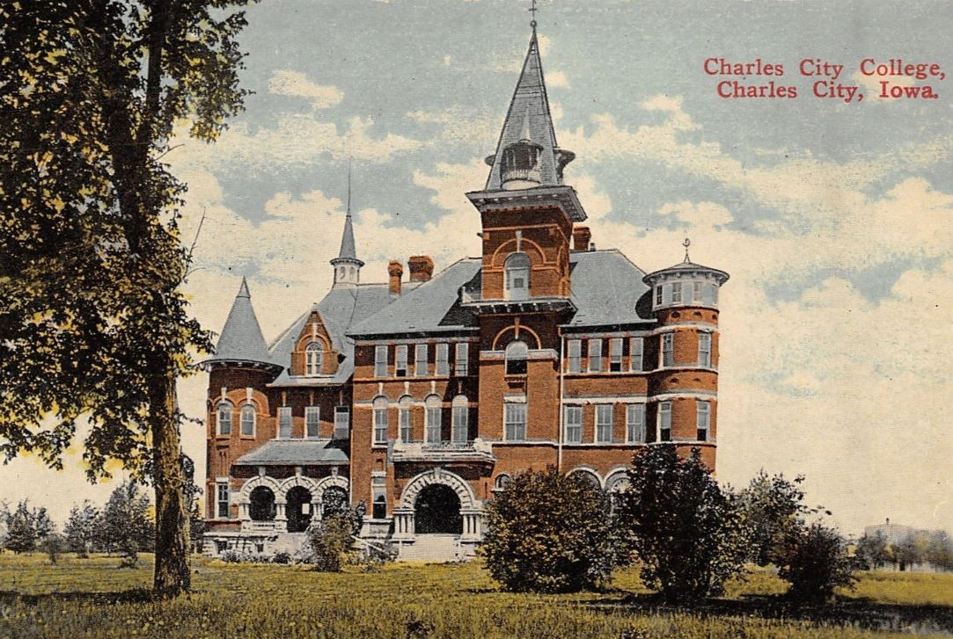
Pappas v. Bever

Slide 29
Please email proof of adoption to kerri.hughes@cap-press.com to request the full slide deck

