Slide 1
Border Security
Chapter 1
James Phelps, Ph.D.
Jeff Dailey, Ph.D.
Monica Koenigsberg, Ph.D.

Slide 2
Key Terms and Concepts
Through this chapter students should be looking for subjects that better explain the following concepts:
  Accretion
  Cession
  Conquest
  Barriers
  Boundaries
  Borders
  Berlin Wall
  Dispute Resolution
  Harmonized Tariff Schedule
  USITC

Slide 3
Introduction
Border Security = National Security
Border integrity is an imperative component of national policy.
Each administration views and applies their own interpretation of when border integrity is established.
Notes:
Border Security is a clear component of National Security. While policy may vary with each administration, the overall importance of border integrity, no matter where a port of entry may be, is an imperative component of national policy. How well border integrity and security is carried out directly affects all citizens, legal residents, and those who want to profit from violating internationally accepted rules on national sovereignty.

Slide 4
Chapter 1 Outline
Definitions
  Geographical
  Political
  Maritime
  Economic
Boundary and Border Dispute Resolution
Barriers
We open with a classic border event, from establishment to dissolution.
Notes:
To understand what a border is there is a necessity to establish several basic definitions. We could easily say that a border is a line drawn on a map. Or a wall is a barrier and boundaries are restrictions placed on people to establish norms for a society to abide by. Unfortunately, such definitions are simplistic and fail to demonstrate the reality of what borders, boundaries, and barriers really are.
We begin this exploration of border security with a story about how two diametrically opposed political ideologies converted their cooperation during wartime into a 50-year political conflict that tore apart a continent, and in particular the country of Germany.

Slide 5
Dividing East and West
World War II has ended
Nazi Germany and Italy are occupied by the allied forces (U.S., Free French, U.K., Polish, USSR, Canadians, etc.)
Western allies are all democracies/republics.
Eastern allies are all socialist/communist.
Let’s split a country and run each side differently
Notes:
From 1940 to 1944 Nazi Germany and Italy occupied and controlled nearly the entire European mainland. To counter this occupation, the military forces of Great Britain, the United States, the free French, the free Polish, and the Union of Soviet Socialist Republics (aka Soviet Union) among others, allied with each other to conduct a combined assault on German and Italian military forces from three different directions. These unlikely allies came from entirely different political ideologies—the western countries being democracies or republics while the Soviet Union was a socialist dictatorship.

Slide 6
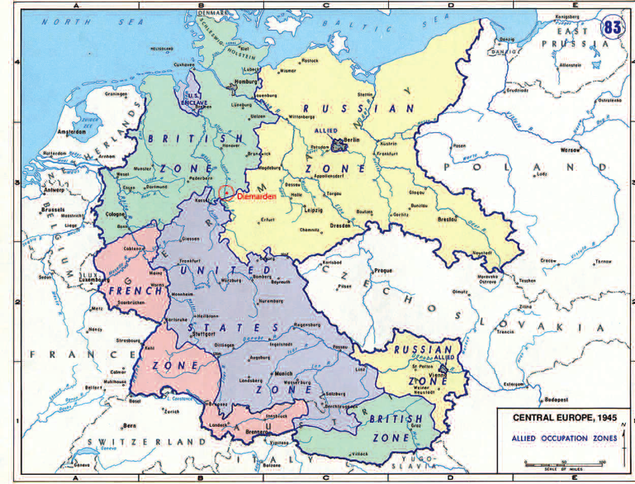
Notes:
Occupation of Germany, 1945. University of Texas.
At the end of the Second World War the allied forces divided the occupation of Germany along pre-determined lines. The selection of these boundaries was made years before Germany was invaded and in several instances, military forces from the U.S. and Britain had to vacate conquered territory so that the Soviet Army could take over per the prior agreements. Between the Soviet, U.S., and U.K. forces existed formal boundaries that each was supposed to maintain. However, that was not the reality driven by political necessity at the war’s end.

Slide 7
Iron Curtains
The goal of the Berlin wall (and the fence between East and West Germany) was not to keep people out, but to keep people in.
East Germany became a prison on the scale of a nation.
Boundaries between occupation forces became barriers to human and commercial traffic.
This morphed into a formal border between two, politically and economically divergent countries.
Notes:
As political tensions between the former allies rose, an Iron Curtain fell across Europe—resulting in the division of Germany into two occupied countries, West and East. Even the capitol city of Berlin was divided. As the people who had remained in the East began to realize the draconian domination being imposed by the Soviets, and the complete lack of freedom they were being subjected to, another exodus began. This time the Soviets attempted to prevent people from leaving—building a barrier across Berlin and eventually through the entire country.

Slide 8
Walls and Fences Rise
The fence between East and West Germany (and East and West Berlin) became a physical barrier, protected with minefields, wire fence that could only be cut with a torch, guard towers, lights, and armed forces with orders to shoot to kill people trying to “leave” rather than potential invading forces.

Slide 9
Walls and Fences Fall
November 1989
Recognizing they could no longer stop people from leaving East Germany and going to the west via Czechoslovakia, the gates in Berlin were opened for free travel to the west.
Within hours the gates were removed along with the barricades.
People climbed the wall and started destructively removing it.
Notes:
The barrier known as the “Berlin Wall” finally came down in November 1989. But the effect of bringing the peoples of East and West together, along with the dissolution of the border and ultimate reunification of the two countries into a single Federal Republic of Germany (Bundesrepublik Deutschland) has not been without difficulties.

Slide 10
A Day Later
East German government is without legitimacy
People start raiding government buildings
The police system collapses
The military forces withdraw from the wall/fence
The Soviet military forces are confined to their bases

Slide 11
The full set of PowerPoint slides is available upon adoption.
Email bhall@cap-press.com for more information.

