Slide 1
Border Security, 2nd ed. Chapter 2
James Phelps, Ph.D.
Jeff Dailey, Ph.D.
Monica Koenigsberg, Ph.D.

Slide 2
Key Terms and Concepts
Through this chapter students should be looking for subjects that better explain the following concepts:
Hadrian’s Wall
Great Wall of China
Maginot Line
Siegfried Line
Iron Curtain
Korean Demilitarized Zone

Slide 3
Introduction
Livestock enclosures exist as early barriers, & symbolic borders, providing some protection for people and property from robbers and thieves.
This grew into a system of providing a means of identifying and defending the boundaries of communities, such as villages and small cities, usually through the building of fortifications.
Notes:
Early peoples living in caves likely symbolized their early living and sleeping quarters with stone markers or a few, strategically placed, possessions.
Conceivably, livestock enclosures for domesticated stock may mark the inception of property needing care and protection from predators.
Providing shelter for families and their domestic animals, these delineations separate groups from each other and provide a sense of security in vulnerable times

Slide 4
Over time this expanded to include markings delineating the boundaries of empires.
When the age of great empires came to an end, the rise of independent city-states drove a return to a simpler time of using natural barriers as city boundaries and erecting walls where nature failed to provide a border.
With the entry of civilizations into an era of national identity, once again, the establishment of borders to define the territory claimed by one particular group in relation to other groups became a necessity, even when those borders were indefensible.

Slide 5
Today we’ve reached a point where borders are essentially lines drawn on maps rather than walls erected for national security – at least in most cases.

Slide 6
The Ancient World
Developing Fortifications
The Walled City
Imperial Walls
Destroying Walls
Back to Natural Barriers

Slide 7
Developing Fortifications
Nature usually plays a key role in shaping the appearance and definition of borders.
It is up to the ingenuity of humans to draw on the natural resources around their territory in the construct of borders, and therefore the development of appropriate fortifications.
This starts first by defending the home.
Next, one defends their community.
Third, nations and empires defend their territorial boundaries.
Notes:
Fortifications play a role as active instruments of policy.
A fortress or walled city had two chief advantages: it allowed a small force to resist a larger opposing force, as least long enough to enable a more effective and substantial resistance, and, secondly, it allowed for poorly-trained forces to hold out against a better trained enemy.
The basic principle of fortification is to put a barrier between defender and attacker.
The number of obstacles and the sophistication of their arrangement may vary, and evolve over time

Slide 8
Hill forts can be found across Europe from the Atlantic to the Urals, in Afghanistan, in the Deccan, throughout North America and in New Zealand.
The first improvement made by prehistoric builders of hill forts was to add obstacles for an attacker to have to overcome.
What may seem as simple earth ramparts are more complex than they appear on the surface.
Some contain a reinforcing core of stone, loosely piled on the ground and then covered with dirt from the ditch.
Others have traces of timber set in stone foundations against the revetment, essentially a reinforced stockade.
Others have palisading with walkways along the top for guards or defenders.
Notes:
While they are similar in detail the idea of digging a ditch around a hill and piling up the earth, perhaps with the addition of a wooden palisade, occurred independently to widely dispersed tribes. The subsequent refinements and additions associated with the development of walled cities or redoubts also sprang from equally random inspiration as sedentary tribes had to adapt to new threats.

Slide 9
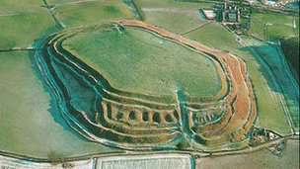
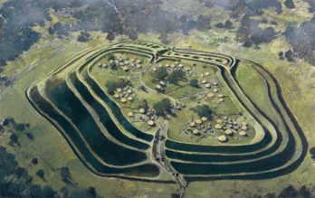
Notes:
Old Oswestry is a large Iron Age hillfort in Shropshire, England, near the border with Wales. The fort has been in the news lately for two reasons: because of plans to build houses within sight of the fort, and because a remarkable artifact was discovered near the fort's main entrance. The fort was constructed in the early Iron Age, perhaps around 600 BCE. At first it had a double earthwork, but not long before the Romans arrived two more ditches and banks were added. The interior has never been systematically excavated, but the characteristic marks left by Iron Age round houses are visible. (Reconstruction by Ivan Lapper for English Heritage.)

Slide 10
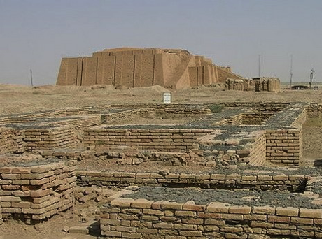
The Walled City
From very early history to modern times, walls have been a near necessity for every city.
The city of Ur is a good example.
Notes:
The idea of surrounding early cities with walls was widespread. Examples can be found in China, Korea, Japan, and across the Middle East. Early Rome was walled, and walls were maintained and expanded around the city as it expanded. Walled cities even existed in North, Central, and South America. Uruk in ancient Sumer (Mesopotamia) is one of the world's oldest known walled cities. Dating to the early second millennium, tales of the building of Uruk by the king Gilgamesh were consolidated sometime around the18th century BCE, making this the oldest narrative tale yet discovered. In the Epic of Gilgamesh, tablet 1, the king builds the wall of Uruk-Haven.
Uruk would later become the city of Ur and grow into the capital city of the Sumerian Empire in southern Mesopotamia. The remains of the original walls are still standing.

Slide 11
The full set of 701 slides is available upon adoption. If you are a professor using this book for a course, please contact Beth at bhall@cap-press.com to request your slides.

