Slide 1
Border Security 3rd ed. Chapter 1
James Phelps, Ph.D.
Jeff Dailey, Ph.D.
Monica Koenigsberg, Ph.D.

Slide 2
Key Terms and Concepts
Through this chapter students should be looking for subjects that better explain the following concepts:
Accretion
Cession
Conquest
Barriers
Boundaries
Borders
Berlin Wall
Dispute Resolution
Harmonized Tariff Schedule
USITC

Slide 3
Introduction
Border Security = National Security
Border integrity is an imperative component of national policy.
Each administration views and applies their own interpretation of when border integrity is established.
Notes:
Border Security is a clear component of National Security. While policy may vary with each administration, the overall importance of border integrity, no matter where a port of entry may be, is an imperative component of national policy. How well border integrity and security is carried out directly affects all citizens, legal residents, and those who want to profit from violating internationally accepted rules on national sovereignty.

Slide 4
Chapter 1 Outline
Definitions
Geographical
Political
Maritime
Economic
Boundary and Border Dispute Resolution
Barriers
We open with a classic border event, from establishment to dissolution.
Notes:
To understand what a border is there is a necessity to establish several basic definitions. We could easily say that a border is a line drawn on a map. Or a wall is a barrier and boundaries are restrictions placed on people to establish norms for a society to abide by. Unfortunately, such definitions are simplistic and fail to demonstrate the reality of what borders, boundaries, and barriers really are.
We begin this exploration of border security with a story about how two diametrically opposed political ideologies converted their cooperation during wartime into a 50 year political conflict that tore apart a continent, and in particular the country of Germany.

Slide 5
Dividing East and West
World War II has ended
Nazi Germany and Italy are occupied by the allied forces (U.S., Free French, U.K., Polish, USSR, Canadians, etc.)
Western allies are all democracies/republics.
Eastern allies are all socialist/communist.
Let’s split a country and run each side differently
Notes:
From 1940 to 1944 Nazi Germany and Italy occupied and controlled nearly the entire European mainland. To counter this occupation, the military forces of Great Britain, the United States, the free French, the free Polish, and the Union of Soviet Socialist Republics (aka Soviet Union) among others, allied with each other to conduct a combined assault on German and Italian military forces from three different directions. These unlikely allies came from entirely different political ideologies - the western countries being democracies or republics while the Soviet Union was a socialist dictatorship.

Slide 6
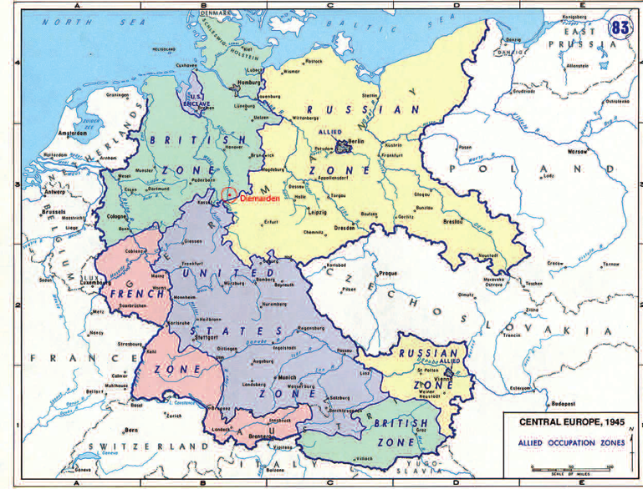
Notes:
Occupation of Germany, 1945. University of Texas.
At the end of the Second World War the allied forces divided the occupation of Germany along pre-determined lines. The selection of these boundaries was made years before Germany was invaded and in several instances, military forces from the U.S. and Britain had to vacate conquered territory so that the Soviet Army could take over per the prior agreements. Between the Soviet, U.S., and U.K. forces existed formal boundaries that each was supposed to maintain. However, that was not the reality driven by political necessity at the war’s end.

Slide 7
Iron Curtains
The goal of the Berlin wall (and the fence between East and West Germany) was not to keep people out, but to keep people in.
East Germany became a prison on the scale of a nation.
Boundaries between occupation forces became barriers to human and commercial traffic.
This morphed into a formal border between two, politically and economically divergent countries.
Notes:
As political tensions between the former allies rose, an Iron Curtain fell across Europe – resulting in the division of Germany into two occupied countries, West and East. Even the capitol city of Berlin was divided. As the people who had remained in the East began to realize the draconian domination being imposed by the Soviets, and the complete lack of freedom they were being subjected to, another exodus began. This time the Soviets attempted to prevent people from leaving – building a barrier across Berlin and eventually through the entire country.

Slide 8
Walls and Fences Rise
The fence between East and West Germany (and East and West Berlin) became a physical barrier, protected with minefields, wire fence that could only be cut with a torch, guard towers, lights, and armed forces with orders to shoot to kill people trying to “leave” rather than potential invading forces.

Slide 9
Walls and Fences Fall
November 1989
Recognizing they could no longer stop people from leaving East Germany and going to the west via Czechoslovakia, the gates in Berlin were opened for free travel to the west.
Within hours the gates were removed along with the barricades.
People climbed the wall and started destructively removing it.
Notes:
The barrier known as the “Berlin Wall” finally came down in November 1989. But the effect of bringing the peoples of East and West together, along with the dissolution of the border and ultimate reunification of the two countries into a single Federal Republic of Germany (Bundesrepublik Deutschland) has not been without difficulties.

Slide 10
A Day Later
East German government is without legitimacy
People start raiding government buildings
The police system collapses
The military forces withdraw from the wall/fence
The Soviet military forces are confined to their bases

Slide 11
Mauer im Kopf
Reunification does not eliminate prejudice
Eastern Germany still suffers from high levels of:
Corruption
Pollution
Environmental Destruction
Western Germany has a higher standard of living, better economy, and pays more in taxes
Notes:
To this day there is animosity and the perception of lower worth expressed towards those from the eastern portion of the country. Professional law enforcement officers who participated in the reunification process have reported, 20 years after the fact, that they see East Germany as lazy and uncivilized; essentially a Mauer im Kopf (Wall in the Head) still exists for about 10% of the country’s population.

Slide 12
45 Years of Separation
The separation between East and West Germany was a political and economic barrier that has left remnants of “otherness” in some people’s minds. A physical, political, and economic wall had separated people of the same ethnicity, language, and culture for nearly fifty years. Twenty years after that barrier came down, there are still political, social, and cultural repercussions.

Slide 13
Questions?
What lessons can you draw from the 20th-century wall between East and West Germany?
What other countries are separated by walls?
What problems can you expect to experience if those walls come down?

Slide 14
Important Definitions
Barrier: a material object that blocks or is intended to block passage. A natural formation or structure that prevents or hinders movement or action. Can also be manufactured structures intended to prevent passage such as solid walls, electric fences, and mine fields.
Boundary: anything that indicates or fixes a limit or extent. Can be political, economic, legal, physical, or mental.
Border: an outer part or edge, perimeter, periphery, or rim. Commonly used to delineate national and political boundaries.
Notes:
There are significant differences between barriers, boundaries, and borders. Each has separate and unique functions while all are common components of the modern political and economic lines that separate countries, states, and counties. Natural barriers and boundaries make some of the best borders because of the inherent difficulties in crossing them. Geography provides the best examples of natural barriers and therefore natural borders.

Slide 15
Natural Geographic Barriers
Mountains
Oceans
Rivers
Lakes
Straights
Deserts
Notes:
Ask students for examples of each and what countries they divide.

Slide 16
Mountains
Large mountain ranges make effective barriers, boundaries, and borders
Key mountain ranges:
Himalayas
Pyrenees
Andes
Carpathian
Caucasus
Notes:
Large mountain ranges make effective barriers, boundaries, and borders between peoples, philosophies, and economies.

Slide 17
Himalayas
Runs west to east
1,500-mile-long (2,500-km) rock wall Varies in width from 250 miles (400 km) in the west to 93 miles (150 km) in the east
A physical barrier separating China from Pakistan, India, Nepal, and Bhutan among others
Create their own weather systems
The rivers that originate in the Himalaya drainage basin provide water to half the world’s population across 18 countries
Notes:
Running west to east, this 1,500-mile-long (2,500-km) rock wall varies in width from 250 miles (400 km) in the west to 93 miles (150 km) in the east. Originating when the Indian tectonic plate (moving northwest) impacted the Eurasian continent about 40-50 million years ago, the Himalayan system acts as a physical barrier separating China from Pakistan, India, Nepal, and Bhutan among others. The mountains are so massive that they create their own weather systems and the rivers that originate in the Himalaya drainage basin provide water to half the world’s population across 18 countries.

Slide 18
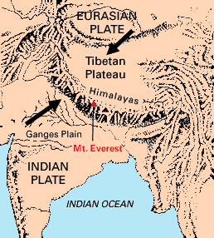
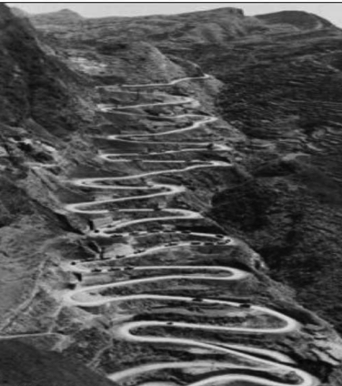
The Ledo or Burma Road
Notes:
As recently as the Second World War, the Himalayas were crossed for military purposes. The Chinese built the 717-mile (1,154-km) “Burma Road” across the eastern edge of the Himalayan range to ship British supplies into China in an effort to stop and then push back the Japanese invaders.
After Japan declared war on Britain in December 1941, they overran Burma in 1942, forcing the British back into India and cutting off all military supplies to the Chinese. This led to the construction of the Ledo Road connecting to the old Burma Road in Wandingzhen, Yunnan, China. This route reopened the supply line to the Chinese military with the first trucks reaching China on January 28, 1945. It is no longer in use and has since been transformed to ruins by time, neglect, and weather.
Today there are nearly no land crossings over the Himalayas and few air routes that cross them.

Slide 19
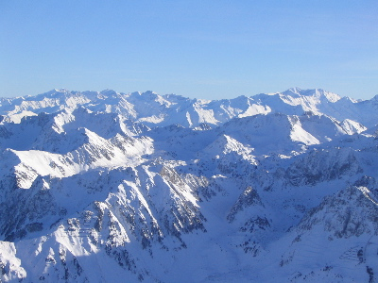
Pyrenees
Notes:
The Pyrenees Mountains are a natural barrier between France and Spain and have long established the Iberian Peninsula as a separate political and economic entity.

Slide 20
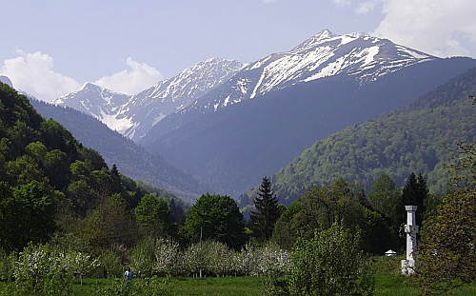
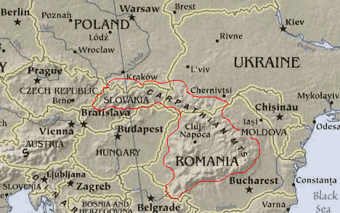
Carpathian
Notes:
The Carpathian Mountains have, until recently, served as a barrier to invasion into traditionally Slavic lands by northern Europeans and Asians.

Slide 21
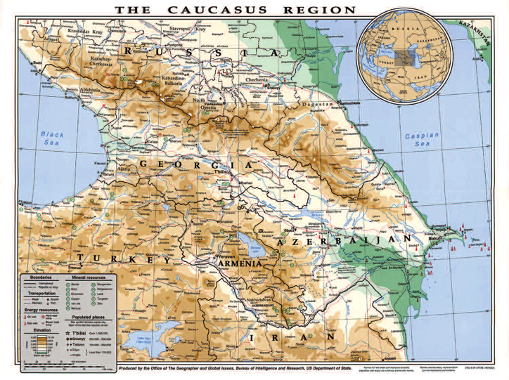
Caucasus
Notes:
The Caucasus Mountains provide a natural barrier between Georgia and Azerbaijan and Russia and have long been a source of acrimonious dispute between the nations and peoples that inhabit the region. These mountains are a natural barrier and therefore a natural border running from the Black Sea to the Caspian Sea. Within the country of Azerbaijan is the community of Khinalug, the oldest continuously inhabited village in the world with a history stretching back over 5,000 years. The high altitude and remoteness of Khinalug have protected it during the innumerable wars across the region over the past 3,000 years.

Slide 22
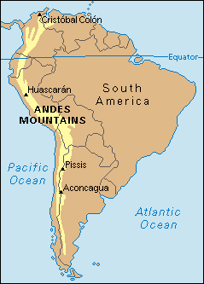
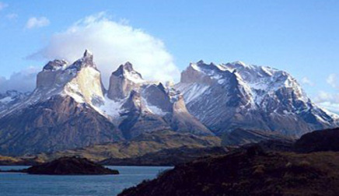
Andes
Notes:
The Andes are the world’s longest continual mountain range, running 4,300 miles (7,000 km) north to south along the west coast of South America. Unlike the Himalayas, the Andes are volcanic in origin. This has resulted in the deposition of large amounts of valuable mineral ores along the length of the range including gold, silver, and copper. These nearly impenetrable mountains form a natural physical barrier, and therefore a natural border between the Pacific and Atlantic countries of South America. Chile, Peru, Ecuador, and Colombia all lay along the western slopes while Argentina, Bolivia, Brazil, and Venezuela lie along the eastern slopes. The Amazon River, the second largest in the world, has its origins in the Andes.

Slide 23
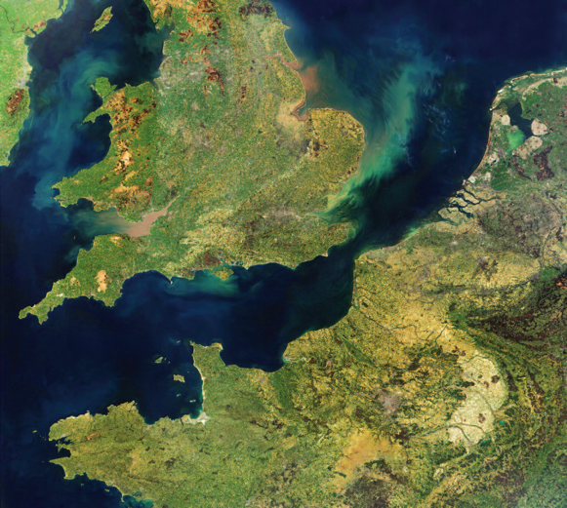
Oceans, Rivers, & Straits
Notes:
Until about 500 years ago, the large oceans were natural barriers to the movement of humans and commercial goods.
Rivers serve as both means of transportation and barriers to travel.
Straits are small portions of oceans acting as narrow barriers between countries.
Above is an image from space of the English Channel. This 350-mile-long (560-km) body of water has acted throughout history as both barrier and challenge to all manner of peoples. It varies from 150 miles (240 km) wide in the west to a mere 21 miles (34 km) wide at the Strait of Dover. The English Channel is a fickle barrier when it comes to invading forces. It was not a major obstacle to the Roman, Norman, Saxon and Dutch invasions of Britain, yet prevented the Spanish Armada, Napoleon, and Nazi Germany from doing the same. It has not proved an obstacle to the British invading the European mainland on many occasions.

Slide 24
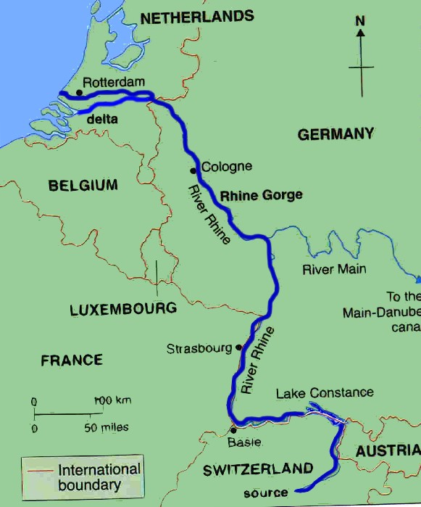
Rhine River
Notes:
The Rhine River originates in the Swiss Alps and flows north, bisecting Europe.
This major river has long been a barrier to east and west movement.
This 766-mile (1,233 km) river was the boundary of the Roman Empire.

Slide 25
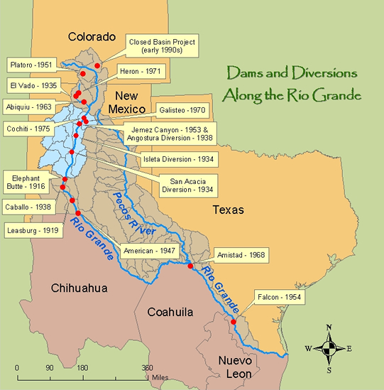
Rio Grande

Slide 26
Rio Grande
The Rio Grande is the twenty-second longest river in the world and the fourth or fifth longest in North America.
It drains more than 40,000 square miles in Texas alone.
The river flows for 175 miles in Colorado and 470 miles in New Mexico.
The official border measurement ranges from 889 to 1,248 miles, depending on how the river is measured.
It dwindles to nearly nothing at Presidio, and only water from the Río Conchos, coming out of Mexico, sustains its journey to the Gulf.

Slide 27
Establishes more of half the international border between the United States and Mexico.
The major water supply for numerous cities and thousands of square miles of agricultural land.
Less than one-fifth of the river’s water actually reaches the Gulf of Mexico.
In some areas water levels have been reduced so low that the river is nearly dry and can be easily crossed by foot, or vehicle.

Slide 28
Other Bodies of Water as Boundaries
The Great Lakes and St. Lawrence River comprise a large portion of the international border between the U.S. and Canada.
Straits narrow both ends of the Mediterranean Sea, the Gibraltar in the west, between Spain (Europe) and Morocco (Africa), and the Bosporus in the east, separating Europe and Asia.
Both straits acts as barriers between continents and natural choke points by which commerce can be restricted or limited in time of war.
The 99-mile (169 km) wide Taiwan Strait separates the Republic of China (Taiwan) from the People’s Republic of China (mainland China).

Slide 29
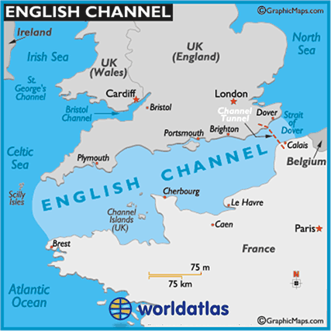
The English Channel acts as both barrier and border.
This 350-mile (560 km) long body of water has acted throughout history as both barrier and challenge to all manner of peoples.
It varies from 150 miles (240 km) wide in the west to a mere 21 miles (34 km) wide at the Strait of Dover.
The English Channel is a fickle barrier when it comes to invading forces.
Notes:
It was not a major obstacle to the Roman, Norman, Saxon and Dutch invasions of Britain
Yet prevented the Spanish Armada, Napoleon, and Nazi Germany from invading Britan.
It has not proved an obstacle to the British invading the European mainland on many occasions.

Slide 30
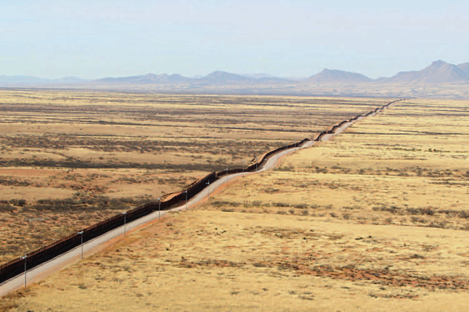
Deserts
Notes:
Arizona- Mexico Border Fence, Donna Burton/ CBP.gov.

Slide 31
What makes deserts natural barriers and good boundaries between nations is the amount of resources and specialized animals or transport equipment it takes to cross them.
Deserts are naturally dry averaging less than 10 inches (25 cm) rainfall per year.
There are few animals, humans included, who can survive long without access to water.
Those who control the limited water sources in a desert region, control the entire area.

Slide 32
Deserts are not simply dry.
They also experience temperature extremes that are detrimental to human life.
Hot deserts, like the Sahara and those in the U.S. southwest, can reach temperatures of 113 °F (45 °C) in the daytime and have daily temperature spans in excess of 25 °F (14 °C), and frequently drop below freezing at night during winter months.
This poses the need for a person crossing a desert region to take precautions against not only dehydration, but also heat stroke and heat exhaustion, while simultaneously carrying enough protection to keep from suffering hypothermia at night.

Slide 33
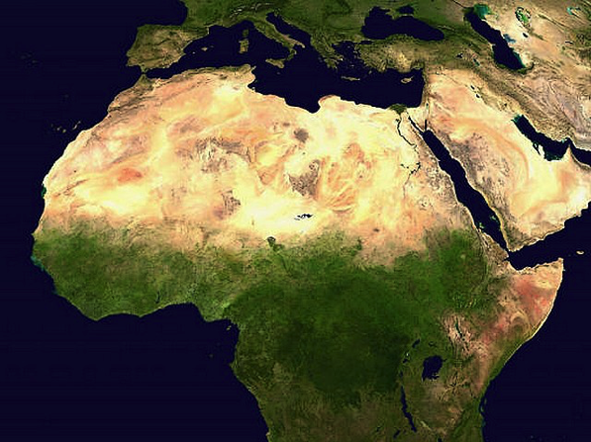
Sahara
Notes:
The Sahara literally divides the African continent.
Below this massive desert is equatorial (or sub-Saharan) Africa and above it is North (or Mediterranean) Africa.

Slide 34
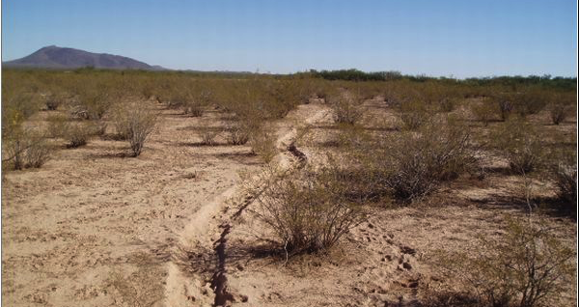
Sonoran
Notes:
North American desert regions act as important barriers, boundaries, or borders are essentially found across the entire southwest of the United States and northwest expanse of Mexico.
Across this region are found several major deserts stretching from Laredo, Texas, to San Diego, California, including the Sonoran and Chihuahuan

Slide 35
Natural Geography
Natural geography can make an excellent barrier, boundary, or border between human populations.
This is not without problems.
Rivers change their paths.
Movement of tectonic plates result in changes to mapped locations.
Deserts expand and contract with changes in climate.
And humans are ingenious creators of methods to turn disadvantage into advantage when it comes to their natural environment.

Slide 36
Political Geography
National borders are established in a variety of ways.
Countries begin with some sense by the people of commonality amongst themselves and uniqueness from others.
Frequently, that commonality stems from a combination of language and ethnicity.
Sometimes religion will play a part.
Over time, fixed, identifiable limits are placed on which group controls a given area politically.
Formal arrangements are usually concluded by treaty—a formal agreement between two or more states in reference to peace, alliance, commerce, or other international relations—usually formalized through some sort of signed document.
Notes:
We cannot simply establish any rules we want, erect any boundaries or barriers, or invoke any method that comes to mind when we address the issue of border security. Social systems are organized around a concept referred to as the “social contract.” The very idea that a “people” have come to an agreement to abide by certain rules and conventions implies that at some point those “people” came together and determined amongst themselves that such a social order was to their mutual benefit. As such, all power of government stems from the people themselves. This is a core component of the constitutional republic of the United States.
The history of the modern law of nations begins with the emergence of independent nation states from the ruins of the medieval Holy Roman Empire, which was based on the claims to universal authority of the Pope as the spiritual, and the Emperor as the temporal, head of the Christian nations of Europe. The idea of a central universal authority precluded the need for rules addressing diplomatic intercourse between sovereign states, principles of territorial sovereignty, jurisdiction, treaty-making, state responsibility, and other aspects of modern interstate relations.

Slide 37
dar al Islam and dar al Harb
Modern Islamic fundamentalist terrorism derives its origins from an era of Muslim conquest of neighboring peoples and the division of the world into two entities, those countries under Moslem rule (dar al Islam) and the rest of the world (dar al Harb).
As these universalist ideologies and approaches to international relations came into contact with their neighbors and each other, and their ascendancy was challenged, the need arose to deal with each other on a basis of equality and mutual respect for sovereignty.
Notes:
Similar conceptions of secular and spiritual empire are found in Chinese, Japanese, Thai, African, and Islamic empires.

Slide 38
Mainland European Borders
The dissolution of the Holy Roman Empire into separate, frequently rebellious states, made it necessary for the newly emerging independent states to develop a system of rules that could govern their mutual relations.
For the sources of these legal relations, they drew predominantly upon Roman law and canon law.
The professional clerks who ran the governments of the emerging states and city republics relied heavily upon Justinian’s Corpus Juris as their source for development of their legal codes.

Slide 39
Angle and Nordic Borders
England and the Scandinavian countries remained outside of this particular orientation towards Roman law, forming their own legal systems based on their particular histories and cultures.
It was during the post-Holy Roman Empire in Europe that two different forms of law developed,
civil law on the mainland and
common law in England.
Notes:
The dissolution of the Holy Roman Empire into separate, frequently rebellious states, coupled with the Reformation, made it necessary for the newly emerging independent states to develop a system of rules that could govern their mutual relations. For the sources of these legal relations, they drew predominantly upon Roman law and canon law.
It was during the post-Holy Roman Empire in Europe that two different forms of law developed, civil law on the mainland and common law in England.
The professional clerks who ran the governments of the emerging states and city republics relied heavily upon Justinian’s Corpus Juris as their source for development of their legal codes.
England and the Scandinavian countries remained outside of this particular orientation towards Roman law, forming their own legal systems based on their particular histories and cultures.
Intensification of international trade, the improvements in navigation and military techniques, and the discovery of many distance lands by the Europeans that stimulated further development of international practices and the emergence of modern conceptions of a law of nations.
Discovery and subjugation of distant lands and peoples by European conquerors, the rise in conflicting claims to territory, and the rights of passage on the seas, stimulated the development of new practices and principles.

Slide 40
Modern Border Law & Statehood*
Not yet even 100 years old.
A state is a “legal personality” or an “international legal person” in proper terms.
The Convention on Rights and Duties of States (1933) defines in Article 1, “The state as a person of international law should possess the following qualifications:
(a) a permanent population;
(b) a defined territory;
(c) government; and
(d) capacity to enter into relations with the other states.”
In Article 2, “The federal state shall constitute a sole person in the eyes of international law.”
Notes:
* It is important that the professor address the difference between a “state” that is a member of a national union, i.e., Texas is a state of the United States, and the term “State” as it applies to nations in international law.
The rise and evolution of the modern nation state from the late 18th century to the early 20th century corresponds with the absolute claims to legal and political supremacy, and the ascendance of effective international law, which has essentially been derived from the will of nations.
Modern international law and the codification of the territorial integrity and existing political independence of nation states is not yet even 100 years old.
With the establishment of the United Nations at the end of World War II came the modern era of international relations, from which we derive the current system of the law of nations. The world no longer operates from the perspective of mutual respect and abstention in the internal affairs of other nations, instead moving to the U.N. model of organized joint cooperation.
When does a “state” become a “state” is the subject of two different theories. One says that it is recognition of the “state” by other, already established and recognized states, which decides whether an entity is a state. The other theory looks to the establishment of facts that meet the criteria of statehood as laid down in recognized international law. Therefore, a state may exist without being recognized by other states. The primary function of international recognition is to declare that one country acknowledges the other state’s political existence and as such is willing to treat that entity as an international person, with the rights and obligations of States.

Slide 41
Expanding Territory of a State
There are many ways in which states can acquire more territory. They include:
Accretion
Cession
Conquest
Notes:
This is a good place for the professor to question students to provide examples of each.
Accretion. This is the expansion of a state’s territory by operation of nature, for example the gradual shifting of the course of a river, volcanism resulting in creation of new landmass, and rivers laying down silt in their drainage basins.
Cession. This involves the transfer of sovereignty by means of an agreement between the ceding and the acquiring states. It is a derivative mode of acquisition. The consent of the population of the ceded territory is not essential to the validity of the cession, and recently this process is seen occurring as a result of the will of the people through a plebiscite, such as the creation of Timor-Leste in South East Asia and the Republic of South Sudan in Africa.
Conquest. This comes when one country acquires the territory of another through the complete and final subjugation through military force and a declaration of the conquering state’s intention to annex it. This is actually rare as a treaty of cession generally carries out most annexation of territory after a war.

Slide 42
Interstate Water Boundaries
Borders between countries frequently span land, rivers, and lakes.
In the Restatement, Second, Foreign Relations Law of the United States (1965), these boundaries were defined in subsection 12 as:
(1) The boundary separating the land areas of two states is determined by acts of the states expressing their consent to its location.
(2) unless consent to a different rule has been expressed,
(a) when the boundary between two states is a navigable river, its location is the middle of the channel of navigation;
(b) when the boundary between two states is a non-navigable river or a lake, its location is the middle of the river or lake.”
Boundaries on oceans fall under a separate rule of law, the Law of the Sea.

Slide 43
United Nations Convention on the Law of the Sea
Establishes the territorial waters of a country as extending 12 miles from the low-tide water line of the country’s landmass, including any islands.
The contiguous zone is limited to 24 nautical miles from the low-tide water line (essentially doubling a country’s territorial waters) and a state may:
1. In a zone contiguous to its territorial sea, described as the contiguous zone, the coastal State may, according to Art. 33, “exercise the control necessary to:
(a) prevent infringement of its customs, fiscal, immigration or sanitary laws and regulations within its territory or territorial sea;
(b) punish infringement of the above laws and regulations committed within its territory or territorial sea.”
Notes:
The United States has not agreed to the United Nations Convention on the Law of the Sea in whole, and only agreed by signature in 1994 to the implementation of Part XI of the Convention but the Senate never ratified the treaty. Concerning part 3 of the Convention, the U.S. signed the treaty in 1995 and the Senate ratified the agreement in 1996.

Slide 44
The Convention also identifies the exclusive economic zone of a country as extending 200 nautical miles from the low-tide water line.
The purpose of exclusive economic zones as defined in Art. 56 is to reserve to the state the:
“sovereign rights for the purpose of exploring and exploiting, conserving and managing the natural resources, whether living or non-living, of the waters superjacent to the seabed and of the seabed and its subsoil, and with regard to other activities for the economic exploitation and exploration of the zone, such as the production of energy from the water, currents and winds.”

Slide 45
U.N. Convention, art. 87, the High Seas
1. The high seas are open to all States, whether coastal or land-locked. Freedom of the high seas is exercised under the conditions laid down by this Convention and by other rules of international law. It comprises, inter alia, both for coastal and land-locked States:
(a) freedom of navigation; (b) freedom of overflight; (c) freedom to lay submarine cables and pipelines, subject to Part VI; (d) freedom to construct artificial islands and other installations permitted under international law, subject to Part VI; (e) freedom of fishing, subject to the conditions laid down in section 2; (f) freedom of scientific research, subject to Parts VI and XIII.
2. These freedoms shall be exercised by all States with due regard for the interests of other States in their exercise of the freedom of the high seas, and also with due regard for the rights under this Convention with respect to activities in the Area.
Notes:
Waters that are not parts of exclusive economic zones, within the territorial sea, or the internal waters of a state, or in the archipelagic waters of an archipelagic state are considered the high seas. For hundreds of years, international law saw the high seas as belonging to everyone or to no one. Under the U.N. Convention, art. 87, the high seas “shall be reserved for peaceful purposes.”
The laws governing borders, limits to economic activities, and transit of the oceans are extensive and detailed.

Slide 46
Economic Boundaries
The sovereignty of a state implies the right to regulate commerce through taxation, tariffs, and prohibitions.
This is one of the fundamental core considerations of being an independent nation.
As the world becomes more globalized, the barriers to trade are constantly being modified, or entirely eliminated.

Slide 47
“Commerce Clause”
U.S. Constitution in Article I, section 8: “The Congress shall have the power…. To regulate commerce with foreign nations, and among the several States, and with the Indian tribes.”
Congress exercises this power through passage of laws and imposition of taxes, duties, imposts, and excises.
In the early 20th century, Congress established the U.S. Tariff Commission in 1916. The Trade Act of 1974 changed the name of the organization to the U.S. International Trade Commission (USITC)

Slide 48
USITC
Determining whether U.S. industries are materially injured by reason of imports that benefit from pricing at less than fair value or from subsidization;
Directing actions, subject to Presidential disapproval, against unfair practices in import trade, such as patent, trademark, or copyright infringement;
Making recommendations to the President regarding relief for industries seriously injured by increasing imports;
Advising the President whether agricultural imports interfere with price-support programs of the U.S. Department of Agriculture;
Conducting studies on trade and tariff issues and monitoring import levels; and
Participating in the development of uniform statistical data on imports, exports, and domestic production and in the establishment of an international harmonized commodity code.
Notes:
The USITC is an independent, nonpartisan, quasi-judicial federal agency with broad investigative powers on matters of trade. The Commission is a national resource where trade data are gathered and analyzed. The data are provided to the President and Congress as part of the information on which U.S. trade policy is based. The USITC performs a number of functions. In countervailing duty and antidumping investigations, which involve either subsidies provided to foreign companies through government programs or the selling of foreign products in the United States at less than fair value, the USITC works in concert with the U.S. Department of Commerce. The USITC determines whether the U.S. industry is materially injured by reason of the dumped or subsidized imports. If the Commerce Department's final subsidy or dumping determination and the Commission’s final injury determination are both affirmative, the Commerce Department issues an order to the U.S. Customs Service to impose duties.

Slide 49
USITC Relief
Assesses whether U.S. industries are being seriously injured by fairly traded imports
Can recommend to the President that relief be provided to those industries to facilitate positive adjustment to import competition.
Relief could take the form of increased tariffs or quotas on imports and/or adjustment assistance for the domestic industry.
Makes determinations in investigations involving unfair practices in import trade, mainly involving allegations of infringement of U.S. patents and trademarks by imported goods.
If it finds a violation of the law, the USITC may order the exclusion of the imported product from the United States.
Notes:
Under the Administration of President Trump we see one of the greatest uses of the USITC powers as a means of forcing international competitors to renegotiate trade agreements, reduce their tariffs and customs on U.S. goods, and to punish nations not willing to participate in the American world view.

Slide 50
Harmonized Tariff Schedule
USITC is responsible for continually reviewing the Harmonized Tariff Schedule
In addition to limiting tonnage, tariffs are placed on specific products based on weight, type of product, preparation, and country of origin.
Country | Quantity (metric ton)
Canada | No limit
Mexico | No limit
Australia | 378,214
New Zealand | 213,402
Argentina | 20,000
Uruguay | 20,000
Other countries or areas | 65,005
Table 1.1: HTS 2022, Section 1, Chapter 2
Notes:
A notable item in table 1 is that Canada and Mexico have no limits on the quantity of meat they can export to the U.S. This came about because of the North American Free Trade Agreement (NAFTA), a treaty between the three countries that went into effect January 1, 1994. Because of NAFTA, all non-tariff barriers to agricultural trade between the United States and Mexico were eliminated, some immediately and others over a 5 to 15-year period. A previous free trade agreement between the U.S. and Canada was incorporated into NAFTA.
With the ongoing renegotiation of NAFTA it is important the instructor/professor keep up to date on these issues.

Slide 51
Open Borders: Costs and Benefits of Globalization
Low standards of living in one country results in lower wages for workers, putting companies in a position where the relocation of a factory from countries with higher standards of living and higher wages, becomes more profitable in the lower wage country.
This “increasing the bottom line” improves the financial reports of companies, at the cost of lost employment in the original country.
Agri-business in the U.S. is extremely efficient in producing food, resulting in low food prices.
This is exported to countries like Mexico where traditional food production methods were costly and labor intensive.
The result is increased exports for U.S. agri-business and a loss of agricultural jobs in an inherently poor country.
This is not all bad as the longer growing season in Mexico allows for the U.S. and Canadian consumers to have continual access to previously seasonally limited fruits and vegetables.

Slide 52
Globalization of trade is rapidly breaking down economic barriers between countries worldwide.
The result is that borders have begun to change in function and purpose.

Slide 53
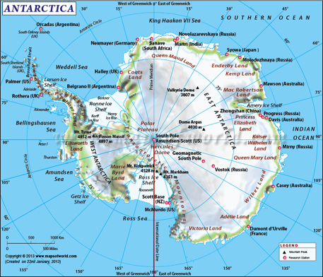
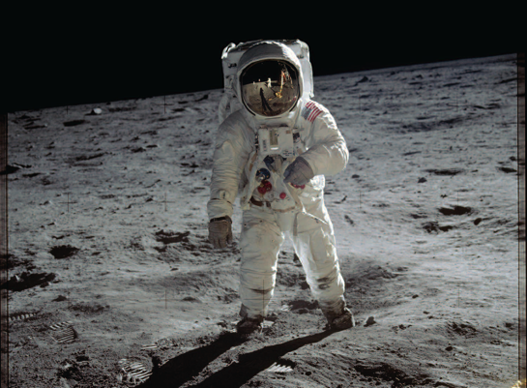
Borderless Regions
Notes:
International conventions and treaties also provide for the exploration and use of territory for the benefit of all. The Antarctic Treaty of 1959 provides that Antarctica “shall be used for peaceful purposes only” (Art. 1) and, to that end, the treaty prohibits military installations, maneuvers, and weapons tests, including the testing of nuclear devices and explosions of all kinds. Provisions of the treaty also provide for the free exchange of scientific information and personnel.
Another area where there is agreement on the free access and use is Space. There is even a treaty addressing access to space and celestial bodies, restricting any country from claiming territorial jurisdiction over any area or celestial body.

Slide 54
Resolving Disputes
Historically, countries have come to blows over border and boundary disputes.
It is only the recent past that has seen a move to negotiation and arbitration to resolve such disputes.
The International Tribunal for the Law of the Sea resolves disputes over access to mineral resources on the seabed in regions not reserved to any state or territory.
For disputes over the delimitation of boundaries along continental shelf between States with opposite or adjacent coasts are resolved first in the International Court of Justice (provided the states in dispute recognize the Court’s authority), or through negotiation, or through application to the U.N. for an arbitral or special tribunal to determine an equitable outcome.
Notes:
There are numerous avenues available to states that have experienced boundary or border violations. The method of remedy is dependent upon the treaties the state is party to, the nature of the violation, and the severity with which the encroachment is seen.
The United States went to war with Mexico in 1846 over a variety of issues, including disputes over where the border was between Mexico and the recently acquired State of Texas. Mexico was soundly defeated during the two-year war and as a result was forced to enter into negotiations with representatives of the U.S. The result was the Treaty of Guadalupe Hidalgo in 1948 in which Mexico ceded California, Nevada, Utah, Arizona, most of New Mexico and Colorado, and formerly claimed lands north of the Rio Grande River.
The dispute over who possessed a particular territory that ended in a military conflict is the Falklands War of 1982. The conflict was the result of a protracted historical confrontation regarding the sovereignty of the islands. The long-standing dispute resulted in the Argentinean invasion and occupation of the Islands on 2 April 1982. In response, the British government dispatched a naval task force to engage the Argentinean Navy and Air Force and retake the islands by amphibious assault.

Slide 55
Disputes over borders and boundaries can be resolved through a variety of methods, from courts, to tribunals, to the employment of outright force.
Another method of resolving continued border violations is for a state to erect barriers.
Notes:
Historically, countries have come to blows over border and boundary disputes.
It is only the recent past that has seen a move to negotiation and arbitration to resolve such disputes.
Other disputes may go to national or international courts for resolution.
For example, the International Tribunal for the Law of the Sea resolves disputes over access to mineral resources on the seabed in regions not reserved to any state or territory.
For disputes over the delimitation of boundaries along continental shelf betweens States with opposite or adjacent coasts are resolved first in the International Court of Justice (provided the states in dispute recognize the Court’s authority), or through negotiation, or through application to the U.N. for an arbitral or special tribunal to determine an equitable outcome.

Slide 56
Barriers
Barriers are material objects that block or are intended to block passage.
Although natural formations make the best barriers, in the modern era most country borders are artificial delimits drawn by politicians on maps.
This has resulted in the need, in some instances, to erect physical barriers to prevent, or limit, unwanted incursions across borders.

Slide 57
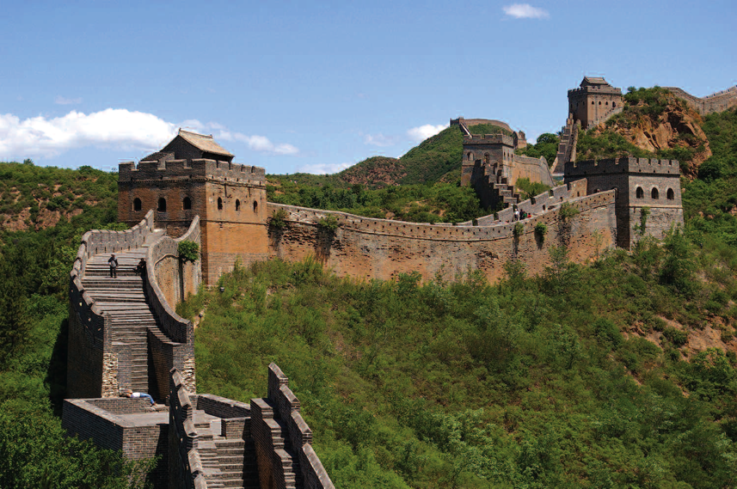
Notes:
Perhaps the most iconic man-made physical barrier is the Great Wall of China, a series of fortifications running generally east to west through the entire northern part of China.
The wall, made of stone, brick, tamped earth, wood and other materials, was erected to protect the Chinese Empire and its associated states from intrusions and military incursions by various nomadic peoples in Mongolia and Siberia.
The original wall has long since deteriorated and has been rebuilt and reinforced many times throughout history.
One of the functions of the Great Wall was border control, such as checkpoints and customs collection centers. The Great Wall also allowed China to control emigration from the north.
It is 5,500.3 miles (8,851.8 km) long, with actual wall sections comprising 3,889.5 miles (6,259.6 km) of that total length, the remainder consisting of trenches and natural defensive barriers such as hills and rivers.

Slide 58
What are some other Famous Walls?
Exercise your minds…….

Slide 59
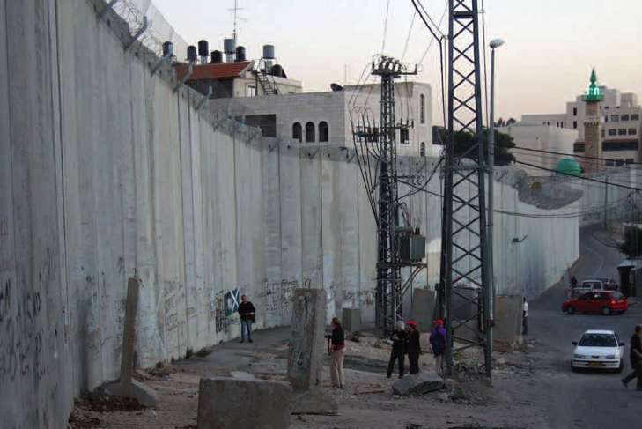
Notes:
The most contentious wall in recent history has been the wall being built by Israel to isolate Jewish settlements from encroachment by the native Palestinians living in the West Bank. Israel has been building communities throughout the land seized in a previous conflict under a variety of initiatives, with frequent starts and stops as part of the ongoing and often stalled peace process with the peoples of the occupied territories. The Israelis refer to the wall as the “separation” or “security fence.” Opponents to the structure refer to it as the “Apartheid Wall.” Regardless of the name, the function is clear—to prevent terrorist attacks, particularly suicide bombers and snipers, from launching attacks against the Jewish population.

Slide 60
Modern manufactured barriers work on a small, or local scale, but tend to be inefficient or cost-prohibitive on a large scale.
The border between the U.S. and Canada is almost entirely devoid of barriers to movement.
The border between the U.S. and Mexico has several natural barriers to movement including the aforementioned Rio Grande River and the extensive deserts. These have been insufficient in stopping the movement of contraband and people into the U.S. from Mexico.
As a result, significant efforts are being expended developing and constructing barriers of various types to control illegal crossings.

Slide 61
Executive Order 13767
January 25, 2017
Border Security and Immigration Enforcement Improvements
”The Wall”
Why has Congress failed to fund this Presidential initiative?
Notes:
The content of this EO is incorporated at the end of the Chapter.
Be prepared to discuss the policies stated in the EO as they relate to the enforcement of EXISTING LAW. All this EO did was establish Presidential Policy that says the existing laws will be enforced at the borders and concerning all persons emigrating to the U.S. legally and those crossing internationally recognized U.S. borders illegally.

Slide 62
Conclusion
Any barrier constructed to restrict illegal movement, also hinders legal crossings and restricts the free flow of commerce. This is the conundrum facing engineers and politicians alike —how to build barriers to keep out those not wanted, while allowing the maximum possible legal movement of people and commodities. This is the fundamental quandary facing all nations throughout history.

Slide 63
Questions for further consideration
1. When thinking of geologic and geographic barriers, such as oceans, rivers, mountains, and deserts, which is the most effective barrier to human movement?
2. With the construction of the “Chunnel” under the English Channel, the Island and European continent were connected. Would a similar system of roads and tunnels be an effective way to connect China and India? Why or why not?
3. Globalization is a term widely used. Is there a solution to the problem globalization presents to national sovereignty?

Slide 64
To request the full slide deck, please email proof of adoption to Beth Hall at
bhall@cap-press.com

