Slide 1
What makes crime newsworthy?
1) the nature of the offense (violent)
2) demographic factors of the victim and offender (white and vulnerable victims)
3) the uniqueness of the event (strange, bizarre)
4) event salience (local relevance v national relevance)

Slide 2
Crime in the news creates misconceptions
1) Criminals are different than “noncriminals”
2) Most crime is violent in nature

Slide 3
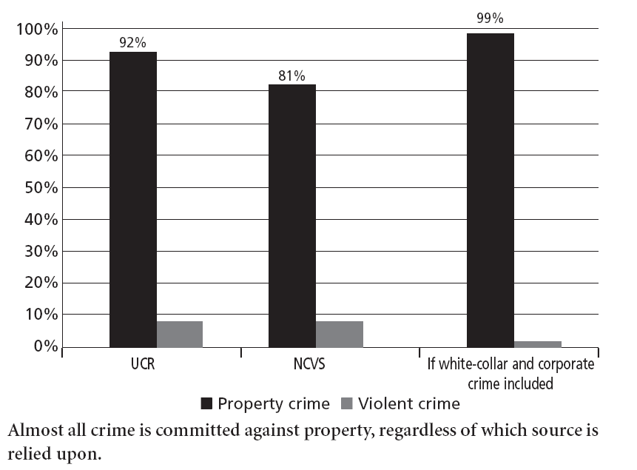

Slide 4
Crime in the news creates misconceptions
3) Greatest threat to us comes from the poor

Slide 5
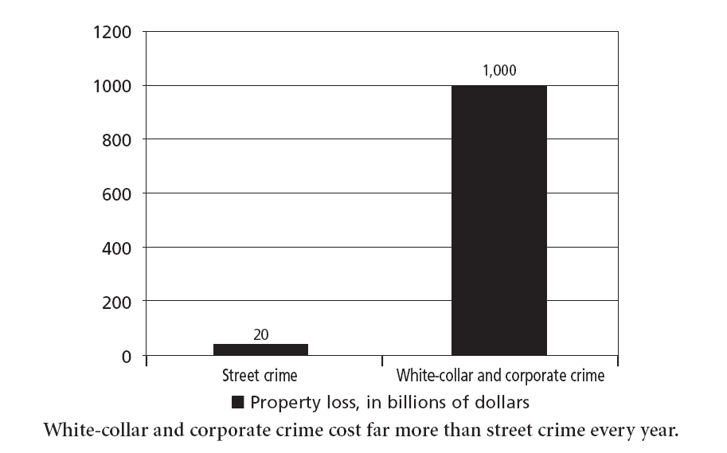

Slide 6
“Serious” street crime generates more coverage
Murder
Robbery
Rape
Aggravated assault
Theft
Car theft
Burglary
Arson
(also drug offenses, terrorism in the news)

Slide 7
Consider homicide
Makes up less than 1% of all crimes in a year
Makes up between 5% and 25% of the news, depending on whether national or local.

Slide 8
Consider homicide
Homicide news focuses on least common types of victims (e.g., female or young victims, multiple victim incidents)
Law of opposites (see pp. 90-91)

Slide 9
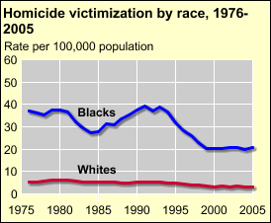
http://bjs.ojp.usdoj.gov/content/homicide/tables/vracetab.cfm
http://www.census.gov/compendia/statab/2011/tables/11s0307.pdf

Slide 10
Random crime
Random crimes are generally more popular in news than crimes committed by people you know
e.g., serial killers (see pp. 92-93)

