Slide 1
Recall the conservative ideology
Liberty over equality
(limited government interference in state and free market issues)
Equality through free market
(free market will take care of all and assure reasonable equality)
Government intervention justified in personal, moral matters
(e.g., abortion, drug use, prostitution)

Slide 2
Recall the conservative ideology
Big government necessary for safety
(e.g., military, crime control agencies)
Disdain for welfare
(seen as a single program for the poor rather than numerous services, infrastructure, regulations, etc.)
Individualistic view on crime (i.e., free will/rational choice; cultural deviance theories)

Slide 3
How ideology impacts criminal justice
1) Define crime and “serious crime”
(it is powerful politicians who decide what is criminal and what is not)
This determines where the spotlight is shined
(on the acts of the powerless)
Powerful people also own the media! (large corporations … see: http://www.freepress.net/ownership/chart)

Slide 4
How ideology impacts criminal justice
2) Create criminal justice policies
(how we deal with crime, as well as how we don’t!)
Policies include more crimes, police, prisons, death penalty
(and tougher, longer sentences)
Wars on crime, drugs, terrorism
war defined: http://www.merriam-webster.com/dictionary/war)

Slide 5
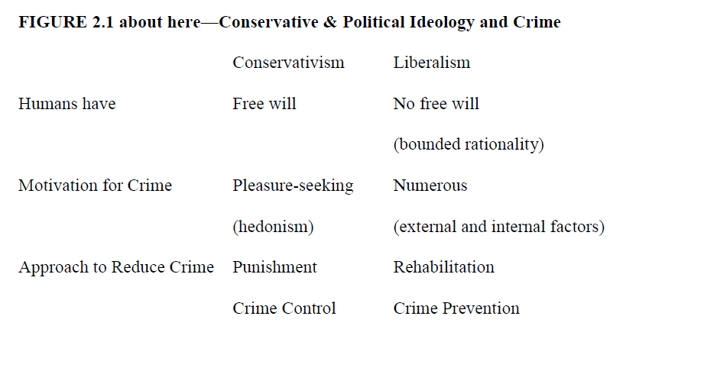
Conservative ideology of criminal justice

Slide 6
How did this happen (and who did it?)
Conservative politicians at state and federal level
(1960s—1970s—1980s—and since)
Pushed for punitive laws and policies
(perceived as supported by public, deleterious outcomes suffered by powerless)
Civil rights versus crime control
(battle between progressives and conservatives)

Slide 7
How did this happen (and who did it?)
1964: Barry Goldwater (R) v. Lyndon Johnson (D)
Great Society v. Crime Control
(government assistance encourages crime)
Goldwater’s 1964 acceptance speech
(See: https://www.youtube.com/watch?v=eKeDW_Ib9I8
http://www.nationalcenter.org/Goldwater.html)

Slide 8
How did this happen (and who did it?)
1964 race
(see: http://en.wikipedia.org/wiki/United_States_presidential_election,_1964)
Johnson’s record:
Commission on Law Enforcement and Administration of Justice(1965-1967)
Omnibus Crime Control and Safe Streets Act(1968)

Slide 9
How did this happen (and who did it?)
1968: Richard Nixon (R) v. Hubert Humphrey (D)
(see: http://en.wikipedia.org/wiki/United_States_presidential_election,_1968)
Nixon’s record:
Nominated Warren Burger, William Rehnquist, Lewis Powell and Harry Blackmun to US Supreme Court(1969–1971)
Rejection of civil liberties advancements of Warren Court (Earl Warren retired in 1968)

Slide 10
The full set of 248 PowerPoint slides is available upon adoption. If you are a professor using this book for a class, please contact Beth Hall at bhall@cap-press.com to request your slides.

