Slide 1
What makes crime newsworthy?
1) the nature of the offense (violent)
2) demographic factors of the victim and offender (white and vulnerable victims)
3) the uniqueness of the event (strange, bizarre)
4) event salience (local relevance v national relevance)

Slide 2
Crime in the news creates misconceptions
1) Criminals are different than “noncriminals”
2) Most crime is violent in nature

Slide 3
Almost all crime is committed against property, regardless of the source relied upon

Slide 4
Crime in the news creates misconceptions
3) Greatest threat to us comes from the poor

Slide 5
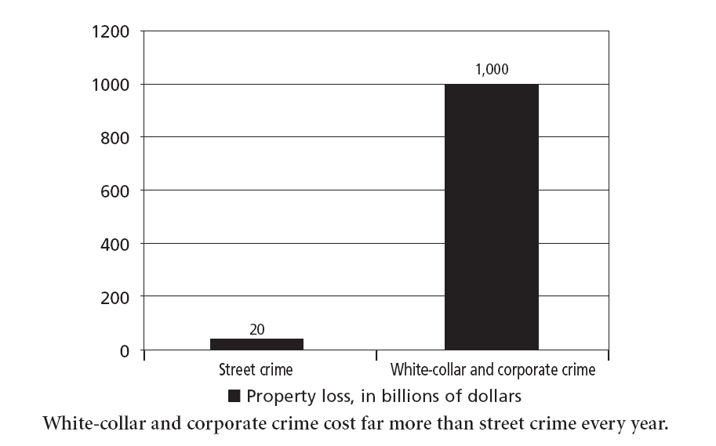

Slide 6
“Serious” street crime generates more coverage
Murder
Robbery
Rape
Aggravated assault
Theft
Car theft
Burglary
Arson
(also drug offenses, terrorism in the news)

Slide 7
Consider homicide
Makes up less than 1% of all crimes in a year
Makes up between 5% and 25% of the news, depending on whether national or local.

Slide 8
Consider homicide
Homicide news focuses on least common types of victims (e.g., female or young victims, multiple victim incidents)
Law of opposites (see pp. 99-100)

Slide 9
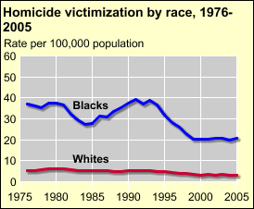
http://bjs.ojp.usdoj.gov/content/homicide/tables/vracetab.cfm
http://www.census.gov/compendia/statab/2011/tables/11s0307.pdf

Slide 10
The full set of 177 slides is available upon adoption. If you are a professor using this book for a course, please contact Beth at bhall@cap-press.com to request your slides.

