Slide 1
A. The Purposes of Criminal Law
Copyright © 2023 Carolina Academic Press, LLC. All rights reserved.
Copyright © 2023 Carolina Academic Press, LLC. All rights reserved.

Slide 2
Regina v. Dudley and Stephens
Can Dudley and Stephens defend the murder charge on the ground of necessity, i.e., that the killing of Richard Parker was necessary to save the three other sailors?
Copyright © 2023 Carolina Academic Press, LLC. All rights reserved.

Slide 3
Regina v. Dudley and Stephens
The Lords rule against the defense
Immoral to kill an innocent person; absence of precedent for such a rule; difficulty of developing standards and risk of false claims
No necessity in this case
If any unfairness in this case, up to the Sovereign (Queen Victoria) to exercise mercy
Copyright © 2023 Carolina Academic Press, LLC. All rights reserved.

Slide 4
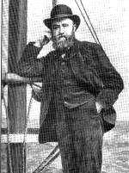
Background: Captain Dudley
Copyright © 2023 Carolina Academic Press, LLC. All rights reserved.

Slide 5
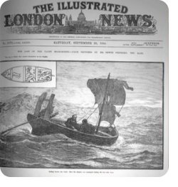
The case in the news
Copyright © 2023 Carolina Academic Press, LLC. All rights reserved.

Slide 6
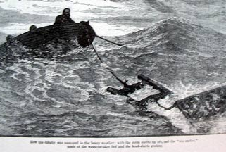
"We need not trouble you, Mr. Attorney-General to reply, as we are all of the opinion that the prisoners must be convicted."
Copyright © 2023 Carolina Academic Press, LLC. All rights reserved.

Slide 7
Richard Parker – The Life of Pi
Copyright © 2023 Carolina Academic Press, LLC. All rights reserved.

Slide 8
Regina v. Dudley and Stephens
Legal Standard
As Applied
Copyright © 2023 Carolina Academic Press, LLC. All rights reserved.

Slide 9
Dobbs v. Jackson Women’s Health Organization
Given the precedent set by Roe v Wade and Planned Parenthood of Southeastern Pa. v. Casey, is a Mississippi statute that generally prohibits an abortion after the 15th week of pregnancy constitutional?
Copyright © 2023 Carolina Academic Press, LLC. All rights reserved.

Slide 10
Dobbs v. Jackson Women’s Health Organization
Does Stare Decisis require the Court to follow the decision in Roe?
Does the statute violate substantive due process by limiting the exercise of a fundamental right?
Copyright © 2023 Carolina Academic Press, LLC. All rights reserved.

Slide 11
The full set of 552 PowerPoint slides is available upon adoption. If you are a professor using this book for a class, please contact Rachael Meier at remeier@cap-press.com to request your slides.
Copyright © 2023 Carolina Academic Press, LLC. All rights reserved.

