Slide 1
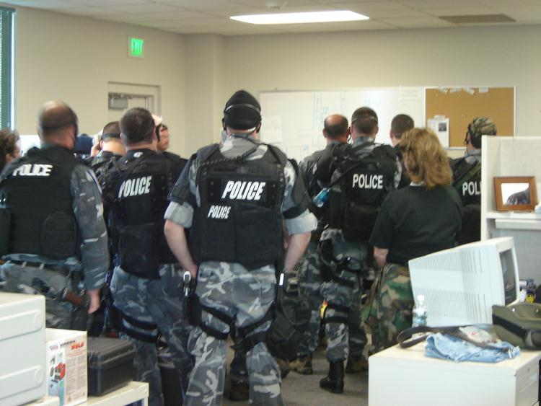
Incident Management System
IMS is a management system that applies common business practices to incident response
Planning
Directing
Organizing
Coordinating
Communicating
Delegating
Evaluating
Photo by Dr. John Wipfler
Notes:
Officers are briefed prior to a tactical deployment.
IMS uses common business practices (law enforcement does this routinely with SOPs, general orders, procedural orders)
IMS uses management by objectives (this is instinctive to law enforcement; police know that object is to protect life and property and, in many instances, legal constraints decide what actions can be taken)
IMS uses an incident action plan to establish the objectives (in sustained events, law enforcement does this but does not usually follow the IMS criteria)
IMS uses delegation of authority and power (already understood in law enforcement operations as they are paramilitary operations, it allows the first on scene to act as the Incident Manager until ranking officers arrive)
Discussion Question: Will IMS cause officers to more efficiently perform these tasks?

Slide 2
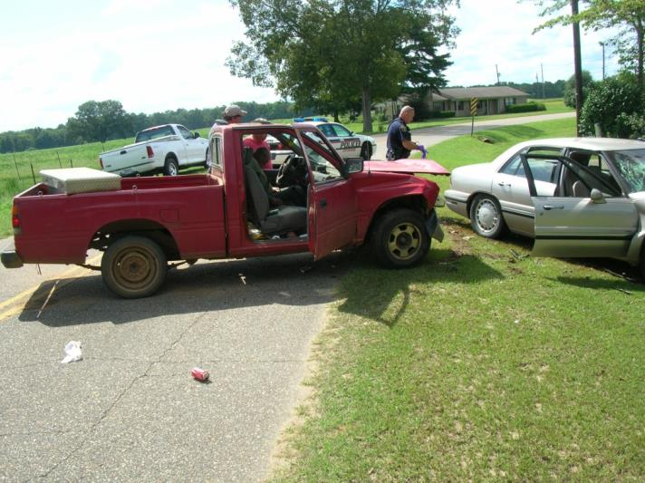
Effective Incident Management
Requires:
Establishing objectives
Setting priorities
Assigning resources
Coordination of
several agencies with
differing missions
Notes:
MVC with two persons injured critically, fire, police, and EMS are on scene.
Incidents require efforts to protect life, protect property, protect the environment, and allow recovery
This requires one to establishing objectives, determine priorities, and use resources efficiently with rescue of the victims, control of traffic, investigation of the crash, gathering evidence, and removal of the vehicles
Coordination between police, fire, EMS, and a wrecker company are required
Police serve as the incident commander using a unified command with fire and EMS
Discussion Question: Where can conflict arise with the differing missions?

Slide 3
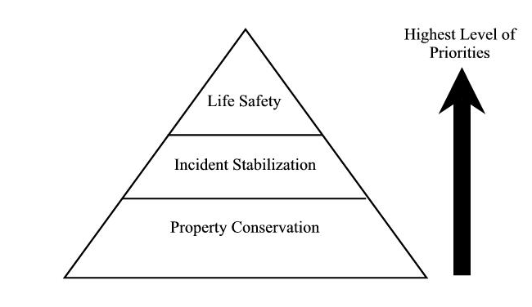
Factors Affecting Emergency Response Management
Basic Incident Priorities
Notes:
Discussion Question: Explain how incident priorities will change during an event; cite examples.
Explain why life safety is the priority
Remember resources may be limited
Remember one may have to use whatever is at hand to contain or isolate the event
Remember property conservation and protection of the environment while lesser priorities are important

Slide 4
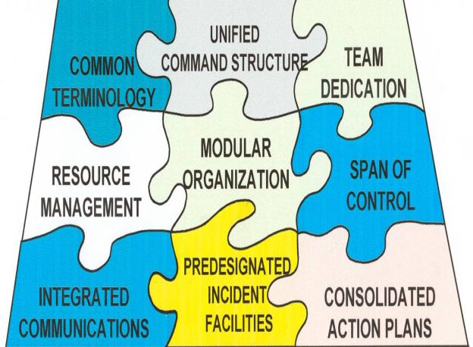
History of ICS/IMS
Recurring problem areas:
Terminology
Organizational structure
Communications
Span of control
Incident facilities
Resource management
Notes:
ICS, now IMS , was adopted by the fire service as part of the management of wildfires.
ICS addressed recurring problems in the fire service setting (these are not issues within the law enforcement community as responses include a very large scope of functions and type incidents)
Terminology issues (not an issue with LE if agencies using same codes and signals not plain language, remember plain language will use three to six times more airtime than codes/signals)
Lack of ability to expand and contract command (law enforcement does this routinely at events without using IMS)
Nonstandard and nonintegrated communications
Lack of Incident Action Plan (Law enforcement has an IAP but calls it something else in most cases)
Span of control issues (the fire service wants narrow spans of control with no more than five to seven personnel with one supervisor, law enforcement is autonomous in most cases and spans of control of 30 are not uncommon
Failure to manage resources (law enforcement with communications assistance routinely handles large numbers of officers at an event)
IMS is touted as an “all risk” management system, however, remember many of the inflexible parts of IMS do not fit well with law enforcement operations, use IMS as a guide not a rule book
Discussion Question: Why should IMS be a guide rather than a rule?

Slide 5
Laws and Policies Pertaining to IMS
Home Land Security Presidential Directive 5 - NIMS
Department of Homeland Security—National Response Plan
OSHA 29 CFR 1910.120
EPA 40 CFR 311
NFPA 1561
NFPA 1500
NFPA 1521
Notes:
President Bush issued HSPD 5 requiring federal and other levels of government response agencies to use IMS as part of the National Incident Management System (NIMS) in support of the new National Response Plan (NRP).
The legal basis for IMS for use in hazmat situations include the SARA (Superfund Amendments and Reauthorization act 1986), OSHA mandates its use via 1910.120 when hazardous materials are involved. States not using OSHA are mandated by EPA to use IMS at hazmat events.
SARA, the Superfund Amendments and Reauthorization ACT of 1986, established Federal regulations for handling hazardous materials. SARA directed the Occupational Safety and Health Administration (OSHA) to establish rules for operations at hazardous materials incidents.

Slide 6
Components of a Good Emergency Response Management System
Notes:
IMS Parts
Common terminology and plain language (consumes valuable radio airtime)
Modular organization (fits the fire service but can be used with law enforcement with modifications, discard the unneeded portions)
Integrated communications (allows communication with outside agencies and liaison)
A unified command structure (works well in routine disasters but not well in swarm attacks, active shooters, or events such a 9/11 where independent action is needed)
Consolidated action plans (work well in routine disasters but not well in swarm attacks, active shooters, or events such as 9/11 where independent actions is needed)
A manageable span of control (span of control is not an issue in most law enforcement operations because of the semi-autonomous nature of law enforcement)
Resource management (avoids duplication of requests)
Discussion Question: Why is IMS not useful in swarm attacks?

Slide 7
Common Terminology and Plain Language Radio Traffic
Common terminology and is important and required in multi agency events when common signals or codes are not used
Most units have standard names
Incidents have names, usually the locale
Common names are used for people, equipment, and places
Plain language is used during radio transmissions but consumes valuable airtime
Notes:
Using common naming criteria is important such that responders understand terms such as outer perimeter, inner perimeter, arterial route, and staging area. The fire service calls some of these by different names (hot zone, warm zone, cold zone). Law enforcement tends to use directional information for structures, highways, incidents, etc., while the fire service in some instances uses codes such as Alpha, Bravo, Charlie, Delta, for building exposures.
Discussion Question: Name other issues with terminology that might be a problem.

Slide 8
Modular Organization
Organizational structure…
Develops top down, from first-in unit
Is based on incident’s management needs
Is always staffed with a designated IC; other functions staffed as needed
Frist Unit on scene
Number of personnel involved
Small
Incident
Large Incident
Notes:
IMS uses an expandable structure which allows expansion and contraction. It starts with the command function and adds the command staff, general staff, and sections such as operations. Most events do not require the establishment of command as in law enforcement such is understood. The first officer on the scene is the incident manager until replaced by a ranking officer.
Discussion Question: What type events would need a formal IMS structure established?

Slide 9
The full set of 150 slides is available upon adoption. If you are a professor using this book for a class, please contact beth hall at bhall@cap-press.com to request your slides

