Slide 1
Copyright
Exclusive rights in original expression

Slide 2
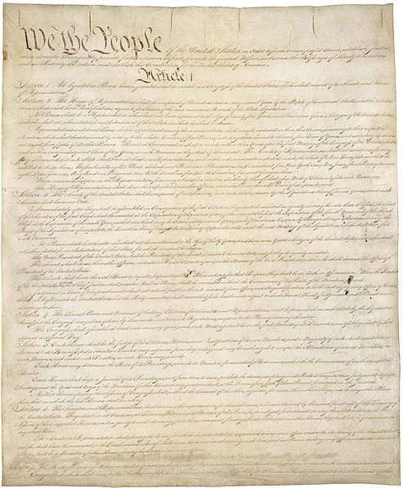
The Congress shall have Power . . .
To promote the Progress of
Science and useful Arts,
by securing for limited Times
to Authors and Inventors
the exclusive Right to their respective
Writings and Discoveries;

Slide 3
The Congress shall have Power . . .
To promote the Progress of
Science and useful Arts,
by securing for limited Times
to Authors and Inventors
the exclusive Right to their respective
Writings and Discoveries;

Slide 4
The Purpose of Copyright
incentivize original expression and its dissemination;
increase knowledge and learning.
The Cost of Copyright
- restrains speech and knowledge

Slide 5
Coverage Overview
1. Requirements for copyright (originality & fixation).
2. Subject matter of copyrightable works
(what can and cannot be copyrighted).
3. Ownership (sole and joint authorship; work made for hire;
licenses).
4. Exclusive Rights (the rights of a copyright owner).
5. Infringement (direct and indirect).
6. Defenses (fair use) and Remedies.

Slide 6
The full set of 669 PowerPoint slides is available upon adoption. If you are a professor using this book for a class, please contact Rachael Meier at remeier@cap-press.com to request your slides.

