Slide 1
Arbitration Law, Policy, and Practice, 2nd Ed.
Weston, Blankley, Gross & Huber
(Carolina Academic Press 2024)

Slide 2

Welcome to Arbitration!
Introductions & Goals
Experience with Arbitration?
ADR?

Slide 3
Chapter 1 ▪ The Nature and Scope of Arbitration
A. Introduction and Overview
B. Historical Background
C. U.S. Commercial Arbitration Law and Practice
D. What Is and Is Not Arbitration?
E. Specialized Uses and Forms of Arbitration
F. A Roadmap for Studying Arbitration
* Describe how you are a party to an arbitration contract. If possible, bring a copy of the arbitration provision
* Arbitration vs. Other Processes
* What, When, Where, Why and How Arbitration?

Slide 4

A. Intro & Overview
Thoughts on arbitration so far?
What is Arbitration?

Slide 5
Experience with Arbitration?
How many of you have arbitrated?
As a party or neutral?
Are you a party to an arbitration contract?

Slide 6
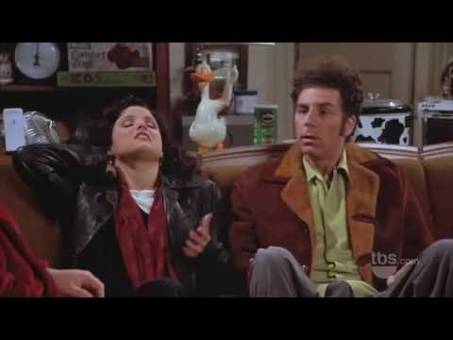
What Is Arbitration??
Is this Arbitration?
https://www.youtube.com/watch?v=wsbgwNe4Rv4

Slide 7
Quick Exercise:
Issue: Lap Top [or AI] Ban Adjudication
Groups of 3
Scene 1 - (3 minutes each)
1 & 2 - Make your case to 3
#3 Decide (but keep secret)
Scene 2 . . .
Student | Position
1 | Yes
2 | No
3 | Neutral

Slide 8
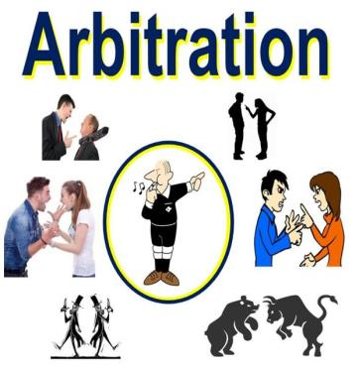

How do we arbitrate?
Informal
Formal

Slide 9
5Ws +H of Arbitration
What is arbitration?
Why arbitrate?
Who arbitrates:
When does arbitration occur?
What are the major norms (laws, rules, standards) that come into play in arbitration?
How does arbitration work?

Slide 10
Basic Concept & Definition
A Dispute Resolution Process
Creature of contract;
Parties agree to submit an existing or future dispute to the final and binding decision of a third party.
* parties may agree as to the identity and selection of the arbitrator;
* opportunity to be heard
* Hearing
* Final Decision
4. Arbitrator has only powers given by the parties under the K
Notes:
A DR process of dispute resolution in which a third party neutral (arbitrator) renders a decision after a hearing at which both parties have an opportunity to be heard.
Substantive Arbitrability e.g, the arbitrator’s SMJ. The parties’ agreement defines the substantive matters they have agreed to submit to arbitration.
b. Procedural Arbitrability  the procedural obligations parties must meet to perfect the arbitrator’s jurisdiction.

Slide 11
Arbitration Characteristics?
(1) consent to have their dispute settled;
(2) by a third party decision-maker, and
(3) the award is final and binding.
The central element of arbitration is the parties intention or agreement to arbitrate

Slide 12
How Does Arbitration Compare to Other Dispute Resolution Processes?
 | Negotiation | Mediation | Arbitration | Litigation
Decision-maker
cost?
Information?
Tone?
standards?
binding?
appeal?
publicity?

Slide 13
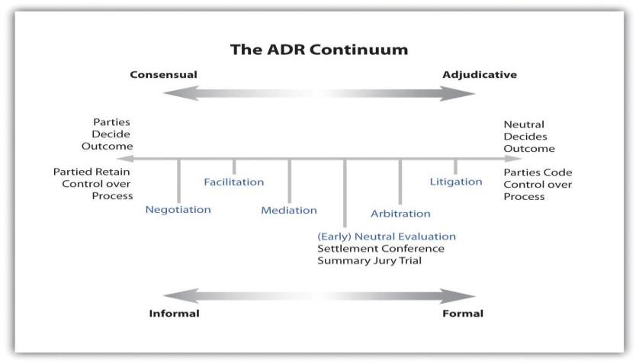
Dispute Resolution Processes

Slide 14
Compare & Contrast
Arbitration
Litigation
Notes:
How does Arbitration differ from adjudication?
Freedom to select the tribunal
Freedom to select applicable law

Slide 15
Compare & Contrast
Arbitration
Litigation
Relative Speed & Economy
Privacy
Avoid Precedent
Select Decision Maker(s)
Industry Expertise
Informal, Process Flexibility
Select Choice Law, Situs
Final & Binding
Certainty
Business relationships
Fairness concerns?
1-3 years
Public Record
Precedent
Randomly Assigned Judge
Formality, Procedures, Rules of Evidence
Rights to Appeal
Judicial Review

Slide 16
Why arbitrate?

Slide 17
Benefits & Drawbacks of Arbitration?
Should parties be able to select a private individual to decide a legal dispute?
Other concerns?
Is it fair?

Slide 18
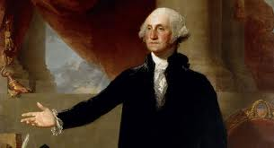
B. Historical Use & Judicial Treatment of Arbitration
Tobey v. County of Bristol (D. Mass 1845)
  How was arbitration used historically?
  Were arbitration agreements enforceable?
  Arbitration awards?
  What is the ‘ouster’ doctrine?
  Judicial skepticism; hostility?

Slide 19

Kulunkundis Shipping v. Amtorg Trading (2nd Cir. 1942)
Claim: B/K to charter ship
Defense: No K but must arbitrate
Alleged K contained arb clause
Arbitration Historical Roots
English Merchants; US Revolution & Trade
Initial Judicial Hostility, Wilko v. Swan (US 1953) (federal securities claims)
FAA 1925 …. 1980’s + Modern Infatuation?
Who decides if parties agreed to arbitrate?

Slide 20
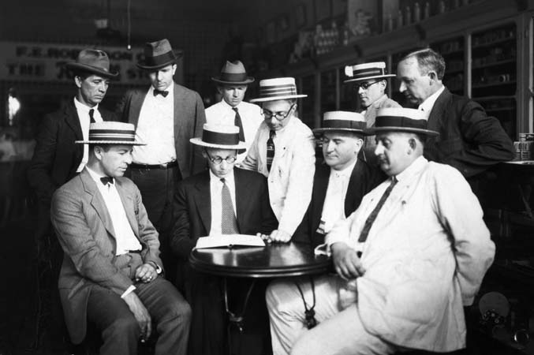
Historical Shifts- Legislative & Judicial Support
1925: Congress enacts the Federal Arbitration Act (FAA), 9 USC §§ 1-16
Why?
What is the FAA?
What does the FAA do?
Notes:
Historically, courts were skeptical, even ‘hostile’ to arbitration and the notion that parties could ‘oust’ a court of jurisdiction. So while back in the 1920’s, when merchants in industry had contracted among themselves to resolve commercial disputes by arbitration, they were not assured that a court would enforce such a deal until Congress passed the FAA.
Enacted in 1925 at the urging of the business-to-business community and long before we had civil rights and many other statutory laws. The FAA is a relatively siple procedural statute that provides for the enforcement of agreements to arbitration. Congress passed the Act pursuant to its Constitutional Commerce Clause powers, thus the FAA applies to agreements involving interstate commerce, broadly interpreted – nearly every transaction. The principal provision is Sec. 2 and its mandate to enforce agreements to arbitrate, subject to the “savings clause,” interpreted as state law contract defenses, such as fraud, duress, and unconscionability. The Supreme Court has interpreted section 2 as permitting states to apply general contract law defenses to invalidate arbitration clauses. Allied Bruce

Slide 21
The Federal Arbitration Act, 9 USC §§ 1-16.
Chapter One
Sec. 1: FAA applies to interstate commerce … but not to employment contracts for certain categories….
Sec. 2: Written Ks to arbitrate are
… valid and enforceable
… except on “such grounds as exist at law or in equity for the revocation of any contract.”
Notes:
Circuit City v Adams (2001) (exemption applies only to transportation Ks); Oliviera v. New Prime (2017), cert. granted on transporation exemption applied to independent contractor in transportation industry

Slide 22
FAA: regulates interface between private arbitration and the courts
§ 3 Court, upon finding valid arbitration agreement shall stay [court proceedings]
§ 4 Federal Court may compel arbitration
§ 5 Federal court may appoint arbitrator if parties fail to agree
§ 7 Arbitrator Power to issue “summons (subpoenas) for witnesses to appear before them…”
§ 9 Court may enter arbitration award as a judgment
§ 10 Grounds for vacatur of arbitration awards

Slide 23
FAA
Chapter 2
  § § 201-208 Convention on Recognition & Enforcement of Foreign Awards (New York Convention)
Chapter 3
  §301-307 Inter-American Convention on International Commercial Arbitration (Panama Convention)
Chapter 4
  Ending Forced Arbitration of Sexual Assault and Sexual Harassment Act of 2021

Slide 24
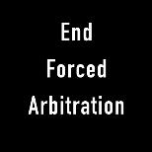
Ending Forced Arbitration of Sexual Assault and Sexual Harassment Act of 2021 , 9 U.S. Code § 402
* Amends the FAA to exclude any disputes that raise claims of sexual harassment, misconduct in the workplace
* Restricts employers from forcing sexual harassment and sexual assault claims into arbitration, which often requires an employee to incur greater cost and keeps the information out of the public record.
* Gives individuals alleging sexual harassment or sexual assault the right to void pre-dispute joint-action waivers and proceed in the appropriate court or agency under federal, state or tribal law.
* Essentially severs these claims from other potential non-sexual harassment/ assault that may proceed in arbitration
* Right to file sex misconduct claims in court
    may increase litigation of these claims
May promote pre-filing mediation/settlement of these cases & use NDA
Act does not address NDAs
  but 16+ state laws ban forced NDAs of sexual misconduct claims in employment (California STAND)

Slide 25




Modern Arbitration in US & Global Economy
Business
Entertainment and sports industry contracts;
Civil/commercial;
Consumer;
Employment;
Labor;
Government, and
International commercial contexts.

Slide 26
Arbitration in U.S. Economy
Widespread Use
Features
Commercial (B2B)
Consumer (B2C)
Employment
Broad scope of “Arbitrable” claims
Matter of Contract
Faster/Cheaper/Flexible?
Private/Party Choice Arbitrator
No precedent/disclosure of wrongdoing
Limited Appeal
Notes:
What do we know about arbitration? How many of you are party to arbitration contract? Features of Process

Slide 27
Various Types of Arbitration
Contractual - Pre/Post-dispute);
Statutory - statute may require parties attempt non-binding arbitration
Court-Annexed - court may refer to non-binding arbitration
Specialized: e.g.,
  Construction/ Commercial
  Labor Arbitration under CBA
  Investor/Broker Disputes (FINRA)
  Pro Sport (MLB, NBA, NFL, MLS)
  International/Olympic Sport - Court of Arbitration for Sport (CAS);
  Entertainment – Guilds (Writer’s, Screen Actors, Directors)
  International Commercial
Notes:
E. Specialized Uses and Forms of Arbitration

Slide 28
Benefits of International Arbitration
Enforceability
Neutral forum
Party Choice in Procedural flexibility & design
Ability to Select Arbitrators
Notes:
-- by statute & multi-lateral treaty

Slide 29

You & Arbitration?
Notes:
Be prepared to describe how you are a party to an arbitration contract. If possible, bring a copy of the arbitration provision.

Slide 30
With Pay Pals like this …
23. Arbitration. Any claim, dispute, or controversy. . . shall be FINALLY and EXCLUSIVELY resolved by binding individual arbitration . . . governed by Federal Arbitration Act (9 U.S.C. 1-16). . . .
NEITHER PARTY WILL HAVE THE RIGHT TO A JURY TRIAL OR TO ENGAGE IN DISCOVERY . .
All determinations . . . scope, interpretation, enforceability and validity shall be made exclusively by the arbitrator. . ..
NO CLASS ACTIONS

Slide 31
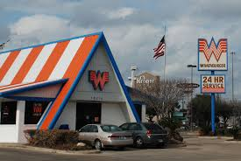
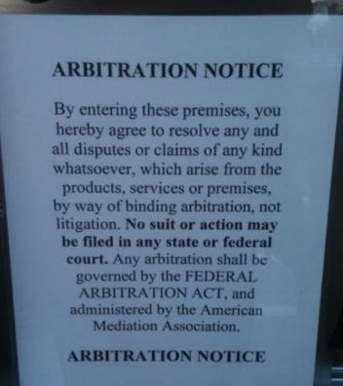
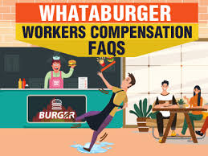
Whataburger?
Notes:
COMPANY OPTS-OUT OF STATE WORKER COMPENSATION SCHEME, IMPOSES ARBITRATION. EMPLOYEES INJURED AND OTHER CLAIMS GO TO ARBITRATION =

Slide 32



“NO CLASS ACTION, OR OTHER REPRESENTATIVE ACTION OR PRIVATE ATTORNEY GENERAL ACTION OR JOINDER OR CONSOLIDATION OF ANY CLAIM WITH A CLAIM OF ANOTHER PERSON OR CLASS OF CLAIMANTS SHALL BE ALLOWABLE.”
Notes:
https://cms.paypal.com/us/cgi-bin/?cmd=_render-content&content_ID=ua/upcoming_policies_full
PayPal cardholder agreement

Slide 33
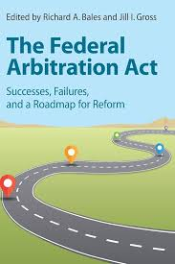
Policy & Fairness Questions?
Should the FAA be amended?
How?

Slide 34

Consumer Financial Protection Bureau
Arbitration Study: Report to Congress (2015)
  Few consumers file arbitration cases
  9 of 10 contracts contain class/representative waivers
2017: CFPB ban mandatory arbitration in consumer financial products. Business community opposed
Congress overturned the rule?
WHY?
Notes:
After 3 year study, CFPB issued a 728 page Report to Congress in March 2015 on use of arbitration in consumer financial products Ks
CFPB evaluated: (1) the prevalence and features of arbitration agreements; (2) consumer understanding of arbitration agreements; (3) how arbitration procedures differ from judicial procedures; (4) the types and resolutions of claims in arbitration; (5) the types and resolutions of claims in litigation; (6) suits brought in small claims courts; (7) the value of class action settlements; (8) the relationship between public enforcement and class actions; and (9) whether arbitration clauses lower prices for consumers. Ejudicate: https://www.consumerfinance.gov/about-us/newsroom/cfpb-takes-action-against-arbitration-platform-ejudicate-for-deceiving-student-borrowers/#:~:text=Enforcement%20Action,demonstrated%20inability%20to%20pay%20more.

Slide 35
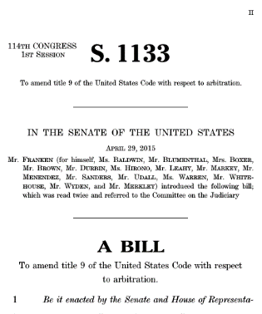
Arbitration Fairness Act Proposals (2015 -2023)
Proposes to invalidate pre-dispute agreements requiring arbitration of employment, consumer, antitrust, or civil rights disputes
n/a to B2B arbitration
Why doesn’t this pass?

Slide 36
Regulatory Framework for Arbitration
National & State Statutes
Institution Provider Rules
Arbitration Agreement
Case Law
Regulatory/Agency
Codes of Ethics & Professional Associations
Notes:
Codes of Ethics
ABA/AAA
JAMS
International bodies (IBA, CofC, UNCITRAL, and others)
Statutes & Statutorily-Imposed Rules
Uniform Arbitration Act
Revised Uniform Arbitration Act
California International & Domestic Arbitration Acts
“California Ethics Standards”
Case Law

Slide 37
D. What Is and Is Not Arbitration? Why does that Matter? The Outer Limits
Process Label
Advanced Bodycare Solutions v. Thione Intnl., (11th Cir. 2008)
Held: The DR clause requiring mediation did not qualify as arbitration because the clause was not “an agreement to settle by arbitration a controversy” and was thus not enforceable under the FAA
How a process is labeled is not always accurate or dispositive.

Slide 38
Four factor test – is DR procedure “classic arbitration”?
an independent adjudicator,
who applies substantive legal standards (i.e., the parties’ agreement and background contract law),
considers evidence and argument (however formally or informally) from each party, and
renders a decision that purports to resolve the rights and duties of the parties, typically by awarding damages or equitable relief.” Advanced Bodycare Solutions, 524 F.3d at 1239
Label Not Dispositive.

Slide 39

3. Is Non-Binding Arbitration “Arbitration”?
Wolsey v. Foodmaker (9th Cir 1998)
K for Development in Hong Kong
A contract may provide for arbitration that is
final and binding, in which case an award can be entered as a judgment of the court; or
non-binding, in which the parties are free to accept or reject the award.

Slide 40
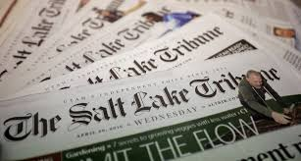
5. Appraisal, Valuation, and Similar Processes
Salt Lake Tribune Publishing v. MGT Planning (10th Cir. 2004)
Sale of media company, with option to repurchase after 5 years.
Option K - Process for determine price to exercise option?
> 3P Apprasier: (Seller: $380 Buyer: $220. MPI “3rd”: $331
SLTP objects --- Is this “appraisal” decision enforceable as “arbitration”?
Dueling Experts or Arbitration?

Slide 41
What is the difference between the two processes?
Arbitration and appraisal are distinct methods of dispute resolution. The FAA, however, only applies to “arbitration.”
Arbitrators decide disputes between the parties and determine liability, generally through the adversarial hearing process.
Appraisal agreements - typically ministerial determinations (e.g., the ascertainment of the quality or quantity of items, the ascertainment of loss or damage to property, or the ascertainment of the value of property”)). Here, no hearing or decision, only a report.

Slide 42
Ch 1 Review & Takeaways?
Basic Concept?
Historical basis?
Definition?
Uses?
How Arbitration Compares to Other Dispute Resolution Processes
Other?
Notes:
> Arbitration is a creature of contract; parties agree to submit an existing or future dispute to the final and binding decision of a third part
> parties agree as to the selection of the arbitrator
> Arbitrator has only powers given by the parties under the K
a. Substantive Arbitrability – i.e., the arbitrator’s SMJ.
The parties’ agreement defines the substantive matters they have agreed to submit to arbitration.
b. Procedural Arbitrability – the procedural obligations parties must meet to perfect the arbitrator’s jurisdiction.

Slide 43
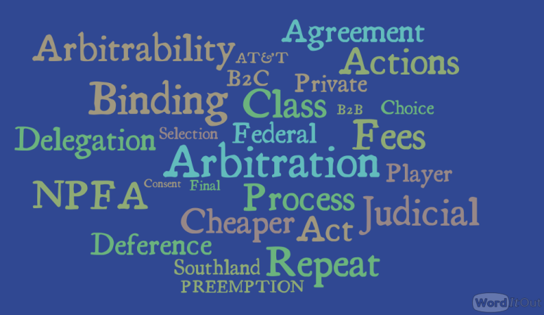
Arbitration Basics
Notes:
Arbitration is a Matter of Contract
Agreement by parties to settle dispute in private forum
Do inverted triangle Federal Level – FAA(NFPA, barebones statute); Sec. 2 enforce as written; savings clause; limited judicial review
Preemption – does it affect everyday practice”
State
Institutional Providers – rules; immunity

Slide 44
Course Overview & Roadmap
CH 1 – Nature of Arbitration
Ch 2 Laws Governing Arbitration
Ch 3 Allocation of Authority Between Courts & Arbitrators
Ch 4 Defenses to Arbitrability
Ch 5 The Arbitration Process
Ch 6 How to Get to Arbitration (the arbitration agreement)
Ch 7 Advocacy in Arbitration
Ch 8 Role of the Arbitrator & Ethical Issues
Ch 9 Judicial Enforcement and Review of Arbitration
Ch 10 Class Actions & Arbitration
Ch 11 Complex Arbitration Procedures
Ch 12 International Arbitration
Appendices: Arbitration Case File, Statutes

Slide 45
Questions??
Next Class: Chapter Two

Slide 46
To request the full slide deck, please email kerri.hughes@cap-press.com with proof of adoption. Thank you!

