Slide 1
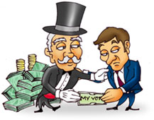
HOW POLITICS AND IDEOLOGY DISTORT AMERICA’S IDEALS OF JUSTICE
Matthew Robinson, Ph.D.
Appalachian State University

Slide 2
The argument
“Criminal justice system” ideally aimed at achieving crime control and due process, goals consistent with Declaration of Independence and US Constitution
Liberty
Equality
Justice
Life/happiness/domestic tranquility/common defense
General welfare

Slide 3
The argument
Progress toward these goals is distorted by the law-making process:
Who makes the law?
Who votes for the law?
Who pays for the law?
Law does not represent “us”
“Crime” and “serious crime” not in our collective interests (based on what is included and what is excluded)

Slide 4
The argument
In other words, the influence of politics and ideology distort America’s ideals
Politics: Winning and holding control of government; competing for power; deciding who gets economic benefits in society; what government does
Ideology: Beliefs and values about how things are, how they should be, and why; why government does what it does
American politics, driven by a particular ideology, interferes with liberty, equality, justice, etc.

Slide 5
How it works
1) Politicians define crime and serious crime
2) Politicians create criminal justice policies
Both determine what criminal justice agencies focus on (and what they ignore)
Both determine which values dominate and who gets economic benefits (and who does not)
So, on what do they focus (and what do they ignore) and who benefits (and who does not)?

Slide 6
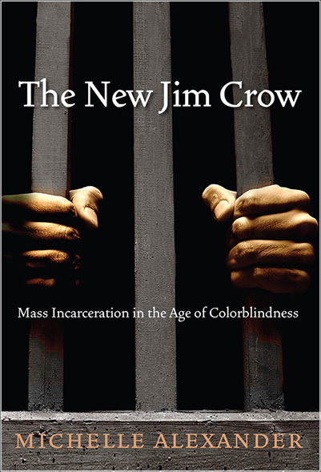
Michelle Alexander
Criminal justice system is really a:
Racial caste system
Aimed at keeping minorities in inferior positions
First slavery, then Jim Crow, and now mass imprisonment

Slide 7
Michelle Alexander
Can’t use race explicitly to discriminate
Have to use “race-neutral” terms
e.g., crime
“Law and order” movement really about controlling people of color (politics/ideology)

Slide 8
Race, Ethnicity, and Punishment
White Black Hispanic
US Population 72% 13% 16%
(2010)
Jail inmates 45% 38% 16%
(2011)
State prison inmates 31% 39% 23%
(2010)
Federal prison inmates 59% 38% 34%
(2011)
Sources: http://www.albany.edu/sourcebook/pdf/t6172011.pdf; http://www.albany.edu/sourcebook/pdf/t6332010.pdf; http://www.albany.edu/sourcebook/pdf/t600222011.pdf; http://www.census.gov/prod/cen2010/briefs/c2010br-02.pdf.

Slide 9
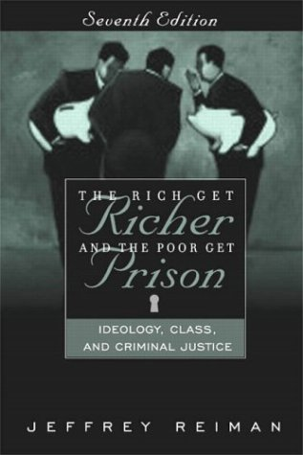
Jeffrey Reiman
Criminal justice operations are really aimed at:
FAILING to reduce crime and do justice …
Failure amounts to a success
Pyrrhic defeat theory—“the failure of the criminal justice system yields such benefits to those in positions of power that it amounts to a success.”

Slide 10
Jeffrey Reiman
Why?
Must fail so that people remain afraid of those below them (the poor)
Must fail so that people will not concern themselves with those above them (the wealthy)
This allows wealthy to get away with all kinds of harmful acts, and also controls the poor

Slide 11
The full set of PowerPoint slides is available upon adoption. Email bhall@cap-press.com for more information.

